Slide 1
THREE PHASE SYSTEM
Our main interest in naming electric systems or devices is in the power.
Energy transfer to the network from the source is called positive power, while energy movement to the source from the network is negative power.
Single - phase systems are quite satisfactory when the a.c is applied for heating. But for use in an a.c motor the single - phase system proves inadequate.

Slide 2
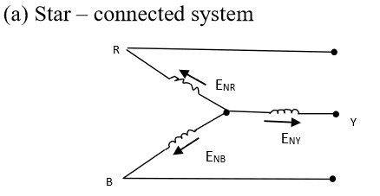
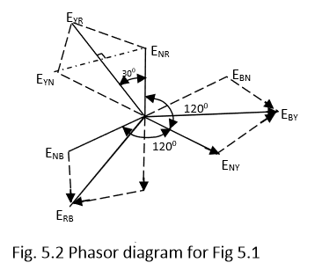
Relationship between line and phase voltage

Slide 3
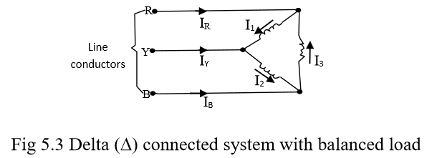
Using the subscripts L and P for line and phase quantities respectively, we can summarize as follows:
VL = √3Vp IL = IP
Delta connected system with a balanced load
Fig 5.3 Delta connected system with balanced load
From fig. 5.3,the voltage on the line and phase are equal. i.e
VL = Vp and IL = √3Ip

Slide 4
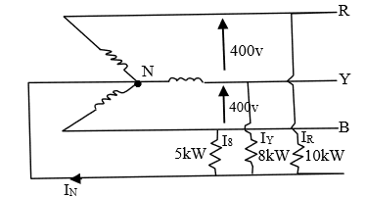
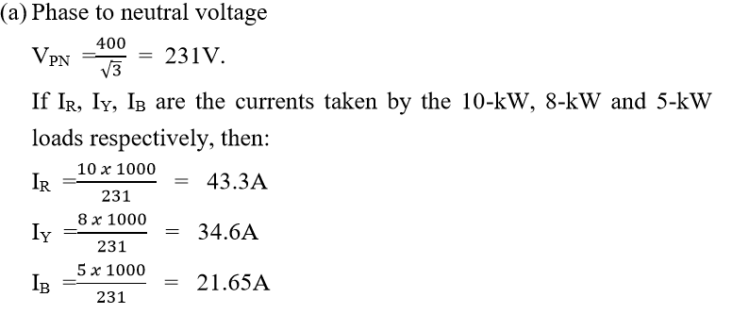
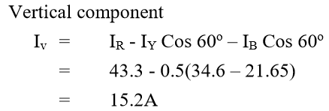
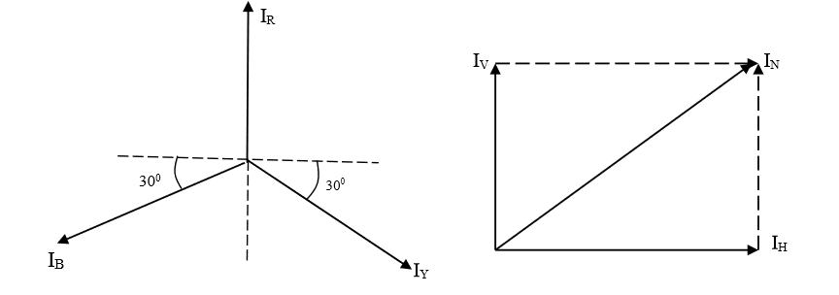
Example 5.1
A line voltage source of 400V and non-inductive loads of 10kW, 8kW and 5kW, all in a 3-phase 4-wire network, are linked to the respective conductors and neutral as depicted in fig. 5.5. Determine (a) the individual line currents, and (b) the neutral conductor current.
Solution
b.

Slide 5
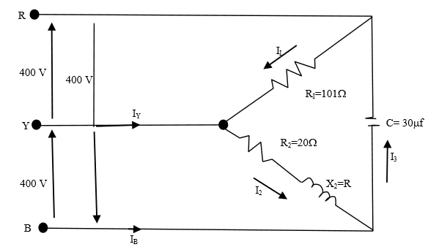
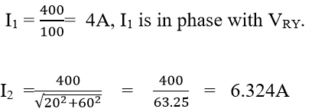
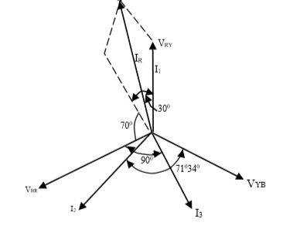
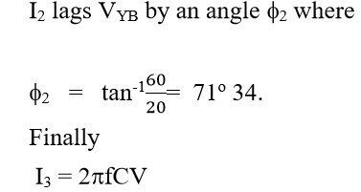
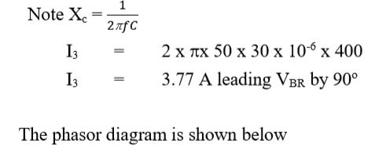
Soluton
IR = I1 – I3

Slide 7
Power with balanced 3-phase load
Let IP = rms value of the current in individual phases
and
Vp = rms value of the p.d. across each phase
Power per phase = IpVp x power factor.
And Total power= 3IpVp x power factor
Using the symbols VL and IL for the rms line voltage and current respectively, then for a star-connected system; Vp =𝑉𝐿/ √3 and Ip = IL
Substituting for Vp and Ip in equation , we have, PTotal =√3 VL IL x pf watts
For a Δ-connected system Vp = VL and Ip = 𝐼𝐿 / √3
And substituting in equation , PTotal =√3 VL IL x pf watts
So in a balanced 3- ф load the total power is always PTotal =√3 VL IL x pf watts
irrespective of the types of connection.

Slide 8
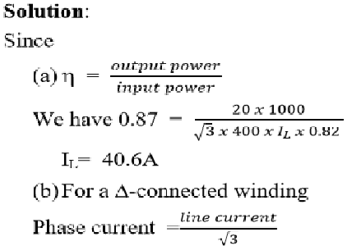
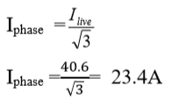
Example
A three phase motor operating on a 400V system is developing 20kw at an efficiency of 0.87 with pf of 0.82. Calculate: (a) the line current and (b) the phase current if the windings are Δ-connected.

Slide 9
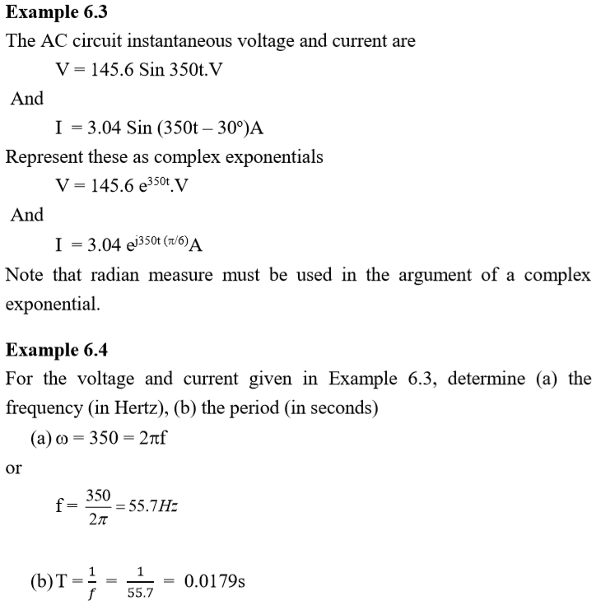
Examples

Slide 10
Example 6.5
Express the following current phasors as instantaneous currents, all at a frequency ω: (a) 10 <0 (b) 25 < -30 (c) 6 < -90
Solution
(a) i = √2 (10) Sinωt = 14.4 Sinωt.
(b) i = √2 (25) Sin(ωt – 30o) = 35.35 Sin (ωt – 30o)
(c) i = √2 (6) Sin (ωt – 90o) = 8.484 Sin (ωt – 90o)
Exercises
Phase voltage of a star-connected alternator are ER = 231 < 0V; and EY = 231< -120V; and EB = 231 <+120V. Determine the phase sequence. Evaluate ERY and EYB
(Answer ERY = EYB = 400V)
2) A 400V, three phase voltage is supplied to a balanced three phase delta connected load of phase impedance (15 + j20) Ω. Determine : i) The phase current in each line
ii) power consumption Per phase ? iii) The vector sum of the three line currents ?
(Answer IL = 27.7A, P = 3,840W, Phasor sum = 0)

