Slide 1
Ishik university
Petroleum & Mining department
Practical General chemistry
First stage
2018-2019
Wrea Mohammed

Slide 2
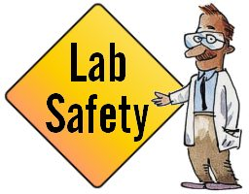

Slide 3
The chemistry laboratory can be a place of discovery and learning. However, by the very nature of laboratory work, it can be a place of danger if proper common-sense precautions aren't taken.
While every effort has been made to eliminate the use of explosive, highly toxic, and carcinogenic substances from the experiments which you will perform, there is a certain unavoidable hazard associated with the use of a variety of chemicals and glassware.

Slide 4
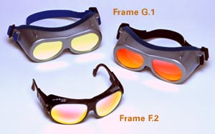
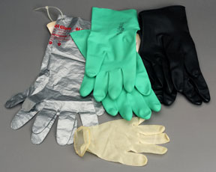
Attire
Safety goggles must be worn at all times while in the laboratory. This rule must be followed whether you are actually working on an experiment or simply writing in your lab notebook. You must wear safety goggles provided by the chemistry department.
Contact lenses are not allowed. Even when worn under safety goggles, various fumes may accumulate under the lens and cause serious injuries or blindness.
Closed toe shoes and long pants must be worn in the lab. Sandals and shorts are not allowed.
Long hair must be tied back when using open flames.

Slide 5
Conduct
Eating, drinking, and smoking are strictly prohibited in the laboratory.
No unauthorized experiments are to be performed.
If you are curious about trying a procedure not covered in the experimental procedure, consult with your laboratory instructor.
Never taste anything.
Never directly smell the source of any vapor or gas; instead by means of your cupped hand, waft a small sample to your nose. Do not inhale these vapors but take in only enough to detect an odor if one exists.
Coats, backpacks, etc., should not be left on the lab benches and stools. There is a hook rack along the back wall at either end of the lab. There are coat racks just inside the each entrance to the balance room at the back of the lab. Beware that lab chemicals can destroy personal possessions.

Slide 6
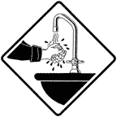
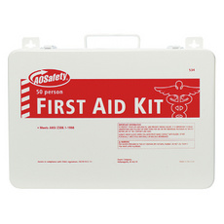
Always wash your hands before leaving lab.
Learn where the safety and first-aid equipment is located. This includes fire extinguishers, fire blankets, and eye-wash stations.
Notify the instructor immediately in case of an accident.

Slide 7
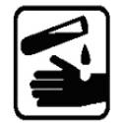
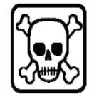
Proper Handling of Chemicals and Equipment
Consider all chemicals to be hazardous unless you are instructed otherwise. Material Safety Data Sheets (MSDS) are available in lab for all chemicals in use. These will inform you of any hazards and precautions of which you should be aware.
Know what chemicals you are using. Carefully read the label twice before taking anything from a bottle.
Excess reagents are never to be returned to stock bottles. If you take too much, dispose of the excess.

Slide 8
Many common reagents, for example, alcohols and acetone, are highly flammable. Do not use them anywhere near open flames.
Always pour acids into water. If you pour water into acid, the heat of reaction will cause the water to explode into steam, sometimes violently, and the acid will splatter.
If chemicals come into contact with your skin or eyes, flush immediately with copious amounts of water and consult with your instructor.

Slide 9
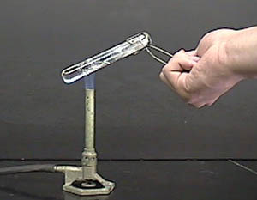
Never point a test tube or any vessel that you are heating at yourself or your neighbor--it may erupt like a geyser.
Never look directly into a vessel being heated.
When observing a smell, always waft fumes towards you. Do not take large breaths through your nose.
Dispose of chemicals properly. Waste containers will be provided and their use will be explained by your instructor. Unless you are explicitly told otherwise, assume that only water may be put in the lab sinks.

Slide 10
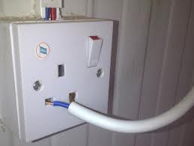
Clean up all broken glassware immediately and dispose of the broken glass properly.
Never leave burners unattended. Turn them off whenever you leave your workstation. Be sure that the gas is shut off at the bench rack when you leave the lab.
Beware of hot glass--it looks exactly like cold glass.
Electrical Hazard, never handle electrical items when you are wet.

Slide 11
Glassware's

Slide 13
Stirrer
Washing bottle
Reagent bottle

Slide 14
Other glassware's

