Slide 1
Distillation

Slide 2
Definition
Distillation An important organic process used to separate two or more than two liquids having different boiling points from a liquid mixture.
Distillation is a physical separation process, not a chemical reaction to purify an impure liquid.

Slide 3
Principle of distillation
Distillation method basis on the difference in boiling point of the components of the mixture at standard pressure conditions.
At any boiling temperature a liquid is in equilibrium with its vapor.
This equilibrium is described by the vapor pressure of the liquid. The vapor pressure is the pressure that the molecules at the surface of the liquid exert (try) against the external pressure, which is usually the atmospheric pressure.

Slide 4
How does it work
As the mixture is heated, the temperature rises until it reaches the temperature of the lowest boiling substance in the mixture,
The other components of the mixture remain in their original phase in the mixture.
The resultant hot vapor passes into a condenser and is converted to the liquid, and then collected in a receiver flask.
The other components of the mixture remain in their original phase until the most volatile substance has all boiled off.
Then the temperature of the gas phase rises again until it reaches the boiling point of a second component in the mixture, and so on.

Slide 5
distillation techniques depends on several factors
The difference in vapor pressure (related to the difference in the boiling points) of the components present.
the size of the sample.
The distillation apparatus.

Slide 6
In a solution containing A & B the partial pressure (PA) of component A at a given temperature is equal to the vapor pressure PºA of pure A multiplied by the mole fraction of A (XA) in solution.
XA = nA/ (nA + nB) , XB = nB/ (nA + nB) and XA + XB = 1
nA and nB represent the number of moles of components A and B.
(PA = XA PºA ) , (PB = XB PºB) and
(PT (total vapor pressure) = PA + PB)

Slide 7
This relationship, derived from Raoult’s law, is capable of describing the boiling point behavior of compound A in a mixture of compounds under a variety of different circumstances. The boiling point of the solution is reached when PT is equal to the pressure applied to the surface of the solution.

Slide 8
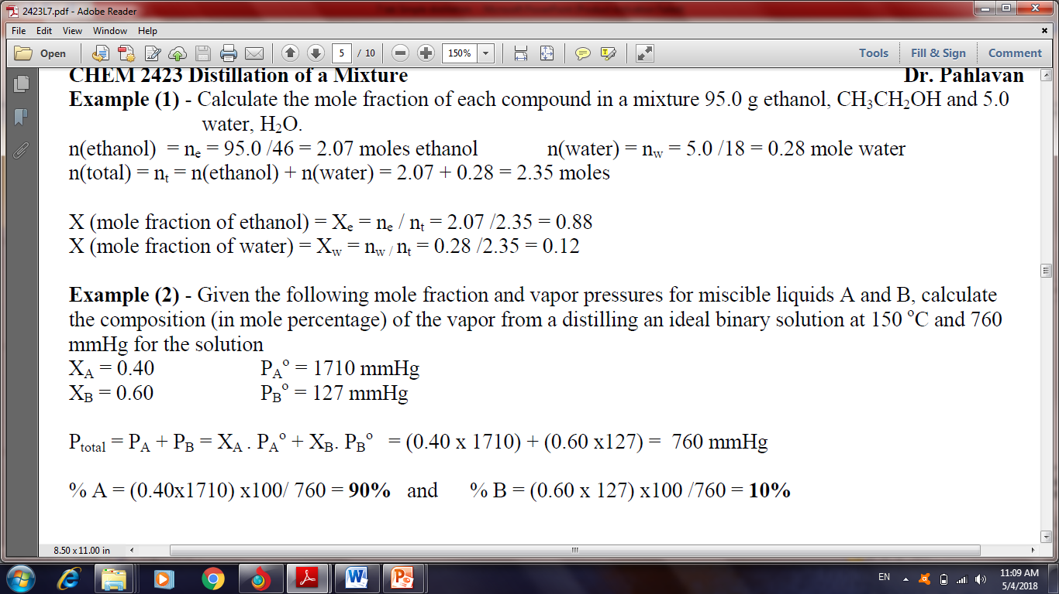

Slide 9
Application of distillations
Distillation is used to:
Separation of crude oil components.
Remove impurities from Water.
Air is distilled to separate its components.
Distillation of fermented solutions to produce distilled beverages with a higher alcohol content.

Slide 10
According to the differences in boiling points between the liquids, distillation process classified into four types:-
Simple distillation.
Fractional distillation.
Vacuum distillation.
Steam distillation.

Slide 11
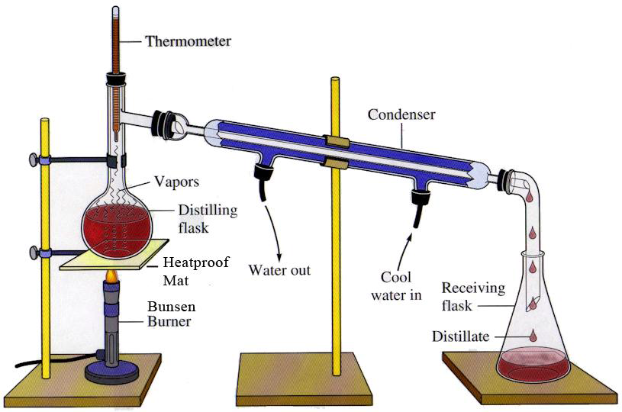
Simple Distillation

Slide 12
Simple distillation
Separating liquids boiling below 150 ˚C at 1 atm. The liquids should dissolve in each other and the difference in boiling point between various liquid components should be at least 25˚C.
Simple distillation involves a single equilibration between the liquid and vapor. This distillation is referred to as involving one theoretical plate.

Slide 13
Separation of liquid mixture by simple distillation:-
A mixture composed of (acetone) and (water) with boiling point (56 & 100) °C respectively is heated.
The lowest boiling point (acetone) will vaporized and ascended (elevated) from the solution till it reach the top of the system, with recording its real b.p. with the help of thermometer.
The ascended (rises) vapor (acetone) will converts to the liquid form by the action of the condenser, then collect at the receiver.
Finally the highest boiling point (water) will remain in the distillation flask.

