Slide 1
Boiling Point Determination

Slide 2
Definition
Boiling point is the temperature at which the vapor pressure of the liquid is equal to the atmospheric pressure and change its state from a liquid to a gas.
In terms of intermolecular interactions the b.p. represents the energy required to overcome the various intermolecular attractions binding the molecules as a liquid (e.g. dipole-dipole attraction and hydrogen bonding). Therefore the boiling point of a liquid is also an indicator of the strength of the attractive forces between the liquid’s molecules.

Slide 3
factors affecting boiling point (b.p)
Pressure
Molecular weight
Impurities
Structure of the molecule & intermolecular interactions like
Branching
Polarity
Van der Waal interactions
H-bonding

Slide 4
factors affecting boiling point (b.p)
1- Pressure
When the pressure is less than 1 atm , the boiling point of the liquid is less than its normal b.p.
When P = 1 atm, the b.p. of the liquid is called normal boiling point
When P is greater than 1 atm, the b.p. of the liquid is greater than its normal b.p.

Slide 5
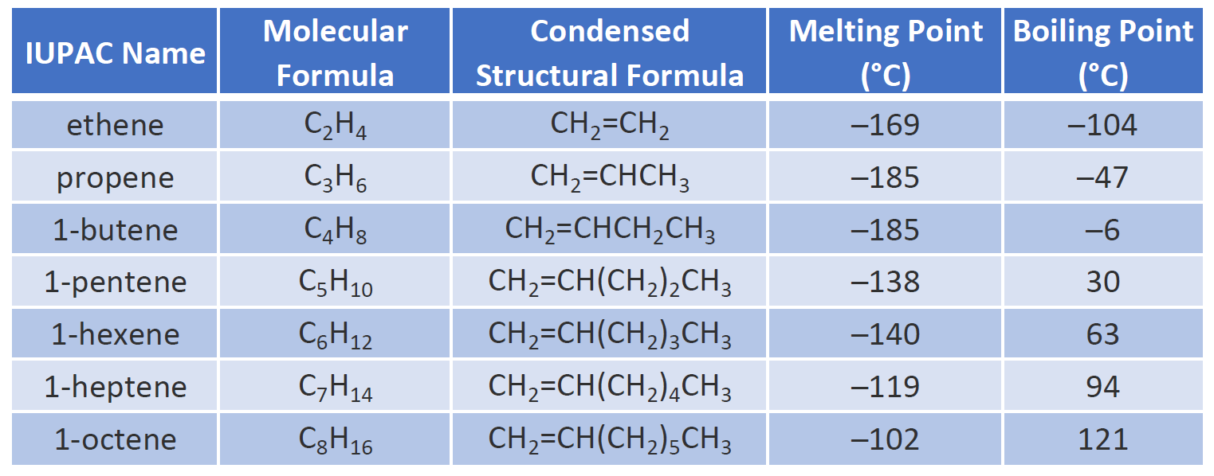
factors affecting boiling point (b.p)
2- Molecular weight
By increasing Molecular weight b.p increase.

Slide 6
factors affecting boiling point (b.p)
3- Impurities
A solution has a higher boiling point than a pure solvent .
The b.p. of pure H₂O is 100 ºC, but that b.p. can be elevated by adding a solute such as a salt.

Slide 7
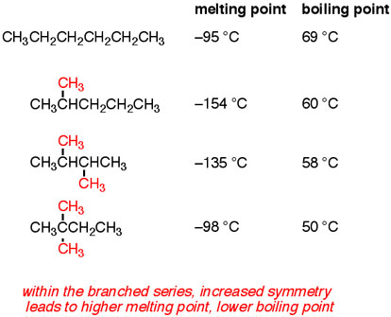
factors affecting boiling point (b.p)
4-Structure of the molecule & intermolecular interactions
1-Branching
Within the branched series, increased branch leads to lower boiling point.

Slide 8
factors affecting boiling point (b.p)
4-Structure of the molecule & intermolecular interactions
2-Polarity
Polarity raises b.p.

Slide 9
factors affecting boiling point (b.p)
4-Structure of the molecule & intermolecular interactions
3-Van der Waal interactions
As the number of carbon in an alkanes increase, the boiling point increase due to the larger surface area and the van der walls interactions increased.

Slide 10
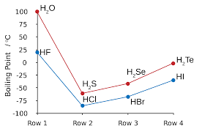
factors affecting boiling point (b.p)
4-Structure of the molecule & intermolecular interactions
4- Hydrogen bonding

Slide 11
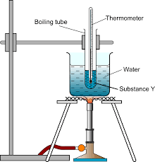
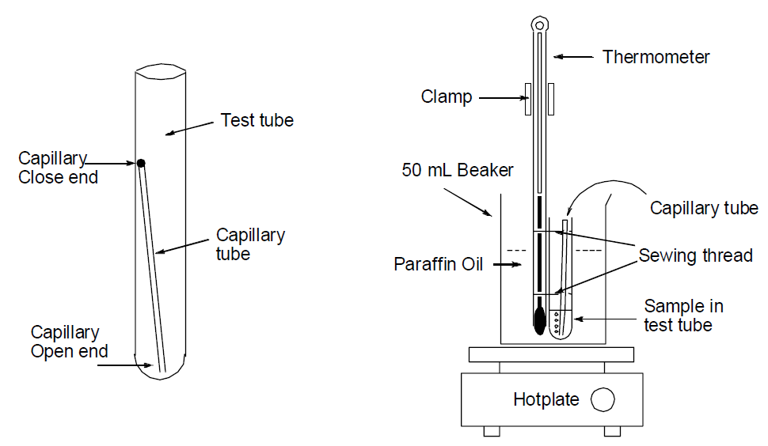
Apparatus

Slide 12
Procedure

