Slide 1
Volumetric Analysis
Glass ware for Volumetric measurements

Slide 4
Stirrer
Washing bottle
Reagent bottle

Slide 5
Analytical chemistry: Is applied throughout industry, medicine and all the sciences it is classified to:

Slide 6
Analytical chemistry
Qualitative
Analysis
Quantitative
Analysis
Chemical method
Instrumental
method
Volumetric analysis
Gravimetric analysis
Thermal analysis
Electroanalytical methods
Optical methods

Slide 7
Qualitative analysis: reveals the identity of the elements and compounds in a sample.
Quantitative analysis: indicates the amount of each substance in a sample.
Volumetric analysis: It is based on accurate measurements of final volume of a standard reagent solution of known concentration needed to react with the analyte in a known volume of sample.

Slide 8
Titration: is a process in which a standard reagent (known conc.) is added to a solution of an analyte until the reaction between the analyte and reagent is attained equivalence point.

Slide 9
Equivalence point: Is the point in a titration when the amount of added standard reagent is exactly equivalent to the amount of analyte.
At equivalent point:
(no. of eq.wt titrant) = (no. of eq.wt. titrand)
(N = no.of eq.wt / V)
(N × V)_{Standard} = (N × V)_{Analyte}

Slide 10
End point: Is the point in a titration when a physical change occurs that is associated with the condition of chemical equivalence.
Indicators: Chemical compounds undergo change in colour during titration which indicates the equivalence point.
Acid-base indicators are generally weak organic acids or bases which, upon dissociation or association, undergo internal structural changes at a specific range of pH that give rise to alterations in color. We can symbolize the typical reaction of an acid-base indicator as follows:

Slide 11
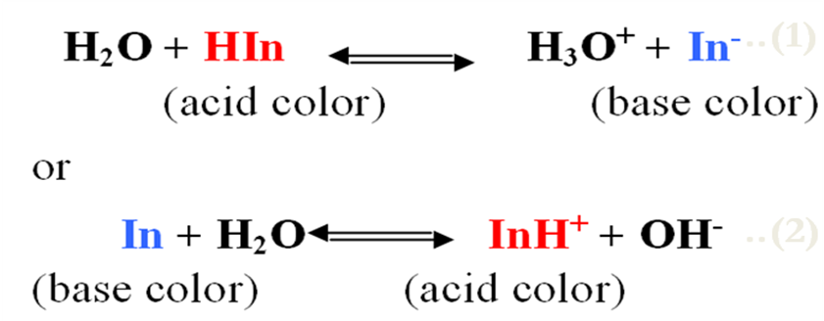
For the first indicator (1), HIn will be the major constituent in strongly acidic solutions and will be responsible for the "acid color" of the indicator, whereas In⁻ will represent its "base color"
For the second indicator (2), the species In will predominate in basic solutions and thus be responsible for the “base color”, whereas InH⁺ will constitute the “acid color”.

Slide 12
Indicator | Color in acidic medium | Color in basic medium | pH range
Thymol blue | Red | Yellow | 1.2 – 3.0
Methyl orange | Red | Yellow | 3.1 – 4.4
Methyl red | Red | Yellow | 4.2 – 6.2
Phenolphthalein | Colorless | Pink | 8.3 – 10

Slide 13
Primary standards
It is a highly purified compound that serves as a reference material in volumetric (titrimetric) method.

Slide 14
Important requirements for a primary standard are the following:
High purity.
High stability.
It has a large molecular weight to minimize the relative error during weighing the substance.
It must be not hygroscopic.
Low cost.
The substance must be not poison.
Soluble in a solvent (especially water).

Slide 15
Secondary standard:
Is a compound whose purity has been established by chemical analysis and that serves as the reference material for a titrimetric method of analysis.
Standard solution:
Is a reagent of exactly known concentration that is used in a titrimetric analysis, and it's prepared either from primary standard material or its concentration determined by standardization with primary standard material.

Slide 16
For use in titrimetric analysis a reaction must fulfill the following conditions:
There must be a simple reaction which can be expressed by a chemical equation. The substance to be determined should react completely with the reagent.
The reaction should be relatively fast. (Most ionic reactions satisfy this condition).
There must be an alteration in some physical or chemical property of the solution at equivalence point.
An indicator should be available which, by a change in physical properties (color or formation of a precipitate), should sharply define the end point of the reaction.

Slide 17
Types of titrations according to the chemical reaction
1-Neutralization titration (Acid-base titration).
NaOH + HCl NaCl + H₂O
2-Precipitation titration.
AgNO₃ + NaCl AgCl + NaNO₃
3-Reduction-oxidation titration (Redox titration).
5Fe²⁺ + Mn⁷⁺ + 8H⁺ 5Fe³⁺ + Mn²⁺ + 4H₂O
4-Complexation titration.
Hg²⁺ + 4I⁻ HgI₄²⁻

Slide 18
1- Neutralization titration (Acid-base titration)
These include the titration of free bases with a standard acid, and the titration of free acids with a standard base. These reactions involve the combination of hydrogen and hydroxide ions to form water.
H⁺ + OH⁻ H₂O
Example:
NaOH + HCl NaCl + H₂O
Na₂CO₃ + 2HCl 2NaCl + CO₂ + H₂O

