Slide 1
Enhancing Safety Through Ergonomic Program
Tishk International University
Civil Engineering Department
Prepared by: Haval M. Selki ©
Haval.tiu@yahoo.com
Chapter 2-Ergon-Part II
Notes:
To view this presentation, first, turn up your volume and second, launch the self-running slide show.

Slide 2
Contents
Ergonomics Principles
The benefits of an ergonomics program
What you can do to prevent injury.
When Ergonomics are improved in the workplace:
Notes:
To view this presentation, first, turn up your volume and second, launch the self-running slide show.

Slide 3
Ergonomics Principles
When Considering Ergonomics Always Observe The Twelve (12) Ergonomic Principles:-

Slide 4
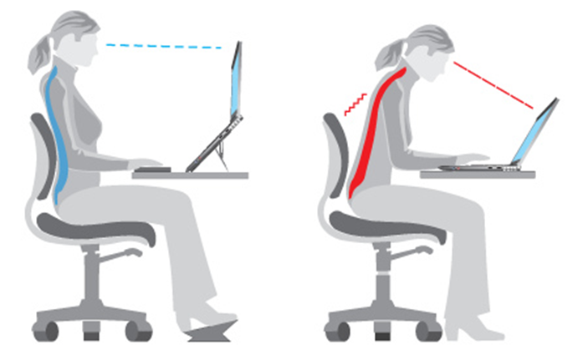
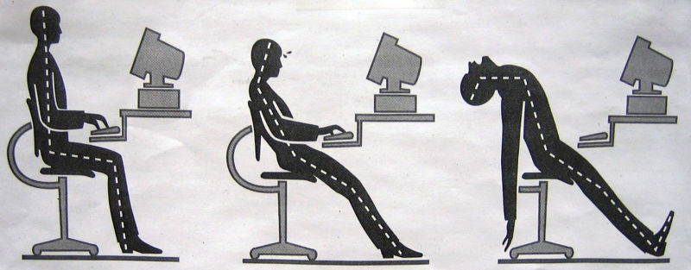
1. Work in neutral postures
Maintain "s-curve" of the spine
Keep wrists in neutral
Kept the neck aligned
Keep elbows in and shoulders relaxed

Slide 5
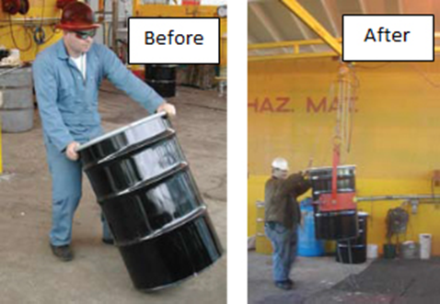
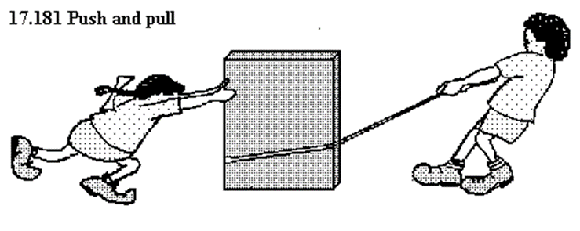
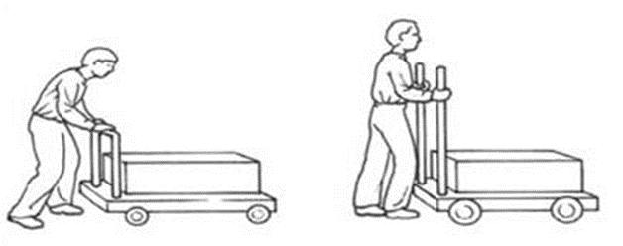
2 . Reduce excessive force
Reduce grasping force
Minimize the arm force needed
Reduce pulling and pushing forces

Slide 6
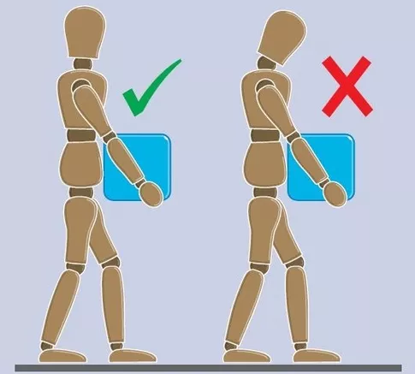
Keep loads as close to the body as possible

Slide 7
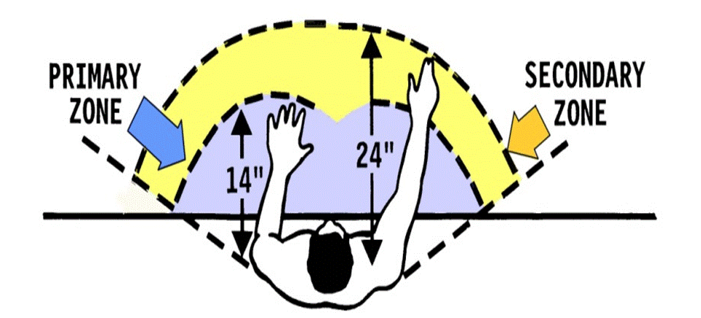
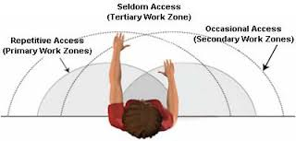
3. Keep everything in easy reach "reach envelope"

Slide 8
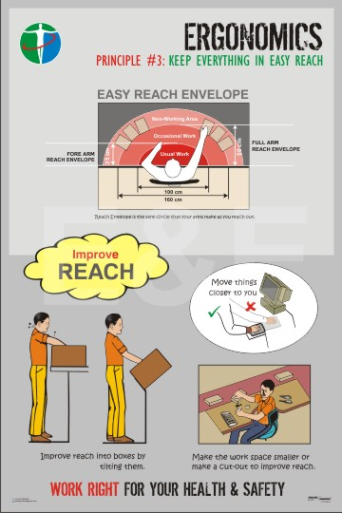

Slide 9
4. Work at proper heights
Do most work at elbow height except for heavy or precision work
Adjusting height

Slide 10
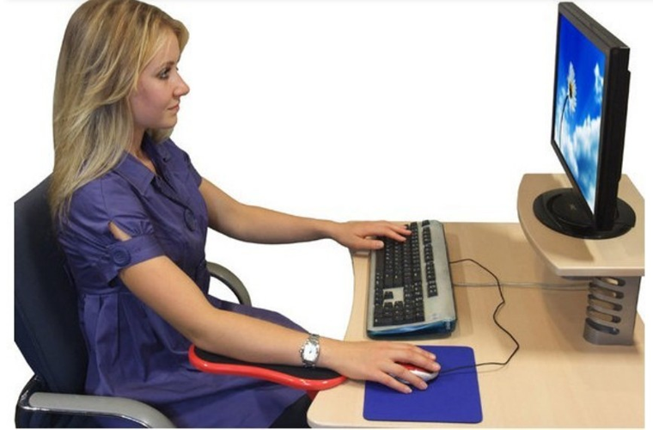
6. Minimize fatigue and static load
Add fixture to tools
Change orientation
Footrest

Slide 11
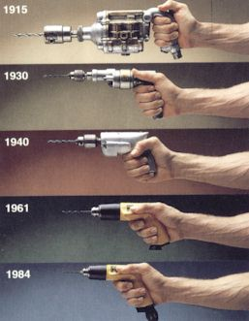
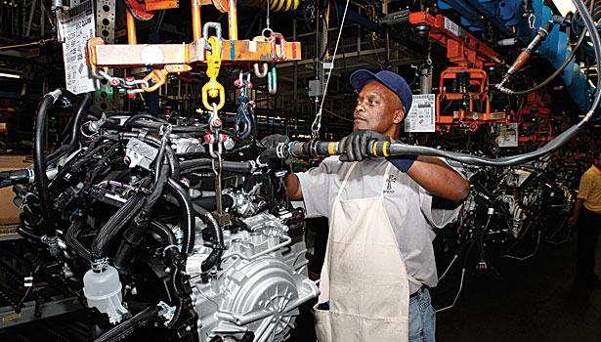
5. Reduce excessive motions
Use power tools
Change equipment layout

Slide 12
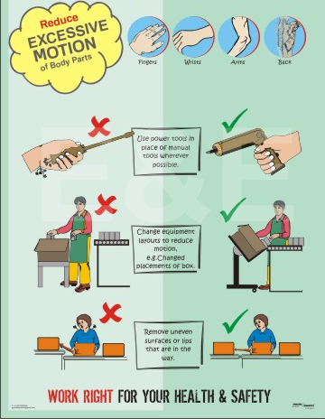
Reduce excessive motions

Slide 13
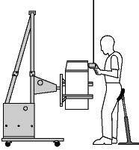
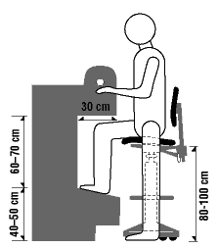
6. Minimize fatigue and static load

Slide 14
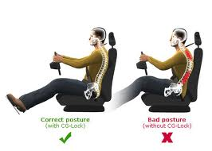
Adjust the seat
Change position

Slide 15
7 . Minimize pressure points
Add cushion/ padding of tool

Slide 16
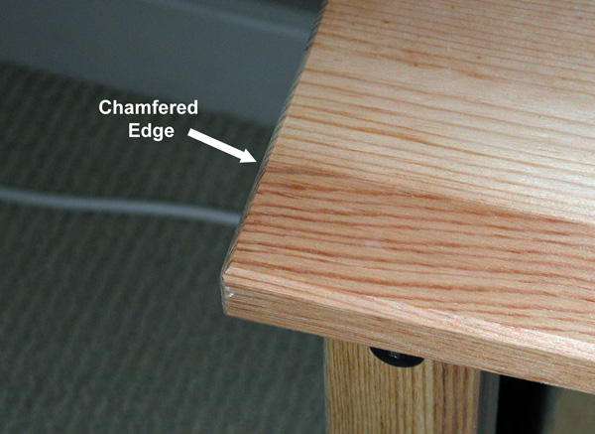
7. Minimize pressure points
Rounding out the edge

Slide 17
8 . Provide clearance
Work spaces with adequate clearance for head, arms, knees, feet and body
Be able to see

Slide 18
9. Move, exercise, and stretch
Stretch and warm up

Slide 19
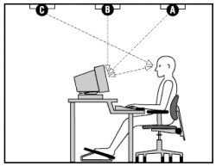
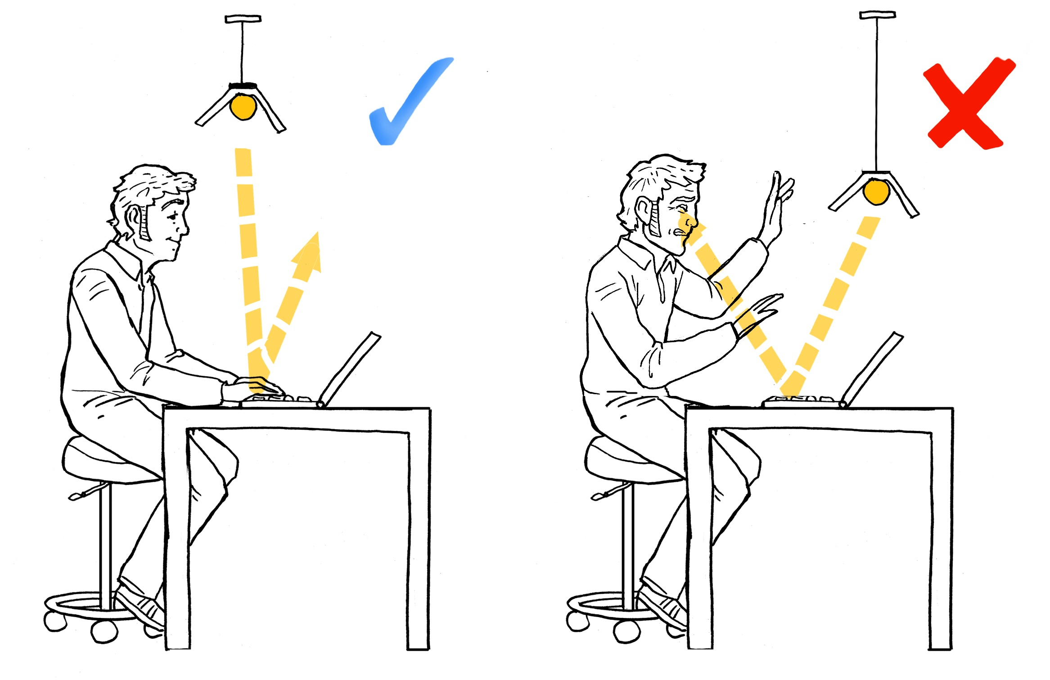
10. Maintain comfortable environment
Lighting and glare

Slide 20
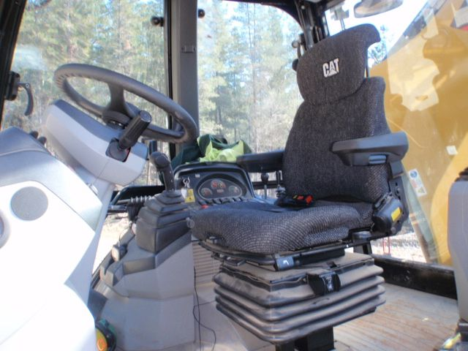
10. Maintain comfortable environment
Reduce Vibration &Temperature

Slide 21
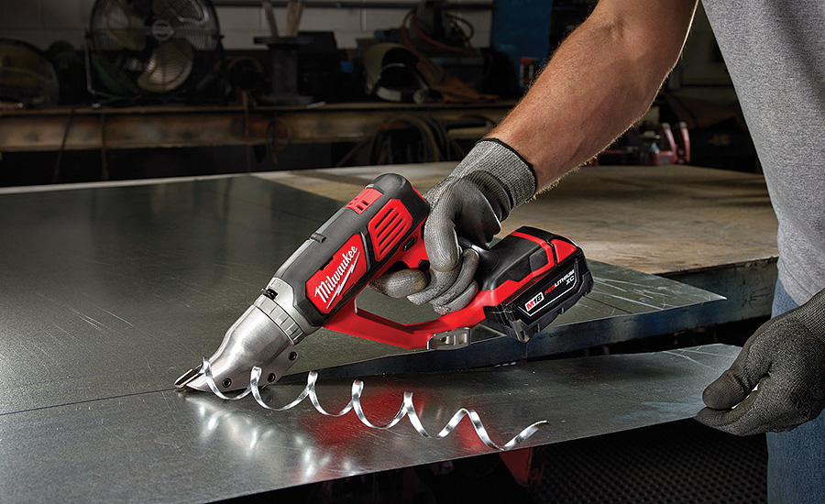
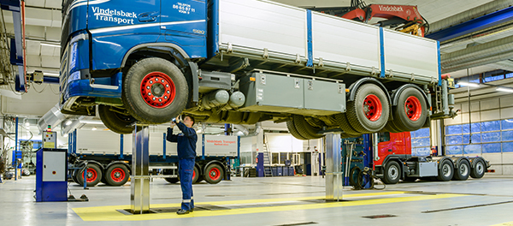
11 . Make displays and controls understandable
Designed to be compatible

Slide 22
12. Improve work organization
Job rotation - shift
Job enlargement
Staffing and scheduling
Rest breaks
Encouraging workers involvement
advice
Consultation
Motivation

Slide 23
What you can do to prevent injury?
Develop an Ergonomics program.
Take proper breaks.
Health and Fitness.
Be aware of your hobbies away from work.

Slide 24
The benefits of an ergonomics program

Slide 25
Saves money: Based on many studies, 1$ out of 3$ of worker compensation costs are due to MSDs related problem.
Improves productivity: Increase the workability of labors by fitting the jobs to the workers.
Improves quality: stress on training courses, emphases on using high quality tools and equipment. This leads to improve the skill of workers.

Slide 26
Improves employee engagement: employees get interested when the company attempt to compliance with standard of health and safety. This increase morale and labor involvement. As a result, it reduces absenteeism and turnover.
Creates a better safety culture: the cumulative of above points shows the commitment of company or employers and this change employees view towards safety to safety culture.

Slide 27
When Ergonomics are improved in the workplace:

Slide 28
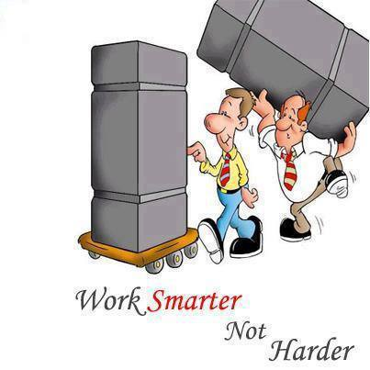

Slide 29
Quality, comfort and safety make us more productive and happy people.

Slide 30
Stay Healthy and Safe

Slide 31
Thank you
End of Chapter 2, part II

