Slide 1
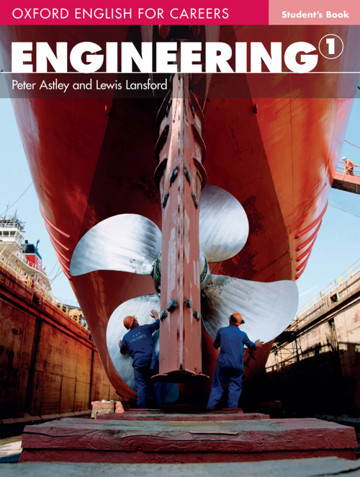
Dr. Yunus Yildiz ERBIL/2018

Slide 2
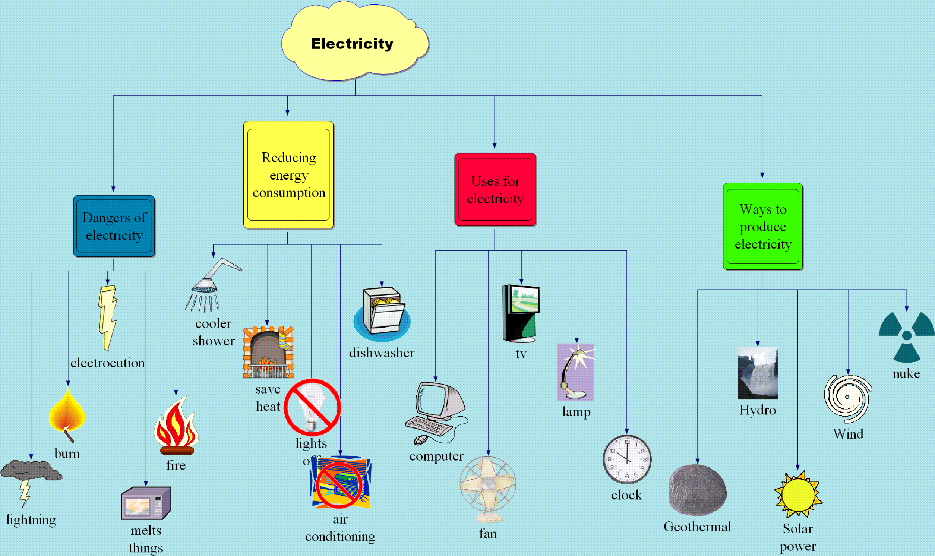

Slide 3
What exactly is electricity?
“a type of energy that can produce light and heat, or make machines work”
Electricity is all around us–powering technology like our cell phones, computers, lights, soldering irons, and air conditioners.
It’s tough to escape it in our modern world.
Even when you try to escape electricity, it’s still at work throughout nature, from the lightning in a thunderstorm to the synapses inside our body.

Slide 4
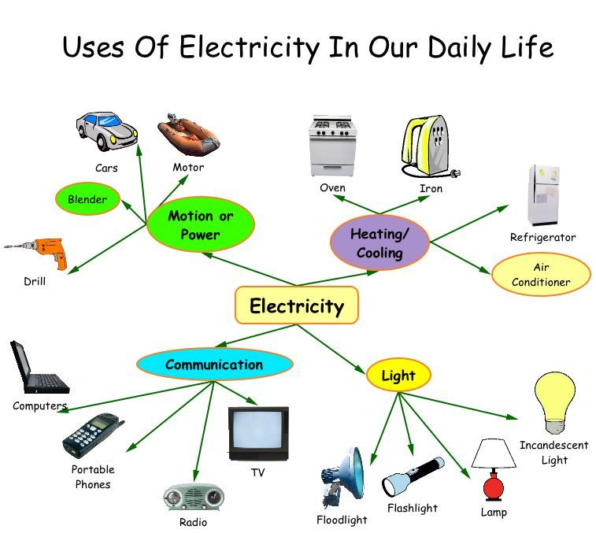

Slide 5
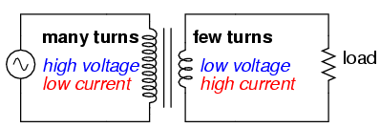
3
1
6
2
5
4
Step-up or Step-down Transformer:
Distribution: “SHARING” :​ the way something is divided and shared in a group or area
Domestic distribution: :​ products and services that are SHARING
Domestic Consumption: :​ products and services that are bought and used in the country that makes or offers them:
Generation: “ENERGY” :​ the production of energy
Transformer: a device that changes the voltage or other characteristic of electrical energy as it moves from one circuit to another:

Slide 6
Picture “C” mainly deals with DC.
The others mainly deal with AC.

Slide 7
Any charger for electrical devices : Cell Phones, Mp3 or MP4 Players etc; anything that uses a battery, including the electrical system of a car.
Electric lights in the home, kitchen appliances
Avoid using electrical items in or near water or wet areas;
don’t use damaged electrical goods;
use electrical goods only with the correct voltage.

Slide 8
volts
resistance
current
amperes
conductor
circuit

