Slide 3
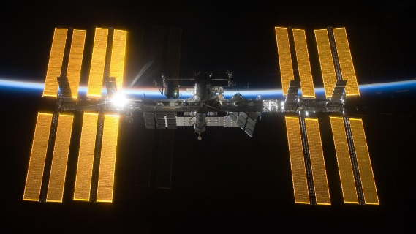
internal: ( adj) INSIDE A PLACE happening or coming from inside a particular country, group, or organization
Constant ( adj) FREQUENT happening a lot or all the time

Slide 4
Eclipse (n) when the sun is covered by the moon, or the moon is covered by the Earth's shadow (= dark area)- solar/lunar eclipse
Orbit (n&V) the circular journey that a spacecraft or planet makes around the sun, the moon, or another planet
Delicate (adj) GENTLE soft, light, or gentle - easy to damage or break

Slide 5
???
The energy production itself is clean and the fuel is free. ( Energy from sun.)
It relies on sunlight, and not everywhere is sunny;
The process of producing solar panels uses a lot of toxic materials;
The equipment production and installation costs are relatively high.
???

Slide 6
Climate control system: temperature and pressure
32.8 kilowatts DC
When the station is in ‘eclipse’ – in the Erath’s shadow
Rechargeable batteries
Heat build-up
6

Slide 7
The ISS’s power system
The equipment onboard
The solar array wings (SAWs)
eclipse
When it is the Earth’s shadow
The station’s
Heat build-up

