Slide 1
C
B
D
A

Slide 2
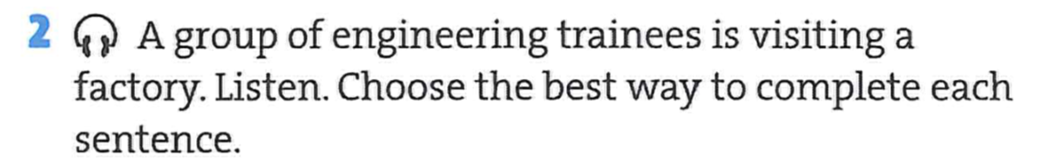


Slide 5
Remember
Don’t be
Take
Work
Know
Check

Slide 6
should
should
shouldn’t
should
shouldn’t
shouldn’t

Slide 7
careful
Remember to wear gloves.
careful
You should wear gloves.
Wear a hard hat.
Don’t turn right.
You should wear a hard hat.
You shouldn’t turn right.
Don’t smoke.
You shouldn’t smoke.

Slide 8
2
4
6
7
5
1
3

