Slide 1

ARCH 322
PRINCIPLES OF PLANNING I
Streets Safer by Design
Notes:
Presenter: Please be patient. Many slides have animations that take a few seconds to complete.

Slide 2
STREETS SAFER by Design

Slide 3
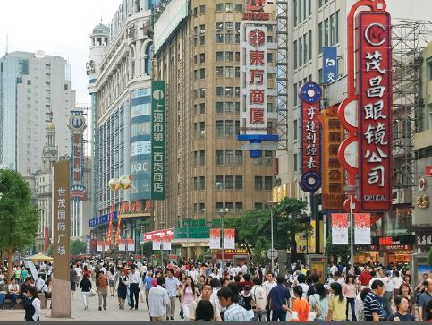
EXECUTIVE SUMMARY
Many of the world’s cities can become safer, healthier places by changing the design of their streets and communities.
Where public streets have been designed to serve primarily motor vehicle traffic, but they can be safer for all users if they are designed to serve pedestrians, public transport users, bicyclists, and other public activity.

Slide 4
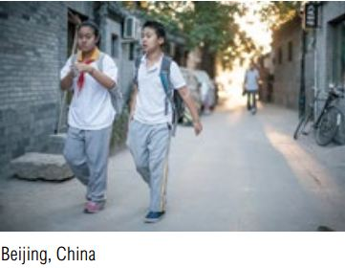
DESIGN PRINCIPLES
Urban design that reduces the need for vehicle travel and fosters safer vehicle speeds.

Slide 5
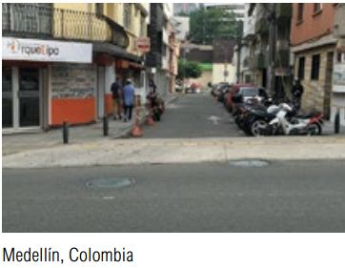
DESIGN PRINCIPLES
Traffic calming measures that reduce vehicle speeds or allow safer crossings

Slide 6
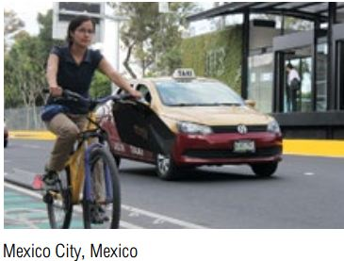
DESIGN PRINCIPLES
Arterial corridors that ensure safer conditions for all road users.

Slide 7
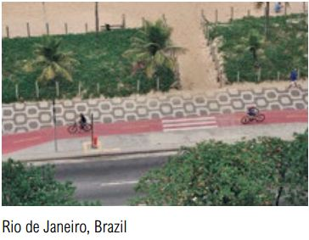
DESIGN PRINCIPLES
A network of connected and specially designed bicycling infrastructure.

Slide 8
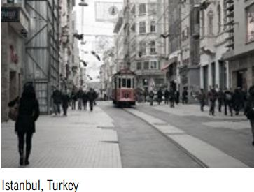
DESIGN PRINCIPLES
Safe pedestrian facilities and access to public spaces.

Slide 9
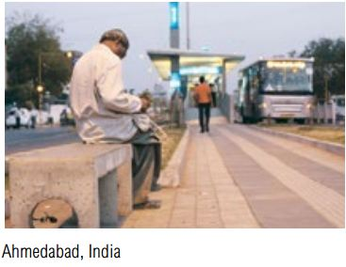
DESIGN PRINCIPLES
Safe access to mass transport corridors, stations, and stops.

Slide 10
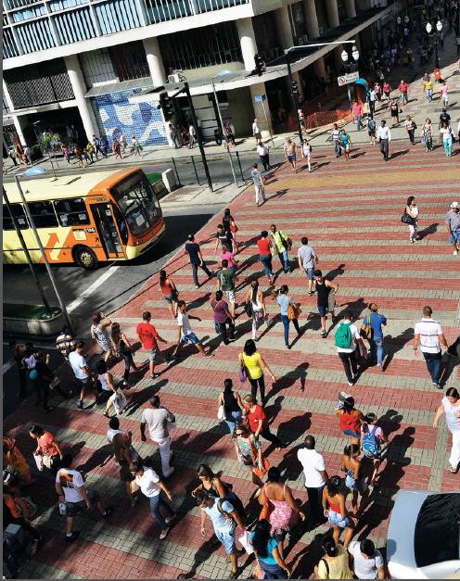
TRAFFIC SAFETY FOR PEOPLE
Traffic safety has much to do with the interaction among people, the street environment, and vehicles, and creating quality of life in cities.

Slide 11
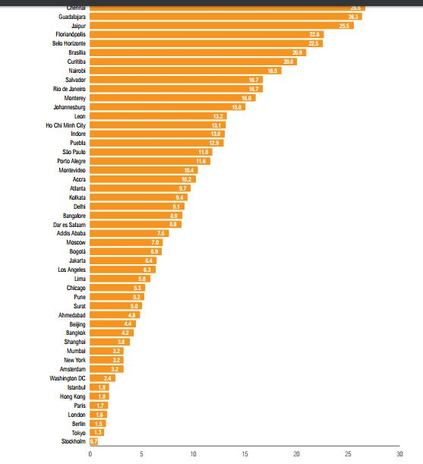
Traffic Safety Across Selected World Cities

Slide 12
Creating a Safer System for All People
Reducing Exposure and Risks:
Connected and compact urban design.
Safer vehicle speeds.
Managing arterials.
Walking, bicycling, and mass transport.

Slide 13
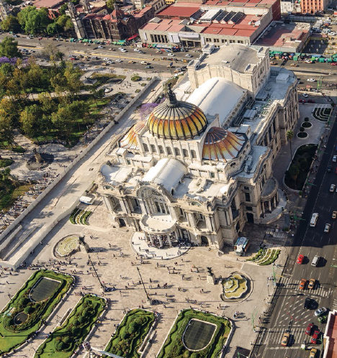
1.Key elements of urban form
Can lead to increased safety:
Block size
Street connectivity
Street widths
Access to destinations
Population density

Slide 14
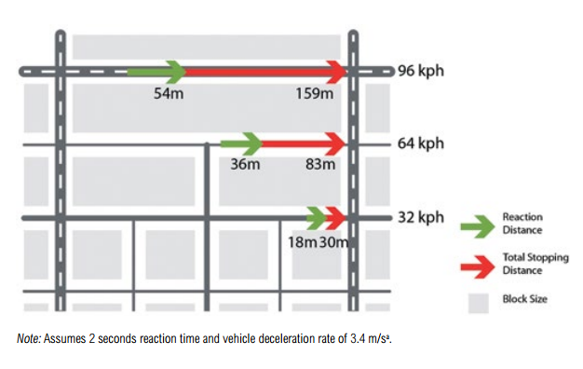
KEY URBAN DESIGN ELEMENTS
1.1 BLOCK SIZE
Longer block allow higher vehicle speeds due to fewer junctions that interrupt travel , placing pedestrians at higher risk.
Long blocks commonly have crosswalks only at intersections, indirectly encouraging unsafe midblock crossings.
More junctions mean more places where cars must stop and pedestrians can cross.

Slide 15
BLOCK SIZE

Slide 16
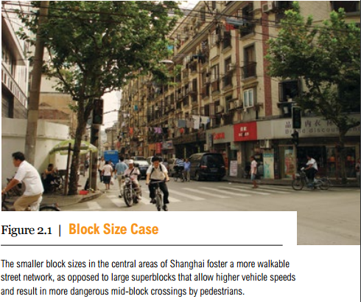
BLOCK SIZE
Benefits
Reduces the incentive for crossing in midblock and intersection.
More frequent stops at intersections will reduce vehicle speeds.
Reduce travel distance to jobs, services, and entertainment by providing more cut through paths

Slide 17
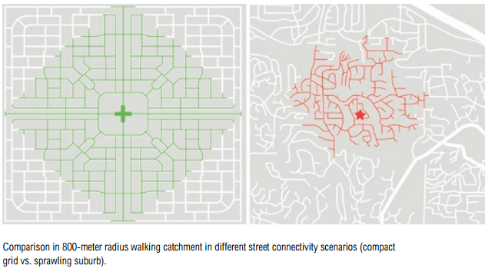
1.2 CONNECTIVITY
Connectivity refers to the directness of links and the density of connections in a street network.

Slide 18
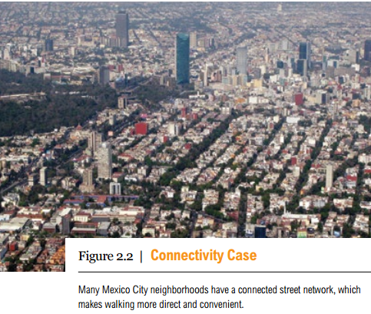
Connectivity
Benefits
Traffic is more spread out.
Discourage car use
Easy to reach a destination.

Slide 19
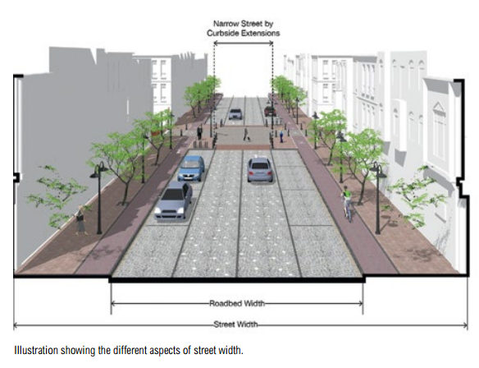
1.3 VEHICLE/TRAVEL LANE WIDTH
Street width often means the roadbed width, which is the distance between curb edges on opposite sides of a street, or from pavement edge to pavement edge.

Slide 20
VEHICLE/TRAVEL LANE WIDTH
Benefits
shorten pedestrian crossing distance.
slows traffic.
lowers vehicle speeds.

Slide 21
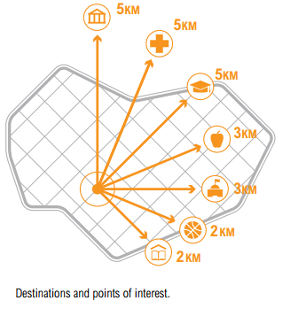
1.4 ACCESS TO DESTINATIONS
Pedestrian destinations or points of interest are normally places that people find useful or interesting uses concentrate.

Slide 22
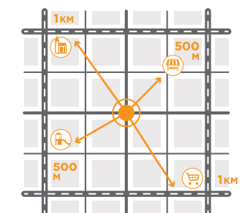
ACCESS TO DESTINATIONS
High-quality networks should be provided particularly between key destinations such as residential areas, schools, shopping areas, bus stops, stations, and places of work.

Slide 23
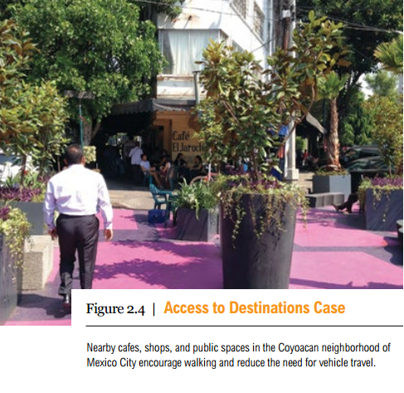
ACCESS TO DESTINATIONS
Benefits
saving time and money.
improve street activity , flexible use of buildings, and crime prevention.

Slide 24
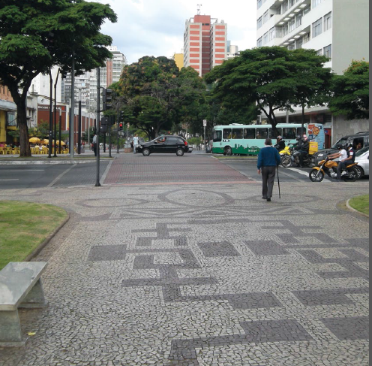
2.TRAFFIC CALMING MEASURES
Lower automobile speeds, especially those below 35 km/hr, have been found to greatly lessen the risk of fatalities.
Creating safer streets when cars are present means balancing the tension between vehicle speeds and the safety of pedestrians, cyclists, and motor vehicle.

Slide 25
2.Traffic calming
Speed humps
Speed cushions
Chicanes
Chokers
Curb extensions
Raised pedestrian crossings
Traffic circles
Roundabouts

Slide 26
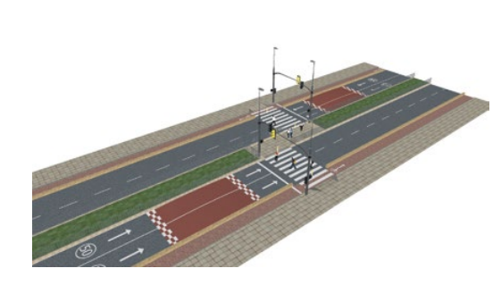
2.1 SPEED HUMPS
Speed humps are raised pavement that can reduce speeds to a certain limit based on the height and length of the hump. Humps are artificial elevations on the roadway.

Slide 27
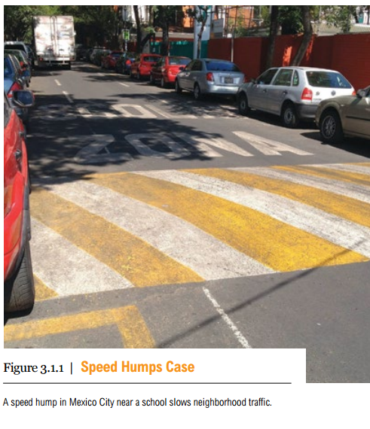
SPEED HUMPS
Benefits
pedestrian/crossing safety.
Low in cost

Slide 28
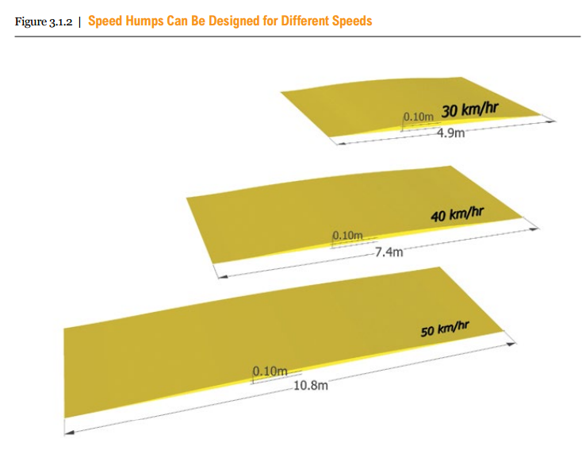
SPEED HUMPS

Slide 29
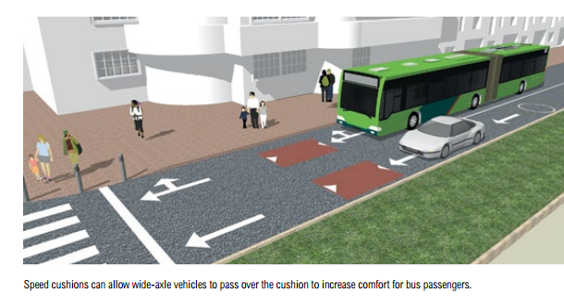
2.2 SPEED CUSHIONS
Speed cushions are traffic calming devices designed as several small speed humps installed across the width of the road with spaces between them, Speed cushions force cars to slow down.

Slide 30
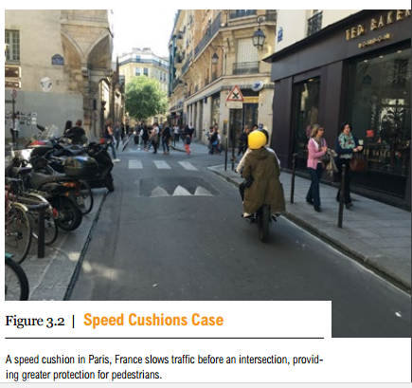
SPEED CUSHIONS
Benefits
Slows down vehicle speed severity of crashes.
Easy to install, remove and maintain

Slide 31
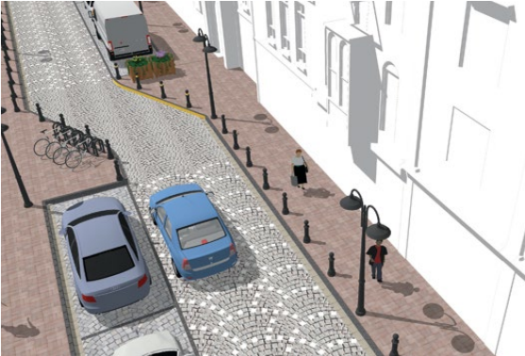
2.3 CHICANES
Chicanes are artificial turns created to slow traffic. They lead to a reduction in the width of the roadway.
Or constructed in a zigzag, staggered pattern that directs drivers away from a straight line, which can reduce vehicular speeds on both one- and two-lane roads.

Slide 32
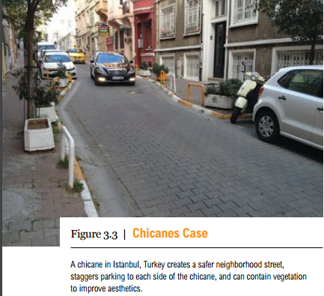
CHICANES
Benefits
Forces to drive more slowly and with greater awareness at midblock locations.
Improving environmental quality.

Slide 33
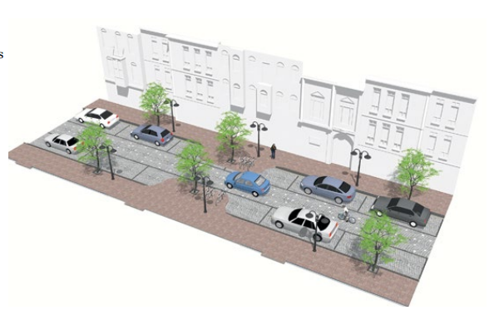
2.4 CHOKERS
Chokers are extensions that narrow a street by widening the sidewalks or placing planting strips, effectively.
They lead to a reduction in the width of the roadway, vehicular speeds, and pedestrian crossing distance.

Slide 34
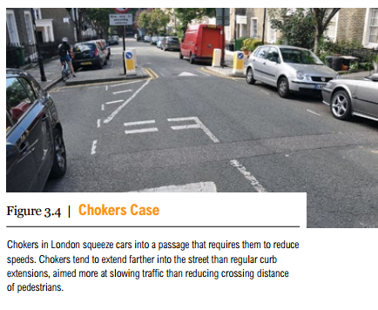
CHOKERS
Benefits
Pedestrian crossing safety.
Planting strip for landscaping or street furniture.
Reduce pedestrian crossing distance at a midblock location.

Slide 35
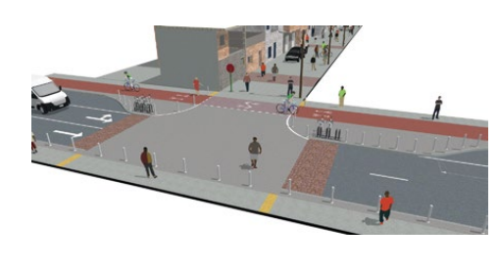
2.5 CURB EXTENSIONS
Curb extensions are extensions of the sidewalk, usually at intersections that improve pedestrian visibility and reduce crossing distances.
Can reduce speeds of turning vehicles and offer protection to pedestrians.

Slide 36
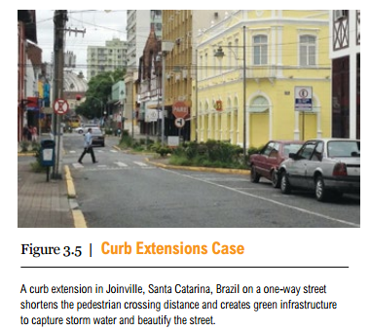
CURB EXTENSIONS
Benefits
Calms traffic by narrowing the roadway.
Slows turning vehicles and shortens crossing distance
Creates space for street furniture, bike parking, etc.
Physically prevents illegal parking near intersections and crossings.

Slide 37
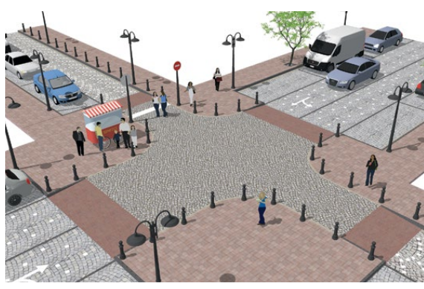
2.6 RAISED INTERSECTIONS/ CROSSINGS
Raised crossings are elevations of the road that slow cars as pedestrians cross, either at the intersection or a midblock location.
The intersection area is raised to the same level as the surrounding pavement.
Ramps are constructed on the access to the raised intersection area.

Slide 38
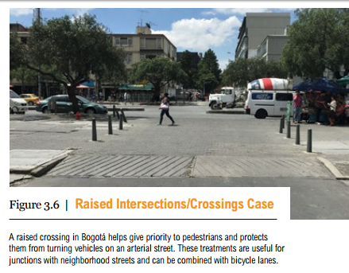
RAISED INTERSECTIONS
Benefits
Vertical elevation helps reduce vehicle speeds.
safety of pedestrians crossing to the opposite side of a street.
Visually turns intersection into a pedestrian-oriented zone.
Bicycle friendly.

Slide 39
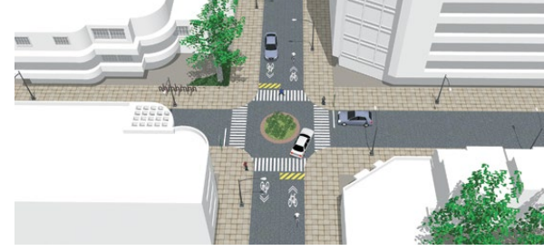
2.7 TRAFFIC CIRCLES
Traffic circles or rotaries are generally circular central islands in the middle of an intersection.
Entering traffic must typically alter direction and speed to avoid the island, creating a circular flow in one direction.
In most applications, traffic circles replace the stop lights and traffic signs that regulate flow in other intersections.

