Slide 1
Concrete 5
Department of Architectural Engineering/2nd stage
Dr. Zaid Al Hamdany

Slide 2
COMPRESSIVE STRENGTH
In designing structural members, it is assumed that the concrete resists compressive stresses and not tensile stresses; therefore, compressive strength is the criterion of quality concrete. The other concrete stresses can be taken as a percentage of the compressive strength, which can be easily and accurately determined from tests. Specimens used to determine compressive strength may be cylindrical, cubical, or prismatic. Test specimens in the form of a 6-in. (150-mm) or 8-in. (200-mm) cube are used in Great Britain, Germany, and other parts of Europe. Before testing, the specimens are moist cured and then tested at the age of 28 days by gradually applying a static load until rupture occurs.

Slide 3
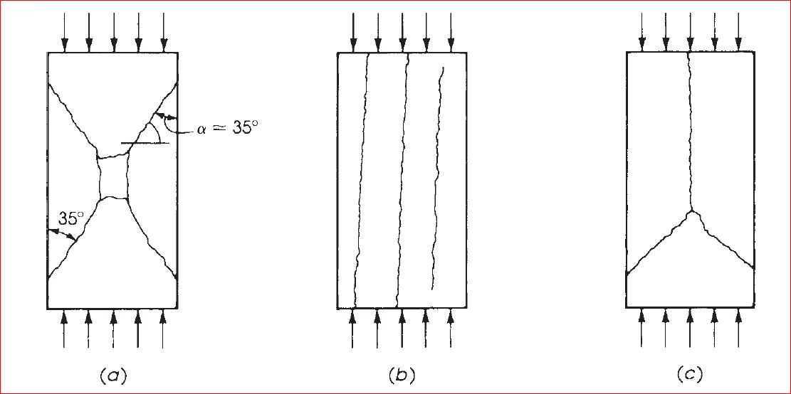
The failure of the concrete specimen can be in one of three modes:
First, under axial compression, the specimen may fail in shear, as in (a) Resistance to failure is due to both cohesion and internal friction. The second type of failure (b) results in the separation of the specimen into columnar pieces by what is known as splitting, or columnar, fracture. This failure occurs when the strength of concrete is high, and lateral expansion at the end bearing surfaces is relatively unrestrained. The third type of failure (c) is seen when a combination of shear and splitting failure occurs.

Slide 4
TENSILE STRENGTH OF CONCRETE
Concrete is a brittle material, and it cannot resist the high tensile stresses that are important when considering cracking, shear, and torsional problems. The low tensile capacity can be attributed to the high stress concentrations in concrete under load, so that a very high stress is reached in some portions of the specimen, causing microscopic cracks.
Direct tension tests are not reliable for predicting the tensile strength of concrete, due to minor misalignment and stress concentrations in the gripping devices. An indirect tension test in the form of splitting a 6×12-in. (150×300-mm) cylinder was suggested by the Brazilian Fernando Carneiro. The test is usually called the splitting test . In this test, the concrete cylinder is placed with its axis horizontal in a compression testing machine. The load is applied uniformly along two opposite lines on the surface of the cylinder through two plywood pads, as shown in Fig. below.

Slide 5
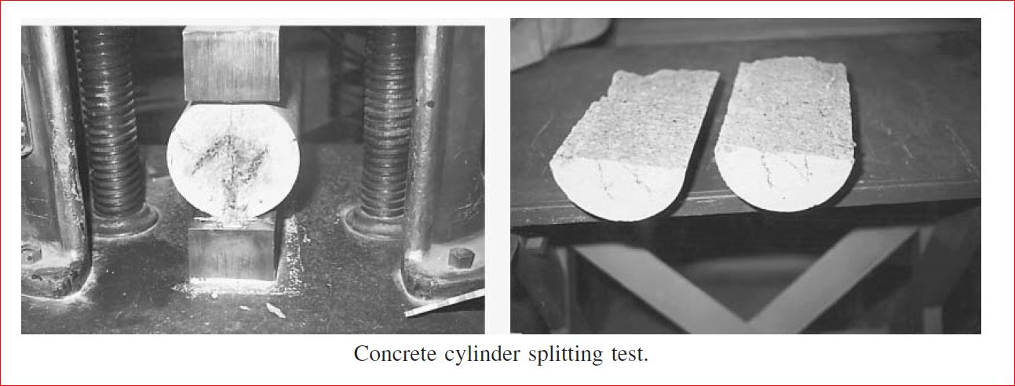
In general, the tensile strength of concrete ranges from 7 to 11% of its compressive strength, with an average of 10%. The lower the compressive strength, the higher the relative tensile strength.

Slide 6
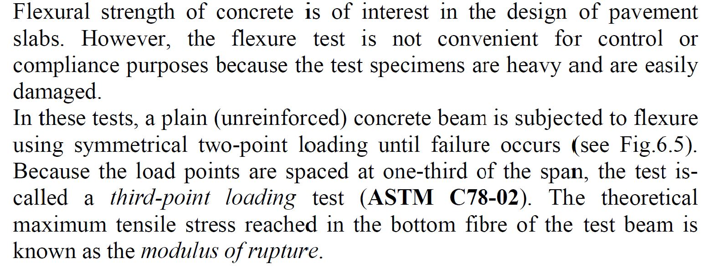
Flexural Strength of Concrete

Slide 7
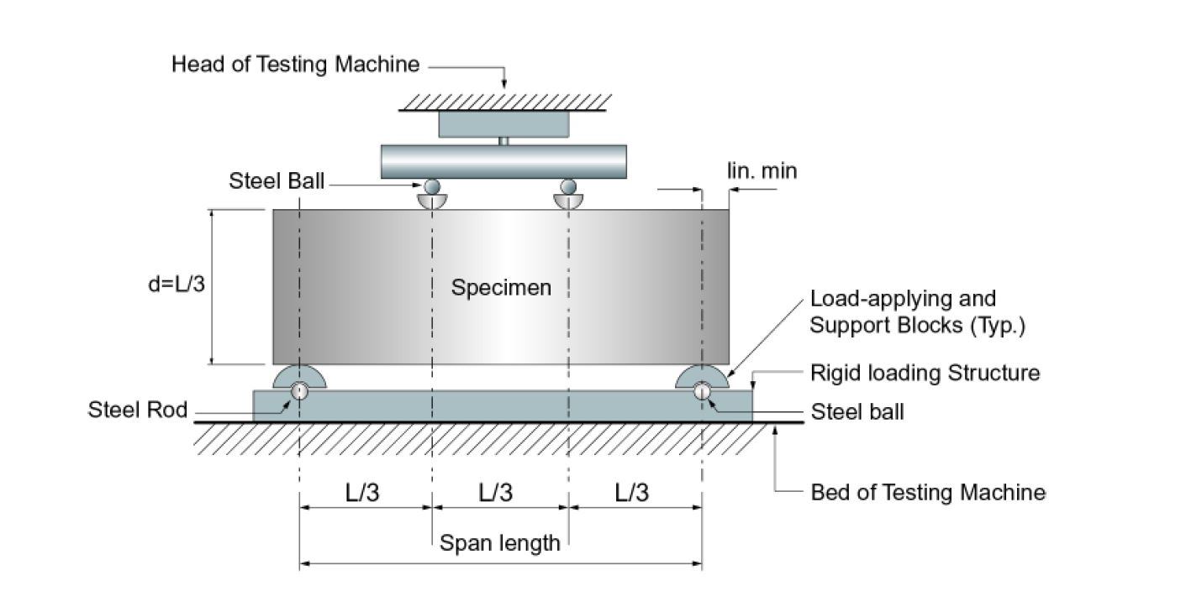
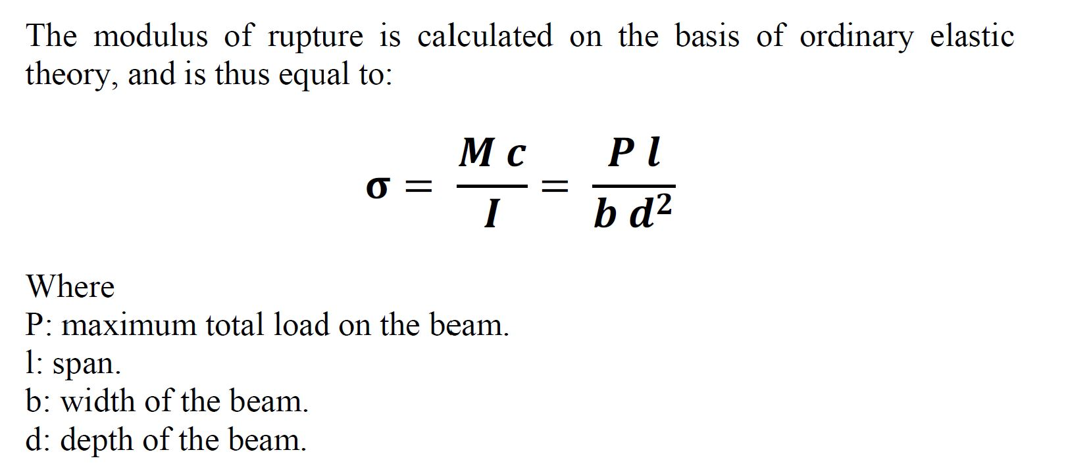

Slide 8
STRESS–STRAIN CURVES OF CONCRETE
The performance of a reinforced concrete member under load depends, to a great extent, on the stress–strain relationship of concrete and steel and on the type of stress applied to the member. Stress–strain curves for concrete are obtained by testing a concrete cylinder to rupture at the age of 28 days and recording the strains at different load increments.
The following figure shows typical stress–strain curves for concretes of different strengths. All curves consist of an initial relatively straight elastic portion, reaching maximum stress at a strain of about 0.002; then rupture occurs at a strain of about 0.003.

Slide 9
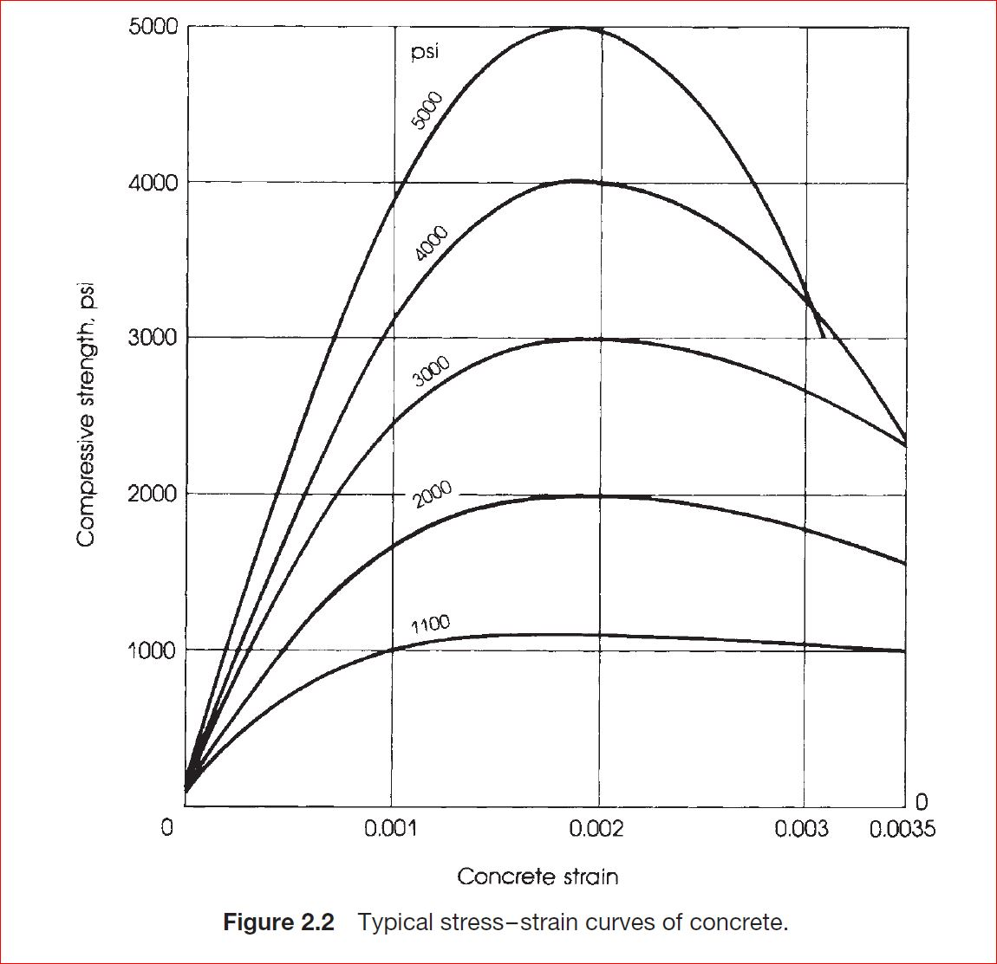

Slide 10
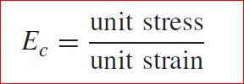
MODULUS OF ELASTICITY OF CONCRETE
One of the most important elastic properties of concrete is its modulus of elasticity, which can be obtained from a compressive test on concrete cylinders. The modulus of elasticity, Ec, can be defined as the change of stress with respect to strain in the elastic range:
The modulus of elasticity is a measure of stiffness, or the resistance of the material to deformation. In concrete, as in any elastoplastic material, the stress is not proportional to the strain, and the stress–strain relationship is a curved line. The actual stress–strain curve of concrete can be obtained by measuring the strains under increments of loading on a standard cylinder.

Slide 11

The ACI Code, Section 8.5.1, gives a simple formula for calculating the modulus of elasticity of normal and lightweight concrete considering the secant modulus at a level of stress, fc’ equal to half the specified concrete strength, fc’
where w = unit weight of concrete [between1400 to 2600 kg/m3] and f’c= specified compressive strength of a standard concrete cylinder. For normal-weight concrete, w is approximately (2320 kg/m3); thus,

Slide 12
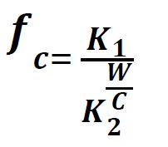
Some Factors affecting strength of concrete
Water/cement ratio
When concrete is fully compacted, its strength is taken to be inversely proportional to the water/cement ratio. This relation was preceded by a so-called law, but really a rule, established by Duff Abrams in 1919. He found strength to be equal to:
The W/C represents the water/cement ratio of the mix (originally taken by volume), and K1 and K2, are empirical constants. The general form of the strength versus water/cement ratio curve is shown in the following Fig.:

Slide 13
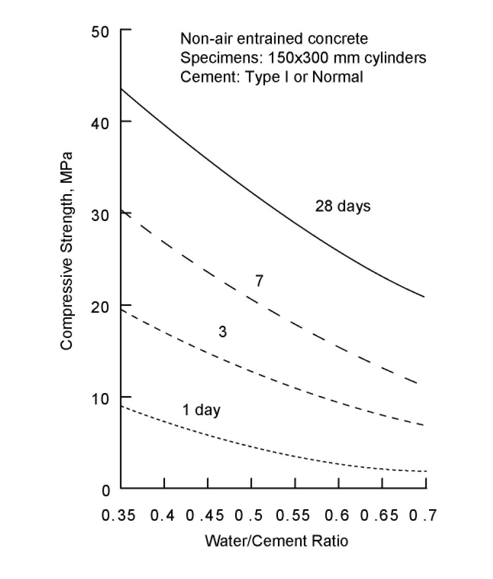

Slide 14
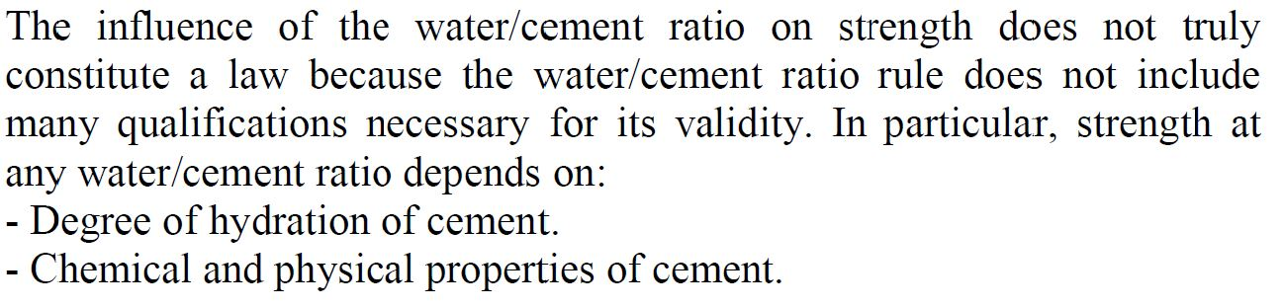
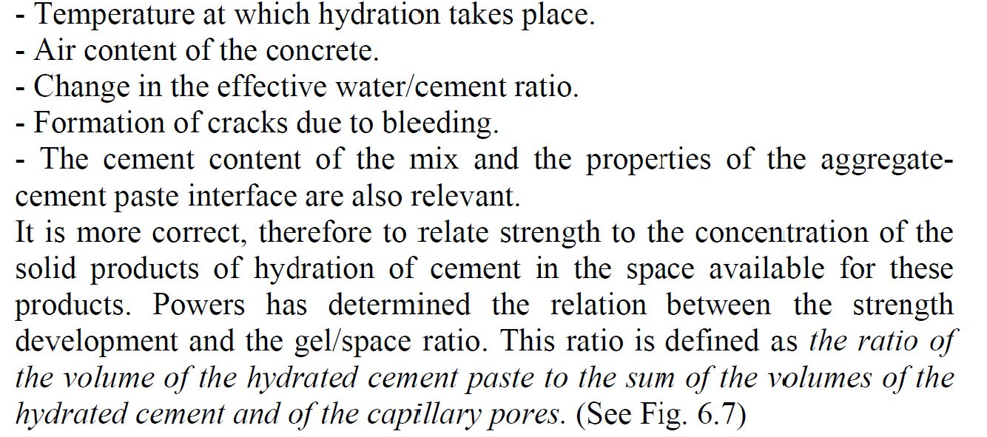
2. Gel/space ratio

Slide 15
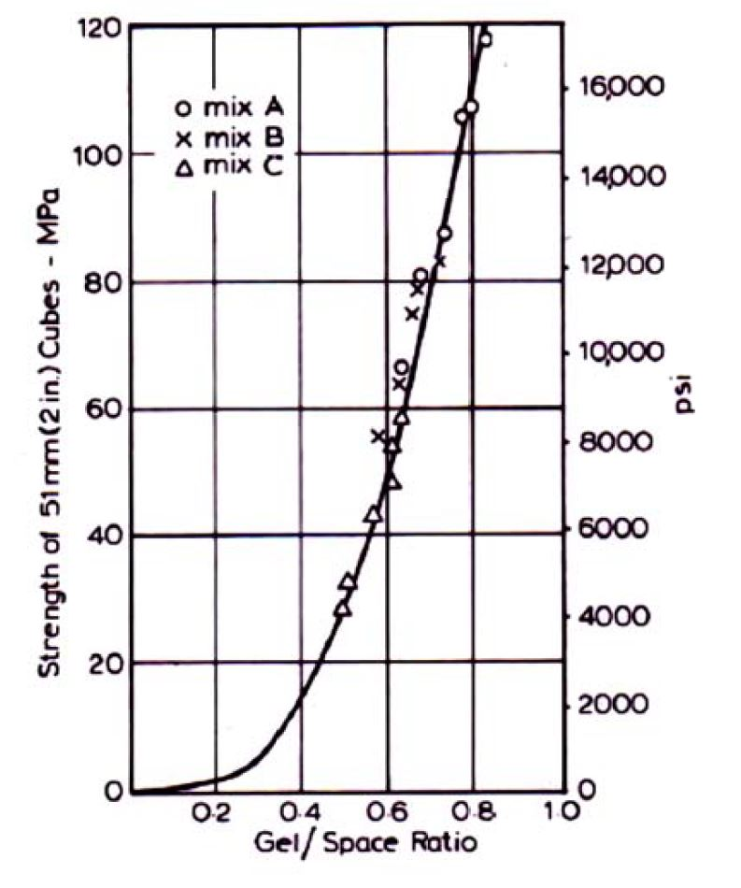

Slide 16
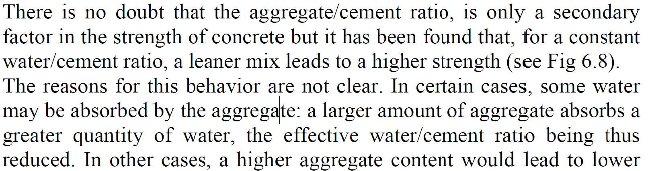
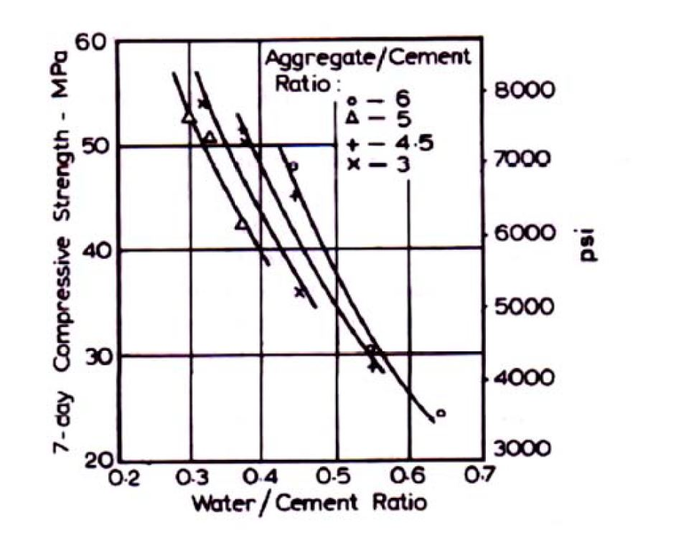
3. Aggregate/cement ratio

Slide 17


4. Effect of age
In concrete practice, the strength of concrete is traditionally characterized by the 28-day value, and some other properties of concrete are often referred to the 28-day strength. If, for some reason, the 28-day strength is to be estimated from the strength determined at an earlier age, say 7 days, then the relation between the 28-day and the 7-day strengths has to be established experimentally for the given mix. Anyway, the following relations could be used as rough estimations only:

