Slide 1
Concrete 4
Department of Architectural Engineering/2nd stage
Dr. Zaid Al Hamdany

Slide 2
Concrete Formworks
What is Formwork?
Formwork is a mould including all supporting structures, used to shape and support the concrete until it attains sufficient strength to carry its own weight.
It should be capable of carrying all imposed dead and live loads apart from its own weight.
Formwork is commonly made of
Steel
Timber

Slide 3
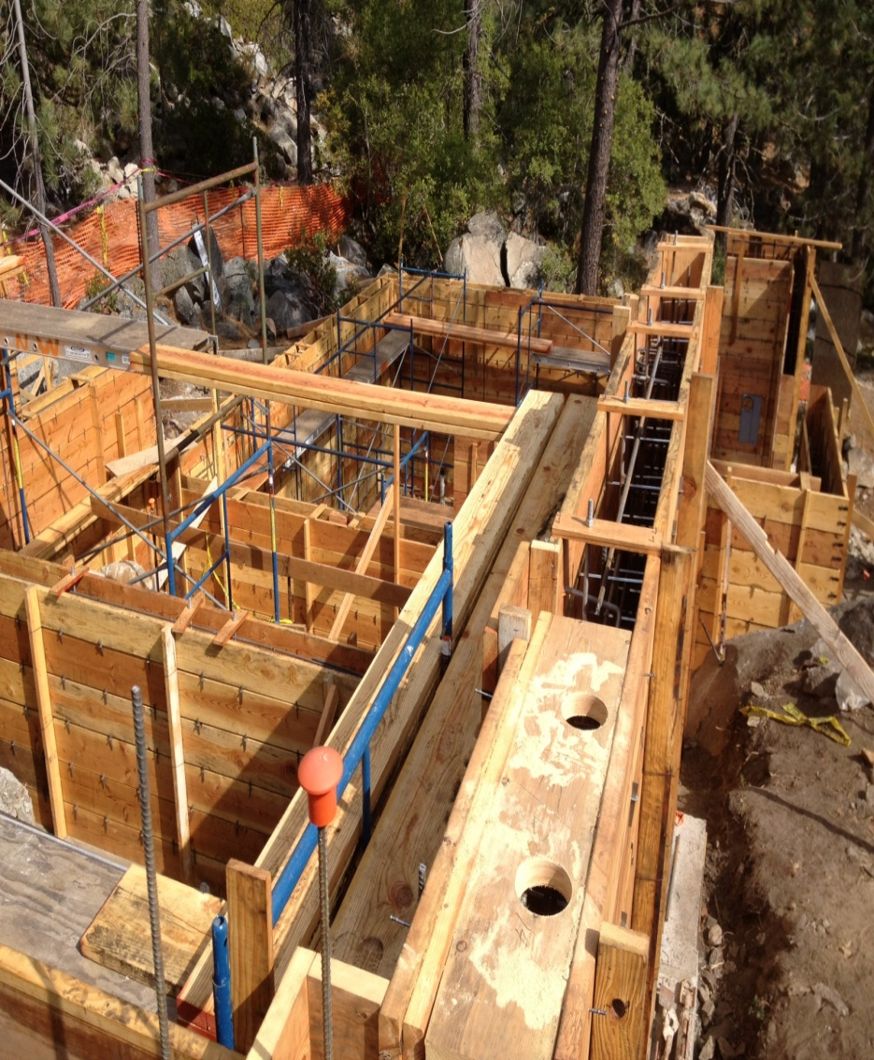
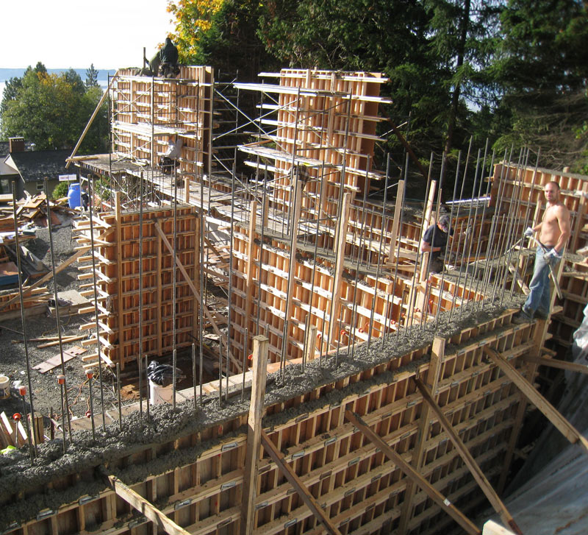
TIMBER FORMWORK

Slide 4
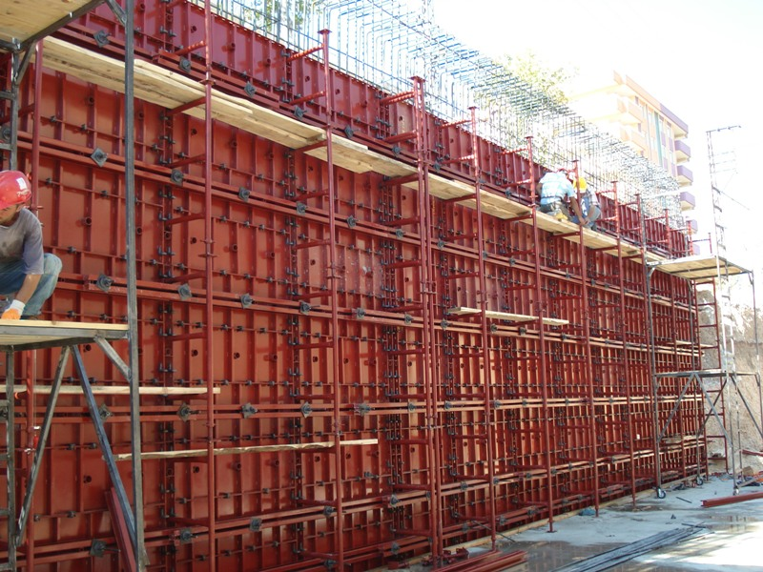
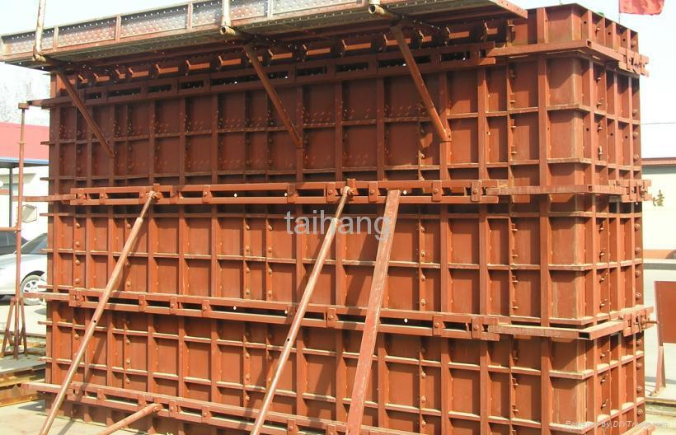
STEEL FORMWORK

Slide 5
Formwork has been in use since the beginning of concrete construction.
New materials such as steel, plastics and fibreglass are used in formwork.
Greater attention is being given to the design, fabrication, erection and dismantling of formwork
Formwork is designed according to The ACI Code
Qualities of Formwork
It should be water tight.
It should be strong.
It can be reusable.
Its contact surface should be uniform.
It should be according to the size of member.

Slide 6
In order to successfully carry out its function, formwork must achieve a balance of following requirements:
Containment
Strength
Resistance To Leakage
Accuracy
Ease Of Handling
Finish And Reuse Potential
Access For Concrete
Economy
Containment: formwork must be capable of shaping and supporting the fluid concrete until it cures.
Strength: formwork must be capable of safely withstanding without distortion or danger the dead weight of the fluid concrete is placed on it, labour weight, equipment weight and any environmental loadings.

Slide 7
Ease of Handling: form panels and units should be designed so that their maximum size does not exceed that which can be easily handled by hand or mechanical means.
In addition all formwork must also be designed and constructed to include facilities for adjustments, levelling, easing and striking without damage to the form work or concrete.
Economy: all the formwork is very expensive. On average about 35% of the total cost of any finished concrete unit or element can be attributed to its formwork; of this just over 40% can be taken for material for formwork and 60% for labour.
The formwork designer must therefore not only consider the maximum number of times that any form can be reused, but also produce a design that will minimize the time taken for erection and striking.

Slide 8
Major objectives considered in formwork: 1. Quality: Forms must be designed and built with sufficient stiffness and accuracy so that the size, shape, position, and finish of the cast concrete are maintained. 2. Safety: Forms must be built sufficient strength and factor of safety so that they have the capable of all supporting loads. 3. Economy: Forms must be built efficiently, minimizing time and cost.

Slide 9
Formwork requirements
Material should be cheap and reusable
It should be practically water proof, so that it should not absorb water from concrete
Swelling and shrinkage should be minimum
Strong enough to withstand all external loads
Deflection should be minimum
Surface should be smooth, and afford easy striping
Light in weight, so that easy to transfer
Joints should be stiff, so that lateral deformation and leak is minimum

Slide 10
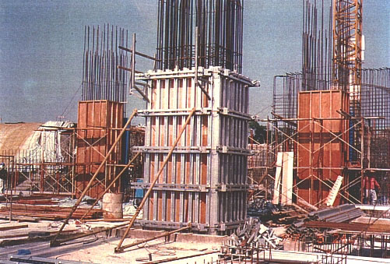

Three stages in the formwork process should be accomplished:
Assembly and erection .
Concrete placement.
Stripping and dismantling.

Slide 11
Formwork detail for different structural members
In concrete construction formwork is commonly provided for the following structural members.
Wall
Column
Slabs & Beams
Stairs
Chimneys
Water tanks
Towers

Slide 12
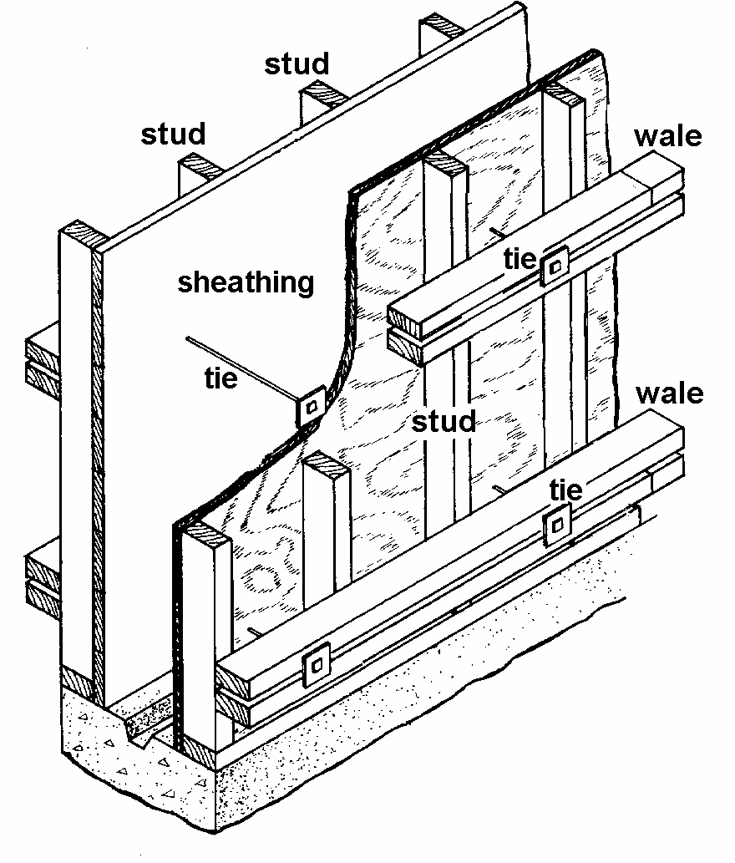
7. Form Work
Formwork for Wall
It consists of
Timber sheeting
Vertical posts (Stud)
Horizontal members (Wales)
Ties
After completing one side of formwork reinforcement is provided at the place then the second side formwork is provided.

Slide 13
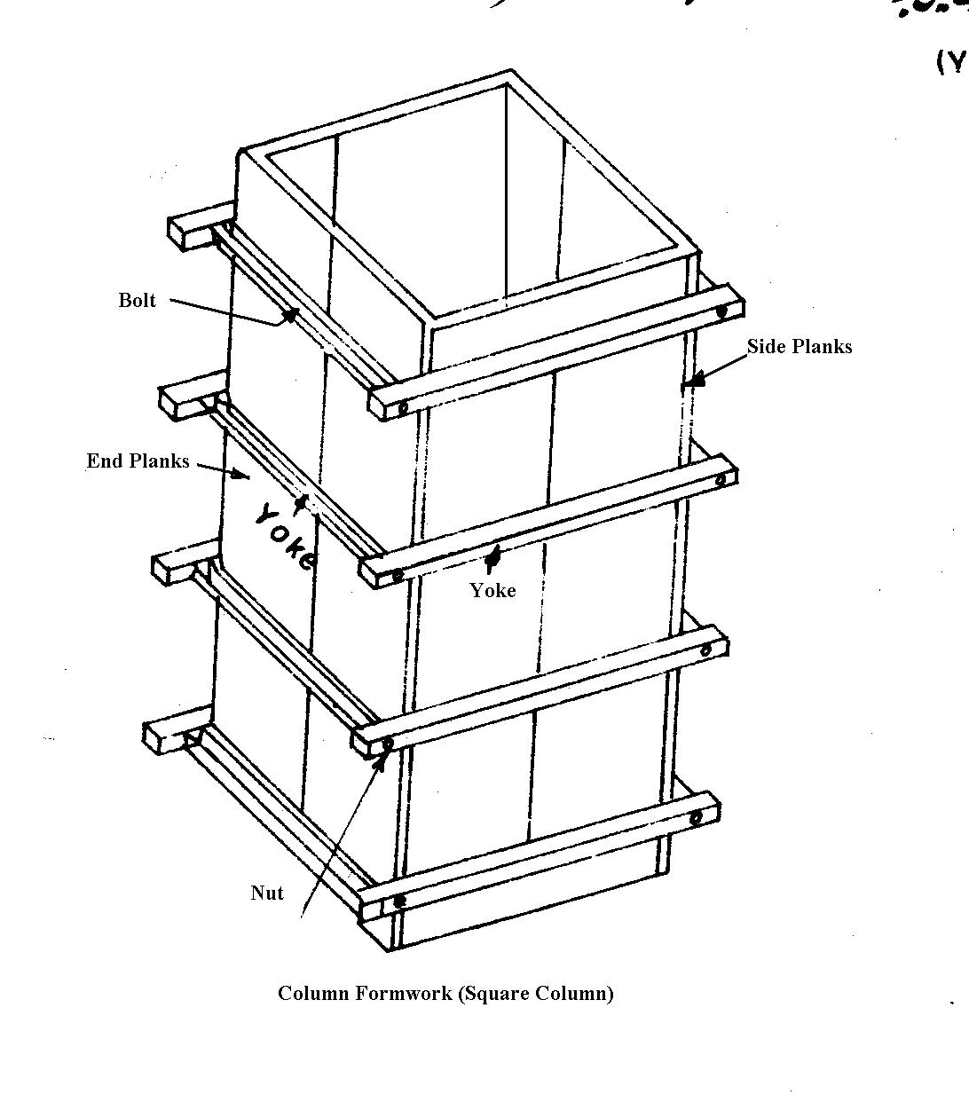
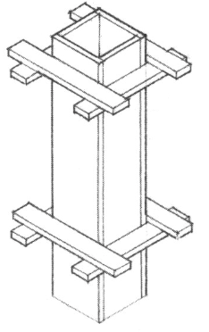
Formwork for Column
It consists of the following
Side & End Planks
Yoke
Nut & Bolts
Two end & two side planks are joined by the yokes and bolts.

Slide 14
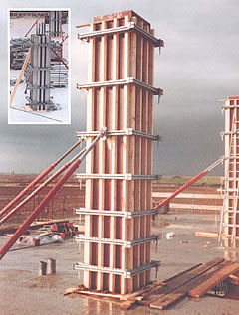
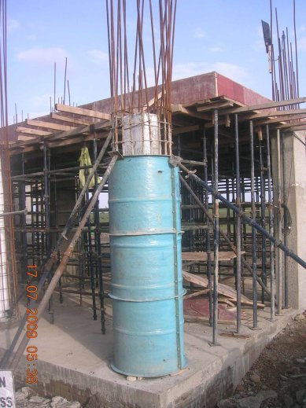
Formwork for columns

Slide 15
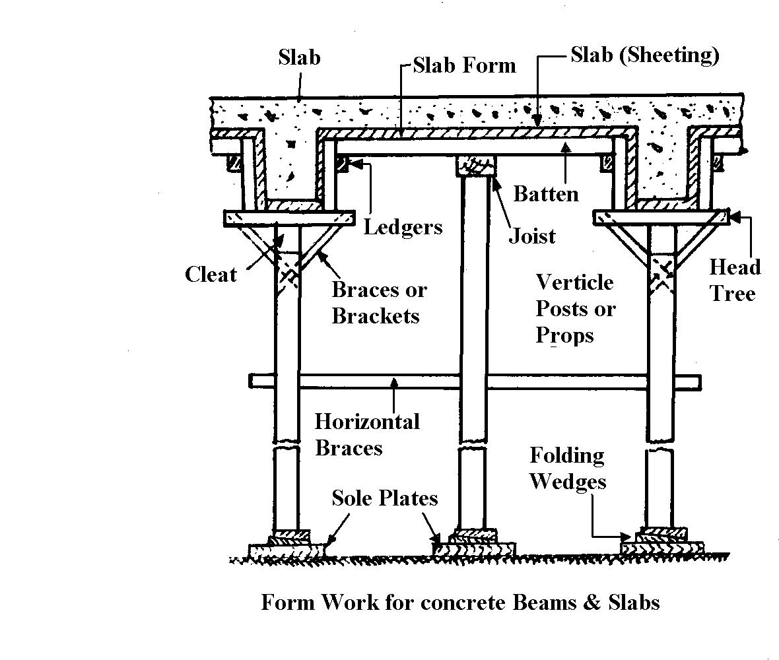
7. Form Work
Formwork for Slabs & beams:
It consists of
Sole plates
Wedges
Props (shores)
Head tree
Planks
Batten (joist)
Ledgers
Beam formwork rests on head tree
Slab form work rests on battens and joists
If prop height are more than 8 feet provide horizontal braces.

Slide 16
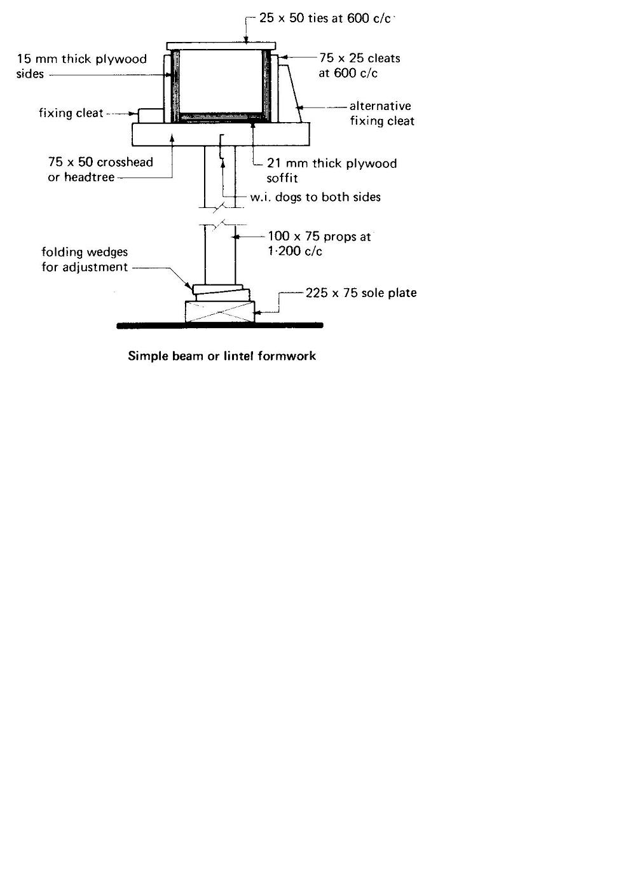
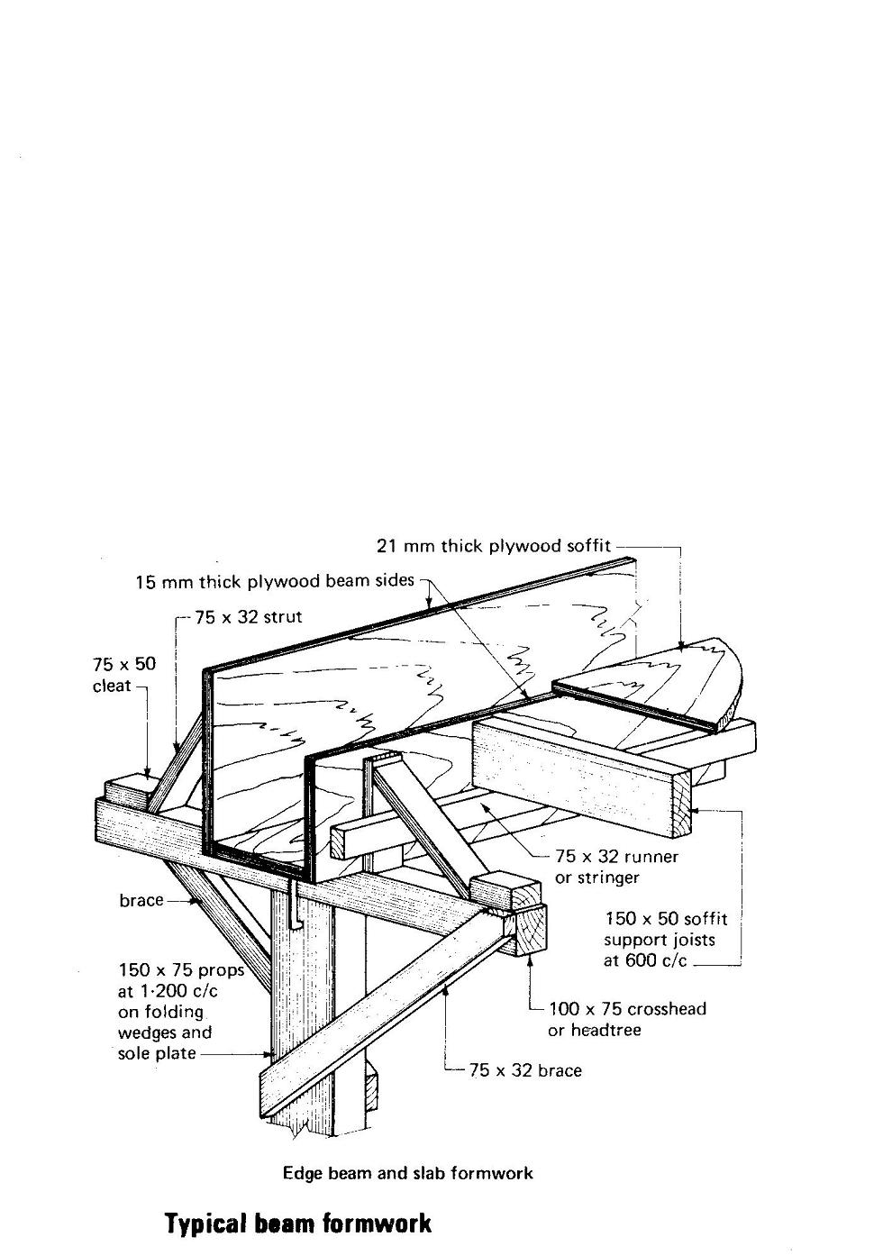
7. Form Work
Lintel or Beam Formwork:

Slide 17
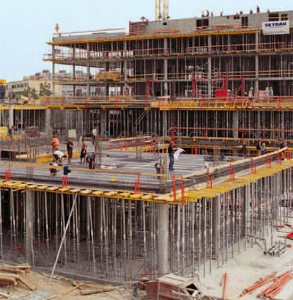
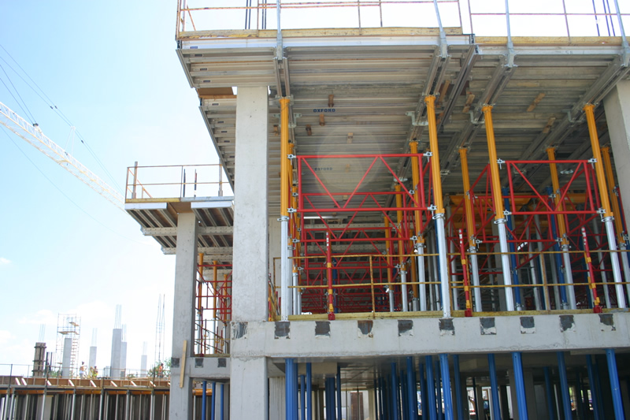
7. Form Work
Formwork of the Slab

Slide 18
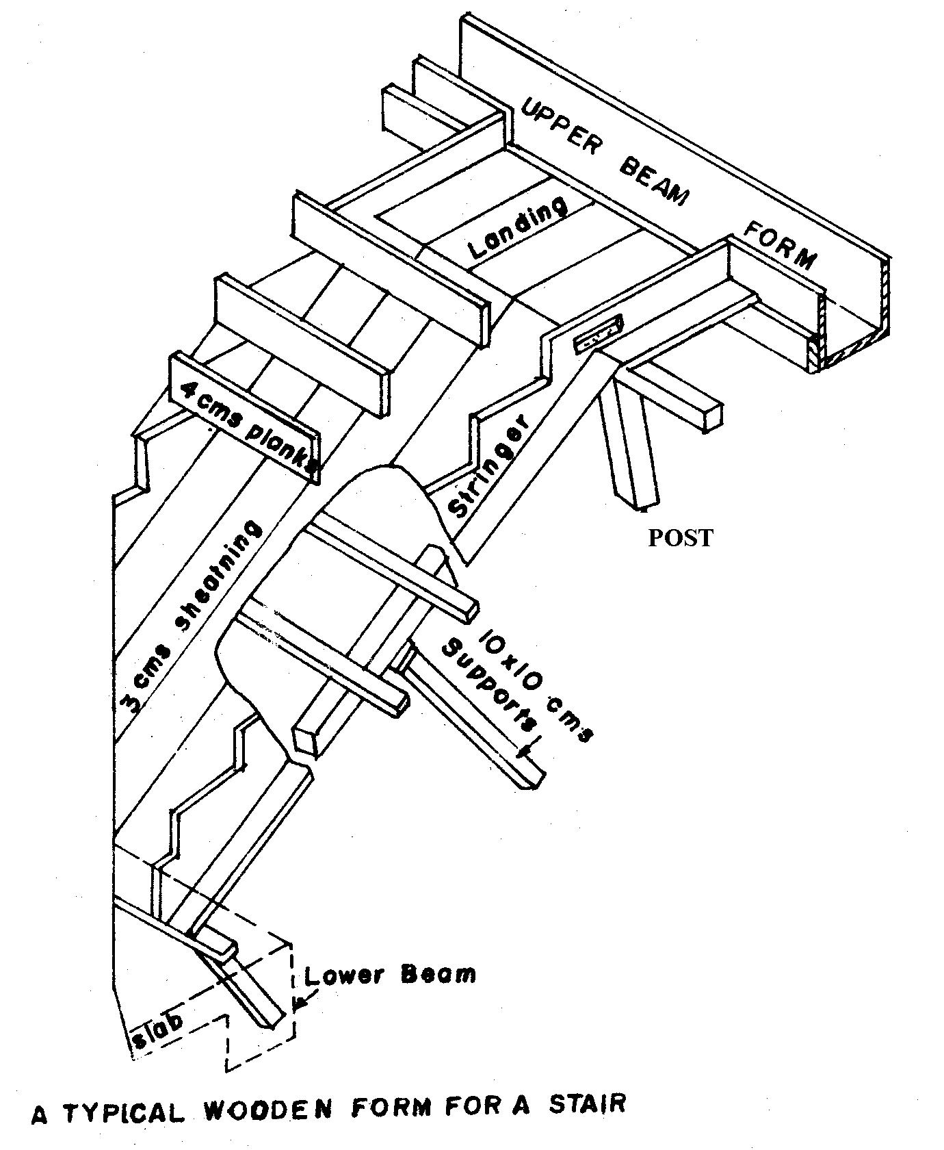
7. Form Work
Formwork of Stairs:
It consists of
Vertical & inclined posts
Inclined members
- Wooden Planks or sheeting
Stringer
Riser Planks

Slide 19
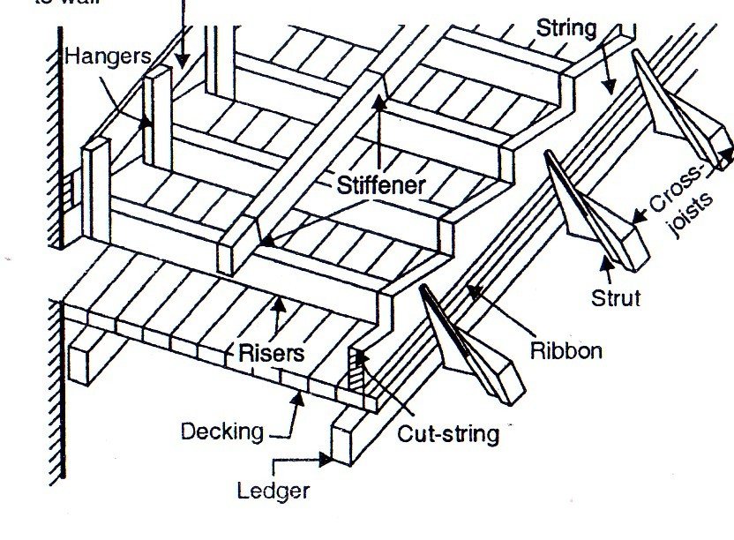
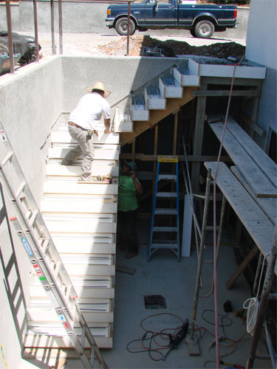
7. Form Work
Formwork of Stairs:

Slide 20
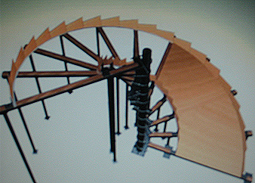
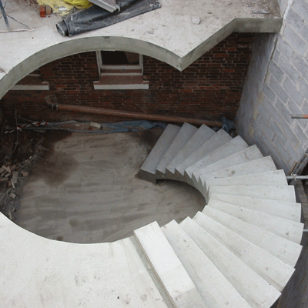
7. Form Work
Formwork of SPIRAL STAIRS :

