Slide 1
Concrete 3
Department of Architectural Engineering/2nd stage
Dr. Zaid Al Hamdany

Slide 2
Fresh concrete or plastic concrete is a freshly mixed material which can be moulded into any shape . The relative quantities of cement, aggregates and water mixed together, control the properties of concrete in the wet state as well as in the hardened state.
Workability To enable the concrete to be fully compacted with given efforts, normally a higher water/ cement ratio than that calculated by theoretical considerations may be required. That is to say the function of water is also to lubricate the concrete so that the concrete can be compacted with specified effort forthcoming at the site of work. The lubrication required for handling concrete without segregation, for placing without loss of homogeneity, for compacting with the amount of efforts forth-coming and to finish it sufficiently easily, the presence of a certain quantity of water is of vital importance.

Slide 3
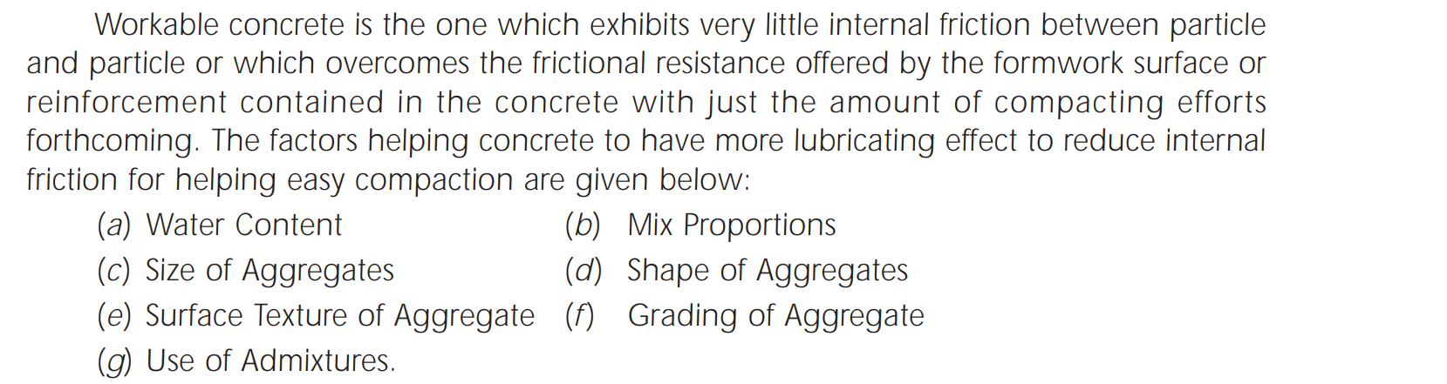
Factors affecting Workability

Slide 4
Measurement of Workability
Slump Test
lump test is the most commonly used method of measuring consistency of concrete which can be employed either in laboratory or at site of work. It is not a suitable method for very wet or very dry concrete. It does not measure all factors contributing to workability, nor is it always representative of the placability of the concrete. However, it is used conveniently as a control test and gives an indication of the uniformity of concrete from batch to batch. Repeated batches of the same mix, brought to the same slump, will have the same water content and water cement ratio, provided the weights of aggregate, cement and admixtures are uniform and aggregate grading is within acceptable limits.

Slide 5
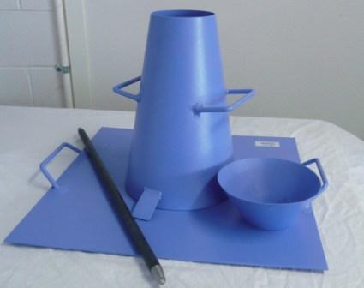
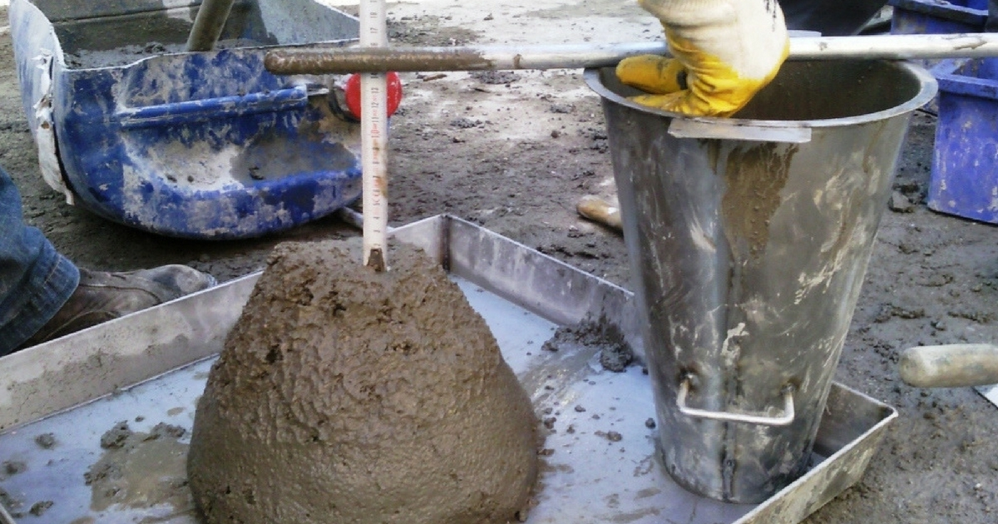

Slide 6
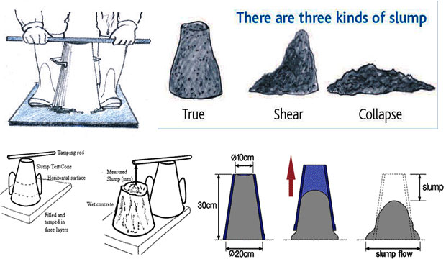
Types of Slump

Slide 7

Process of Manufacture of Concrete Production of quality concrete requires meticulous care exercised at every stage of manufacture of concrete. It is interesting to note that the ingredients of good concrete and bad concrete are the same. If meticulous care is not exercised, and good rules are not observed, the resultant concrete is going to be of bad quality. With the same material if intense care is taken to exercise control at every stage, it will result in good concrete. Therefore, it is necessary for us to know what are the good rules to be followed in each stage of manufacture of concrete for producing good quality concrete. The various stages of manufacture of concrete are:

Slide 8
Batching:
The measurement of materials for making concrete is known as batching.
b) Mixing
Thorough mixing of the materials is essential for the production of uniform concrete. The mixing should ensure that the mass becomes homogeneous, uniform in colour and consistency. There are two methods adopted for mixing concrete: Hand Mixing: Hand mixing is practiced for small scale unimportant concrete works. As the mixing cannot be thorough and efficient, it is desirable to add 10 per cent more cement to cater for the inferior concrete produced by this method.

Slide 9
Hand mixing should be done over an impervious concrete or brick floor of sufficiently large size to take one bag of cement. Spread out the measured quantity of coarse aggregate and fine aggregate in alternate layers. Pour the cement on the top of it, and mix them dry by shovel, turning the mixture over and over again until uniformity of colour is achieved. This uniform mixture is spread out in thickness of about 20 cm. Water is taken in a water-can fitted with a rose-head and sprinkled over the mixture and simultaneously turned over. This operation is continued till such time a good uniform, homogeneous concrete is obtained.
Machine Mixing: Mixing of concrete is almost invariably carried out by machine, for reinforced concrete work and for medium or large scale mass concrete work. Machine mixing is not only efficient, but also economical, when the quantity of concrete to be produced is large.

Slide 10
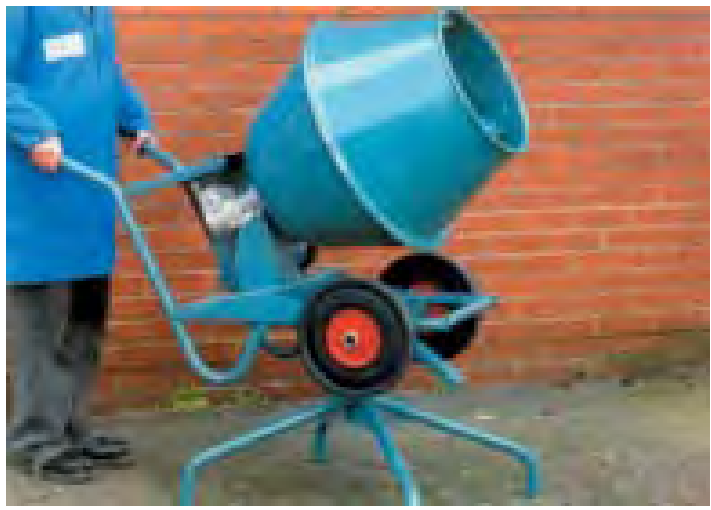

Slide 11
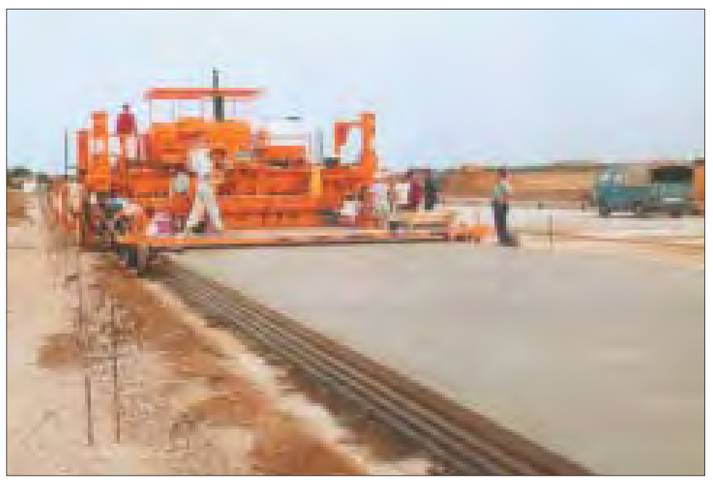
c) Transporting. Concrete can be transported by a variety of methods and equipments. The precaution to be taken while transporting concrete is that the homogeneity obtained at the time of mixing should be maintained while being transported to the final place of deposition.
d) Placing. It is not enough that a concrete mix correctly designed, batched, mixed and transported, it is of utmost importance that the concrete must be placed in systematic manner to yield optimum results.

Slide 12
Concrete is invariably laid as foundation bed below the walls or columns. Before placing the concrete in the foundation, all the loose earth must be removed from the bed. Any root of trees passing through the foundation must be cut, charred or tarred effectively to prevent its further growth and piercing the concrete at a later date. The surface of the earth, if dry, must be just made damp so that the earth does not absorb water from concrete.
When concrete is laid in great thickness, as in the case of concrete raft for a high rise building or in the construction of concrete pier or abutment or in the construction of mass concrete dam, concrete is placed in layers. The thickness of layers depends upon the mode of compaction. In reinforced concrete, it is a good practice to place concrete in layers of about 15 to 30 cm thick and in mass concrete, the thickness of layer may vary anything between 35 to 45 cm. Several such layers may be placed in succession to form one lift, provided they follow one another quickly enough to avoid cold joints. The thickness of layer is limited by the method of compaction and size and frequency of vibrator used.

Slide 13
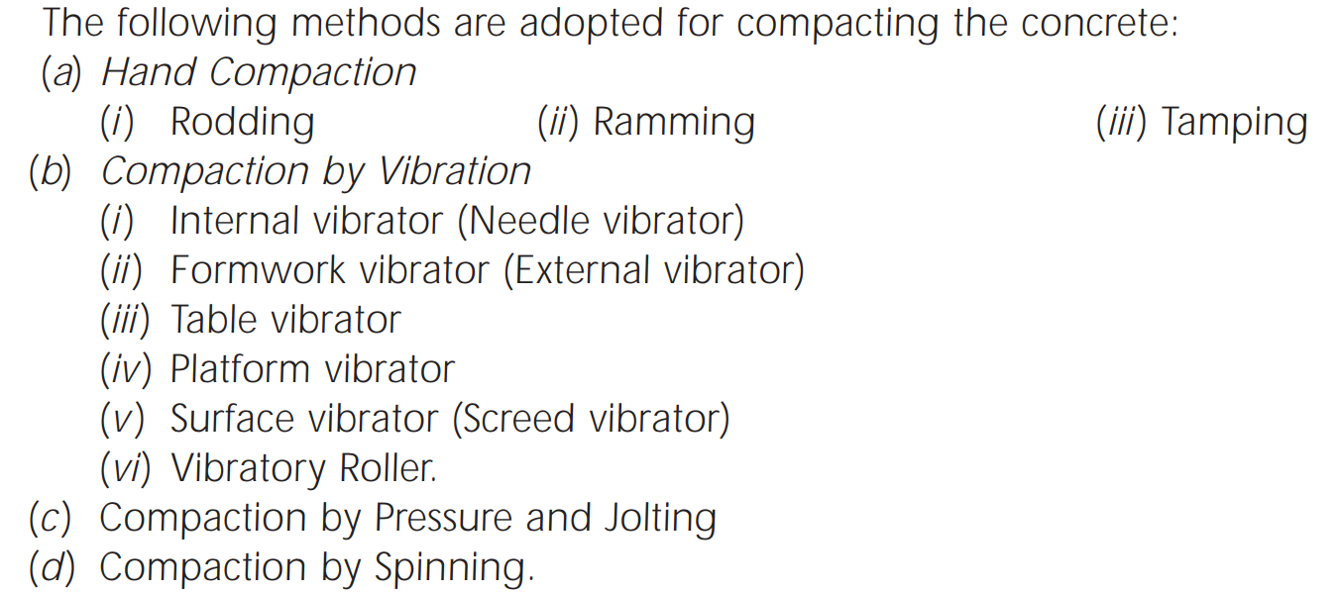
e) Compacting.
Compaction of concrete is the process adopted for expelling the entrapped air from the concrete. In the process of mixing, transporting and placing of concrete air is likely to get entrapped in the concrete. The lower the workability, higher is the amount of air entrapped. In other words, stiff concrete mix has high percentage of entrapped air and, therefore , would need higher compacting efforts than high workable mixes.

Slide 14
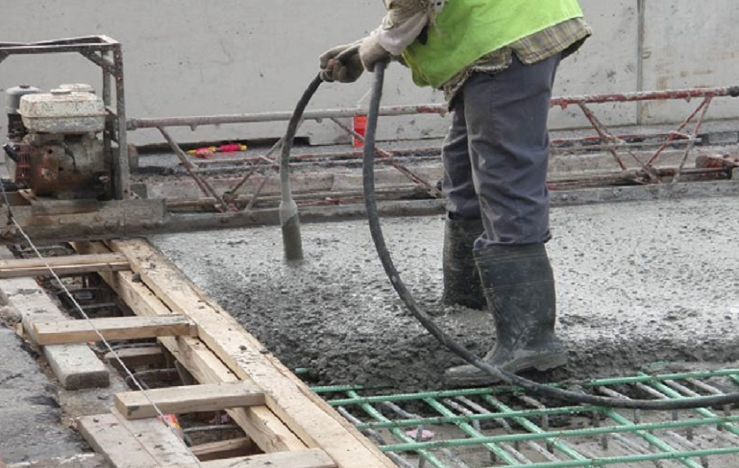

Slide 15
f) curing
A typical definition of curing (BS 8110, 1997) is ‘the process of preventing the loss of moisture from the concrete whilst maintaining a satisfactory temperature regime’. This particular definition adds that the curing regime should prevent the development of high temperature gradients within the concrete.
Many other definitions exist which include references to hydration, durability and cost but there are three basic elements to consider:
• Moisture
• Heat
• Time

Slide 16
Why cure concrete?
According to the British Standard for the structural use of concrete, BS 8110 (1997), the intention of curing is to protect concrete against:
• premature drying out, particularly by solar radiation and wind (plastic shrinkage)
• leaching out by rain and flowing water
• rapid cooling during the first few days after placing
• high internal thermal gradients
• low temperature or frost
• vibration and impact which may disrupt the concrete and interfere with bond to reinforcement.
Adequate curing will facilitate, but not necessarily ensure, the optimal development of the surface zone of fresh, newly cast concrete into strong, impermeable, crack-free and durable-hardened concrete.

Slide 17
CURING METHODS AND MATERIALS
Concrete can be kept moist (and in some cases at a favorable temperature) by three curing methods:
1. Methods that maintain the presence of mixing water in the concrete during the early hardening period. These include ponding or immersion, spraying or fogging, and saturated wet coverings. These methods afford some cooling through evaporation, which is beneficial in hot weather.
2. Methods that reduce the loss of mixing water from the surface of the concrete. This can be done by covering the concrete with impervious paper or plastic sheets, or by applying membrane-forming curing compounds.

Slide 18
3. Methods that accelerate strength gain by supplying heat and additional moisture to the concrete. This is usually accomplished with live steam, heating coils, or electrically heated forms or pads.
The method or combination of methods chosen depends on factors such as availability of curing materials, size, shape, and age of concrete, production facilities (in place or in a plant), esthetic appearance, and economics.

Slide 19
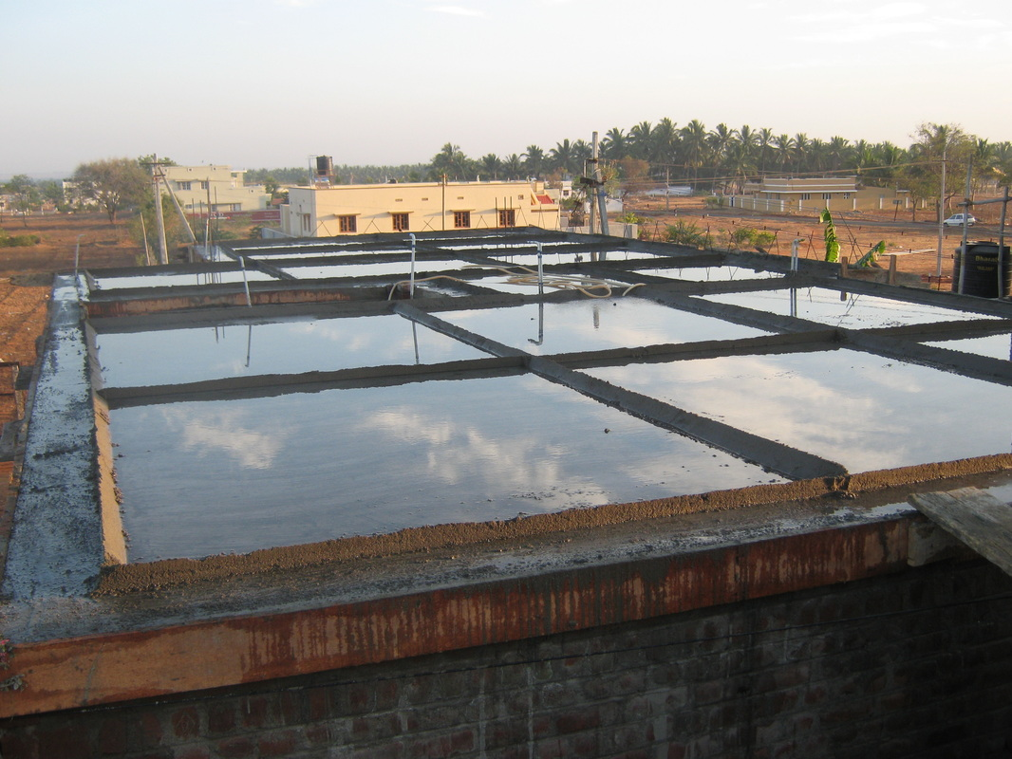
Water pond curing

Slide 20
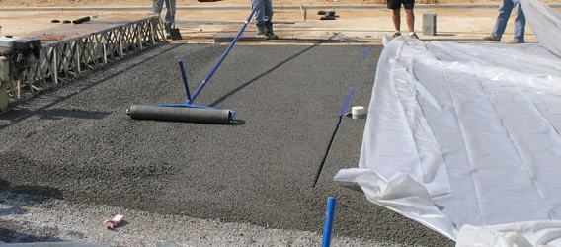
Plastic sheeting curing

Slide 21
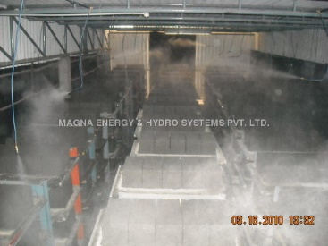
Steam curing

Slide 22
How long should curing be applied?
This depends upon:
• the reason for curing (plastic shrinkage, temperature control, strength, durability, etc.)
• the size of the element
• the type of concrete (especially rate of hardening)
• the ambient conditions during curing
• the exposure conditions to be expected after curing
• the requirements of the specification

Slide 23
The following circumstances warrant particular consideration of curing needs:
• horizontal surfaces
• dry, hot, windy conditions (one or more of these)
• wear-resistant floors
• high-strength concrete (initial curing is especially important)
This list is not exhaustive and curing may still be of great importance in other conditions. Abrasion resistance is particularly dependent on good curing but also relies upon other factors including materials and surface finishing.

Slide 24
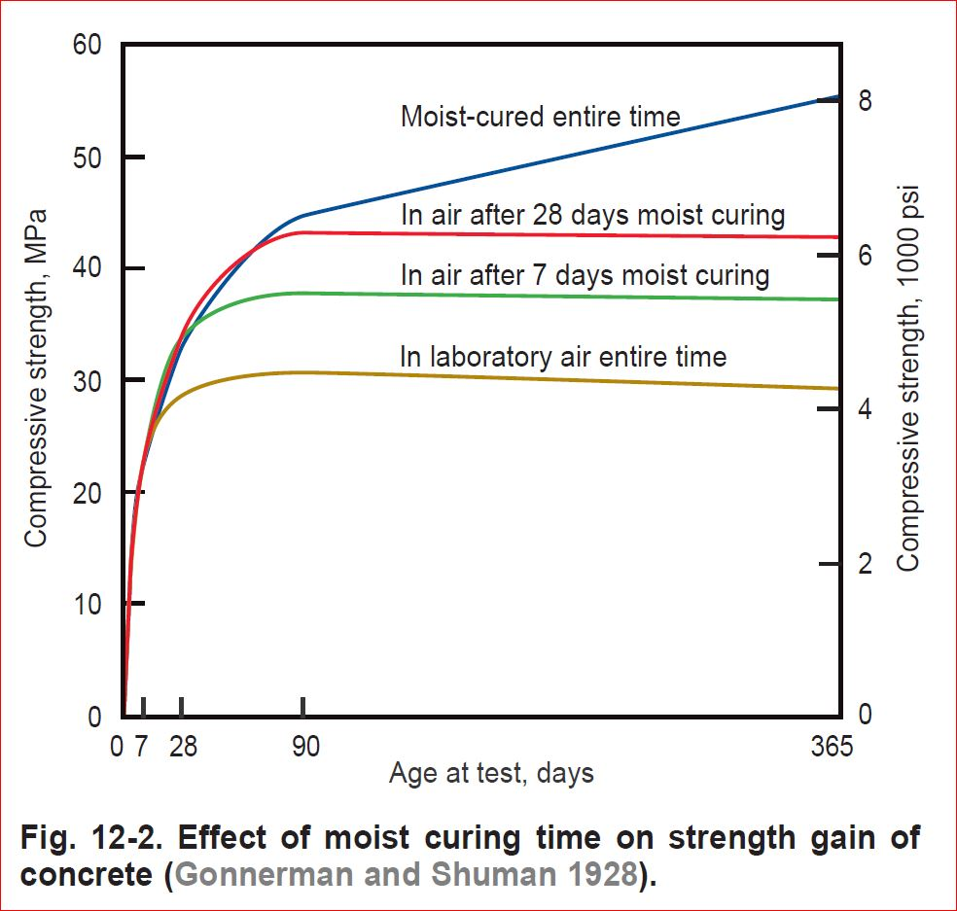
With proper curing, concrete becomes stronger, more impermeable, and more resistant to stress, abrasion, and freezing and thawing. The improvement is rapid at early ages but continues more slowly thereafter for an indefinite period. For example, Fig. below shows the strength gain of concrete with age for different moist curing.

Slide 25
g ) finishing
Finishing operation is the last operation in making concrete. Finishing in real sense does not apply to all concrete operations. For a beam concreting, finishing may not be applicable, whereas for the concrete road pavement, airfield pavement or for the flooring of a domestic building, careful finishing is of great importance. Concrete is often dubbed as a drab material, incapable of offering pleasant architectural appearance and finish. This shortcoming of concrete is being rectified and concretes these days are made to exhibit pleasant surface finishes. Particularly, many types of prefabricated concrete panels used as floor slab or wall unit are made in such a way as to give very attractive architectural affect. Even concrete claddings are made to give attractive look.

