Slide 1
Concrete 2
Department of Architectural Engineering/2nd stage
Dr. Zaid Al Hamdany

Slide 2
Aggregates are the important constituents in concrete. They give body to the concrete, reduce shrinkage and effect economy. The mere fact that the aggregates occupy 70–80 per cent of the volume of concrete, their impact on various characteristics and properties of concrete is undoubtedly considerable. To know more about the concrete it is very essential that one should know more about the aggregates which constitute major volume in concrete. Without the study of the aggregate in depth and range, the study of the concrete is incomplete. Cement is the only factory made standard component in concrete. Other ingredients, namely, water and aggregates are natural materials and can vary to any extent in many of their properties.

Slide 3
Aggregate is relatively inexpensive and does not enter into complex chemical reactions with water; it has been customary, therefore, to treat it as an inert filler in concrete. However, due to increasing awareness of the role played by aggregates in determining many important properties of concrete, the traditional view of the aggregate as an inert filler is being seriously questioned.

Slide 4
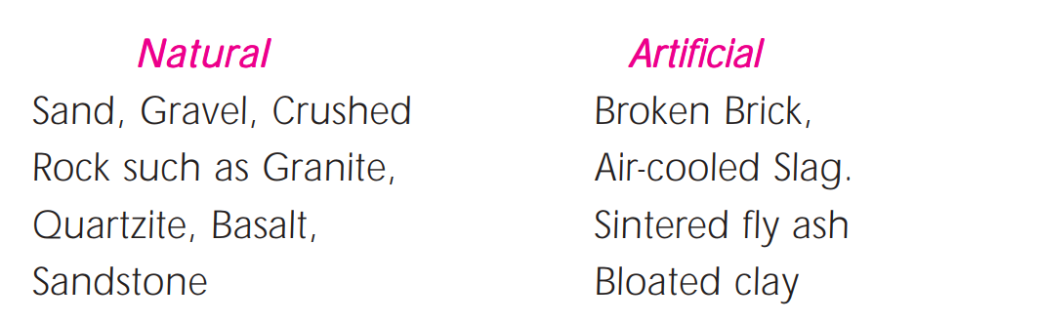
Classification
Aggregates can be classified as
Normal weight aggregates
Light weight aggregates
Heavy weight aggregates.
Normal weight aggregates can be further classified as natural aggregates and artificial aggregates.

Slide 5
Natural aggregates
Natural mineral aggregates form the most important class of aggregates for making portland cement concrete. Approximately half of the total coarse aggregate consumed by the concrete industry in the United States consists of gravel; most of the remainder is crushed rock. Carbonate rocks comprise about two-thirds of the crushed aggregate; sandstone, granite, diorite, gabbro, and basalt make up the rest. Natural silica sand is predominantly used as fine aggregate, even with most lightweight concrete.

Slide 6
Aggregates from Recycled Concert and Municipal Waste (Artificial aggregates)
Rubble from demolished concrete buildings yields fragments in which the aggregate is contaminated with hydrated cement paste, gypsum, and minor quantities of other substances. The size fraction that corresponds to fine aggregate contains large amounts of hydrated cement and gypsum, and it is unsuitable for making fresh concrete mixtures. However, the size fraction that corresponds to coarse aggregate, although coated with cement paste, has been used successfully in several laboratory and field studies. Compared with concrete mixtures containing natural aggregate, the mixtures containing recycled-concrete aggregate generally gave at least two-thirds of the compressive strength and modulus of elasticity, and show satisfactory workability and durability.

Slide 7
Source of aggeragte
Almost all natural aggregate materials originate from bed rocks. There are three kinds of rocks, namely, igneous, sedimentary and metamorphic. These classifications are based on the mode of formation of rocks. It may be recalled that igneous rocks are formed by the cooling of molten magma or lava at the surface of the crest (trap and basalt) or deep beneath the crest (granite). The sedimentary rocks are formed originally below the sea bed and subsequently lifted up. Metamorphic rocks are originally either igneous or sedimentary rocks which are subsequently metamorphosed due to extreme heat and pressure.

Slide 8
Size of aggeragte The largest maximum size of aggregate practicable to handle under a given set of conditions should be used. Perhaps, 80 mm size is the maximum size that could be conveniently used for concrete making. Using the largest possible maximum size will result in (i) reduction of the cement content (ii) reduction in water requirement (iii) reduction of drying shrinkage. However, the maximum size of aggregate that can be used in any given condition may be limited by the following conditions:

Slide 9
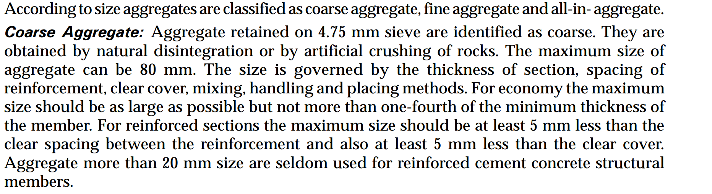
Coarse & Fine Aggregates

Slide 10
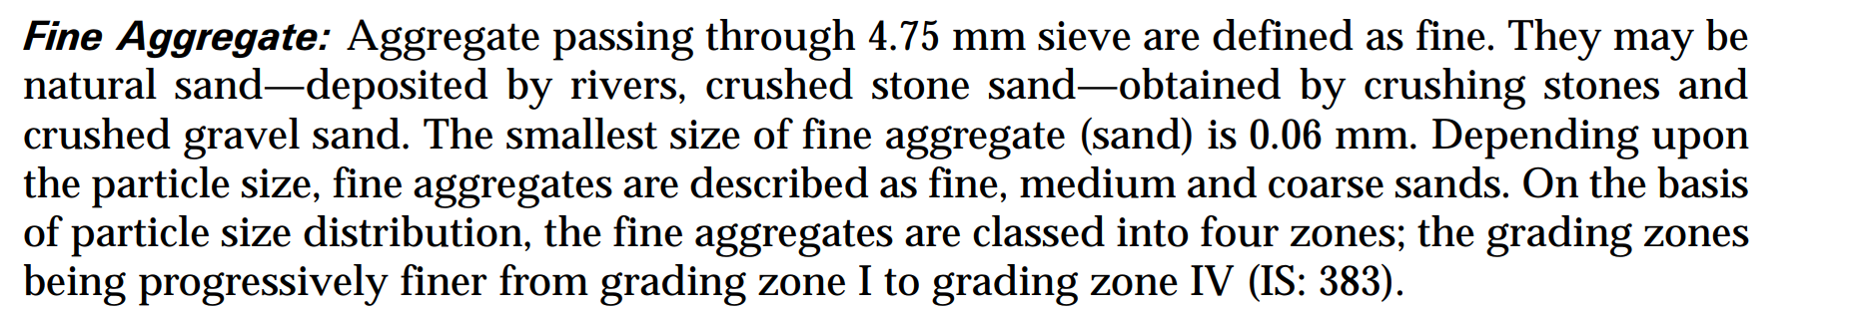

Slide 11
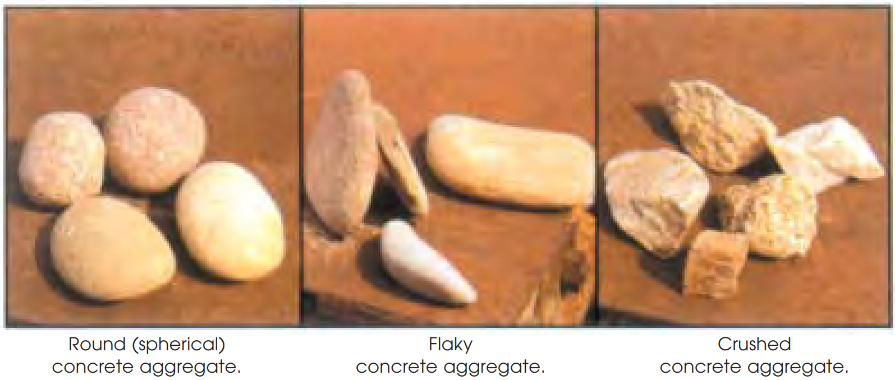
Shape of aggregate
The shape of aggregates is an important characteristic since it affects the workability of concrete. It is difficult to really measure the shape of irregular body like concrete aggregate which are derived from various rocks. Not only the characteristic of the parent rock, but also the type of crusher used will influence the shape of aggregates.

Slide 12
Based on their shape, aggregates can be classified as rounded, irregular, angular, and flaky. Rounded aggregate These are generally obtained from river or sea shore and produce minimum voids (about 32 per cent) in the concrete. They have minimum ratio of surface area to the volume, and the cement paste required is minimum. Poor interlocking bond makes it unsuitable for high strength concrete and pavements.
Irregular aggregate
They have voids about 36 per cent and require more cement paste as compared to rounded aggregate. Because of irregularity in shape they develop good bond and are suitable for making ordinary concrete.

Slide 13
Angular aggregate
They have sharp, angular and rough particles having maximum voids, about 40 per cent. Angular aggregate provide very good bond than the earlier two, are most suitable for high strength concrete and pavements; the requirement of cement paste is relatively more.
Flaky aggregate
These are sometimes wrongly called as elongated aggregate. However, both of these influence the concrete properties adversely. The least lateral dimension of flaky aggregate (thickness) should be less than 0.6 times the mean dimension.

Slide 14
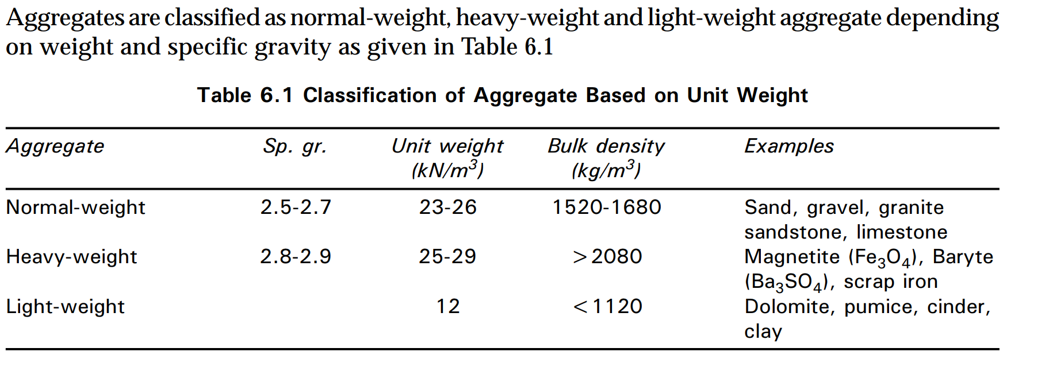
Aggregates units weight.

Slide 15
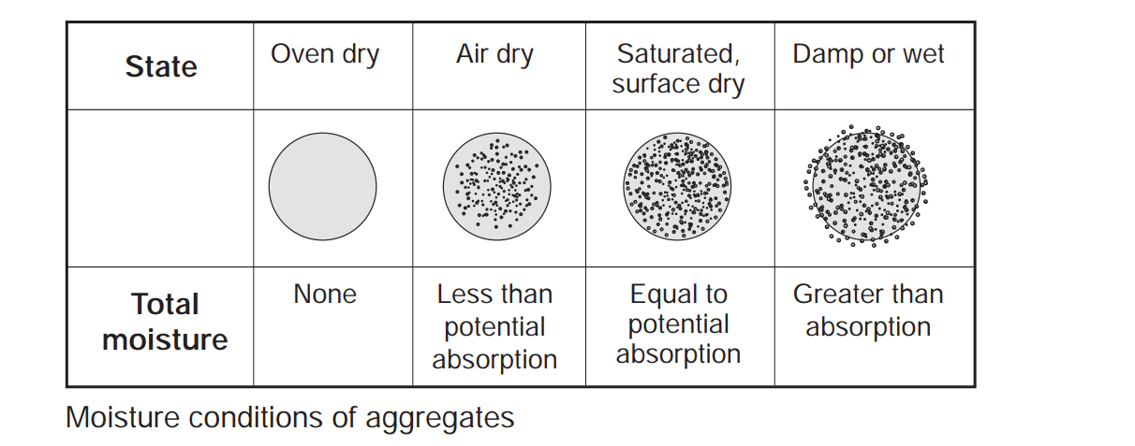
Absorption and surface moisture of aggregates
Various states of moisture absorption in which an aggregate particle can exist are shown in Fig Below:

Slide 16
Soundness of aggregates
An aggregate is considered unsound when the volume changes in aggregate induced by weather (e.g., alternate cycles of wetting and drying, or freezing and thawing), result in the deterioration of concrete. Unsoundness is shown generally by rocks having a certain characteristic pore structure. Concretes containing some cherts, shales, limestones, and sandstones have been found susceptible to damage by frost action or by salt crystallization within the aggregate particle.

Slide 17
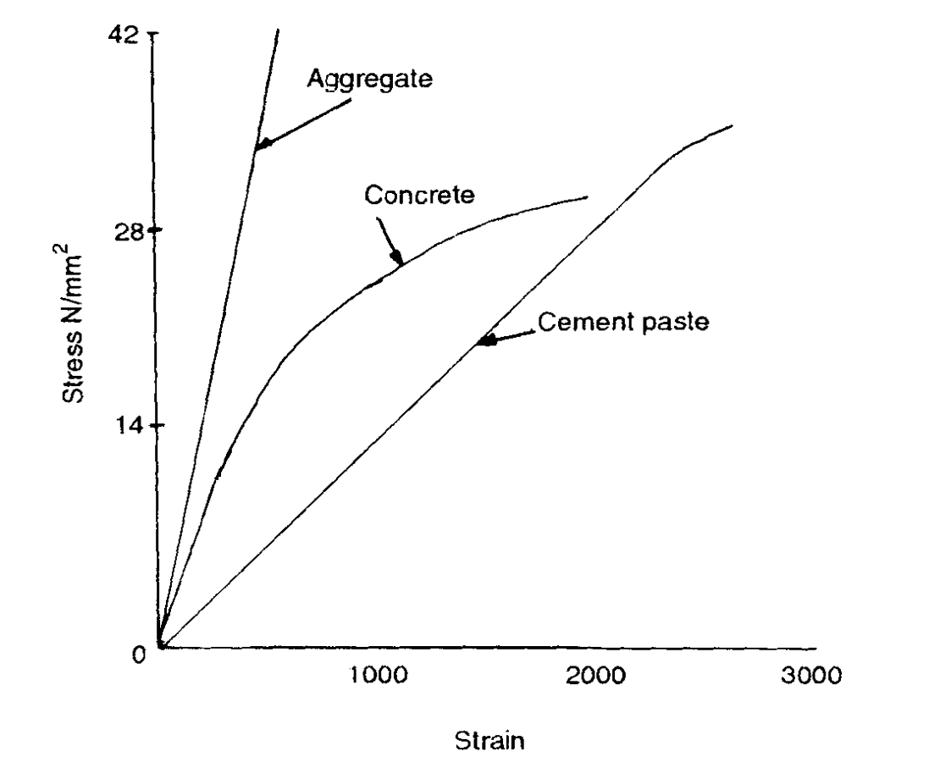
Strength of aggregate
The strength should be at least equal to that of the concrete. Rocks commonly used as aggregates have a compressive strength much higher than the usual range of concrete strength.

Slide 18
Bond Strength of Aggregates
Due to difference between the coefficients of thermal expansion of paste and aggregate and to the shrinkage of cement paste during hardening, concrete is in a state of internal stress even if no external forces are present. It is reported that the stresses are likely to be greatest at the paste-aggregate interfaces where minute cracks exist, even in concrete that has never been loaded. Under increasing external load, these cracks spread along the interfaces before extending into the paste or aggregate particles. The strength of the bond between aggregate and cement paste thus has an important influence on the strength of concrete.

Slide 19
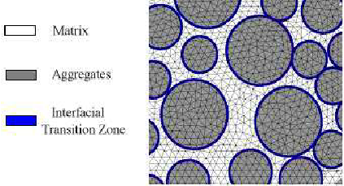
There is no standard test for bond but it is known that the rougher the surface texture of the particles, the better the bond. The role of particle shape is less well understood; the greater specific surface of angular particles should enable greater adhesive force to be developed, but the angular shape probably causes more severe concentrations of internal stress.

