Slide 1
Principal Properties of Building Materials
Department of Architecture /2nd stage
Lecturer: Dr. Zaid Al Hamdany

Slide 2
Introduction
Building materials have an important role to play in this modern age of technology. Although their most important use is in construction activities, no field of engineering is conceivable without their use. Also, the building materials industry is an important contributor in our national economy as its output governs both the rate and the quality of construction work.
Materials engineers are responsible for the selection, specification, and quality control of materials to be used in a job.

Slide 3
These materials must meet certain classes of criteria or materials properties. These classes of criteria include:
economic factors
mechanical properties
non mechanical properties
production/construction considerations
aesthetic properties
Materials most frequently used in construction are summarized in the following figure:

Slide 4
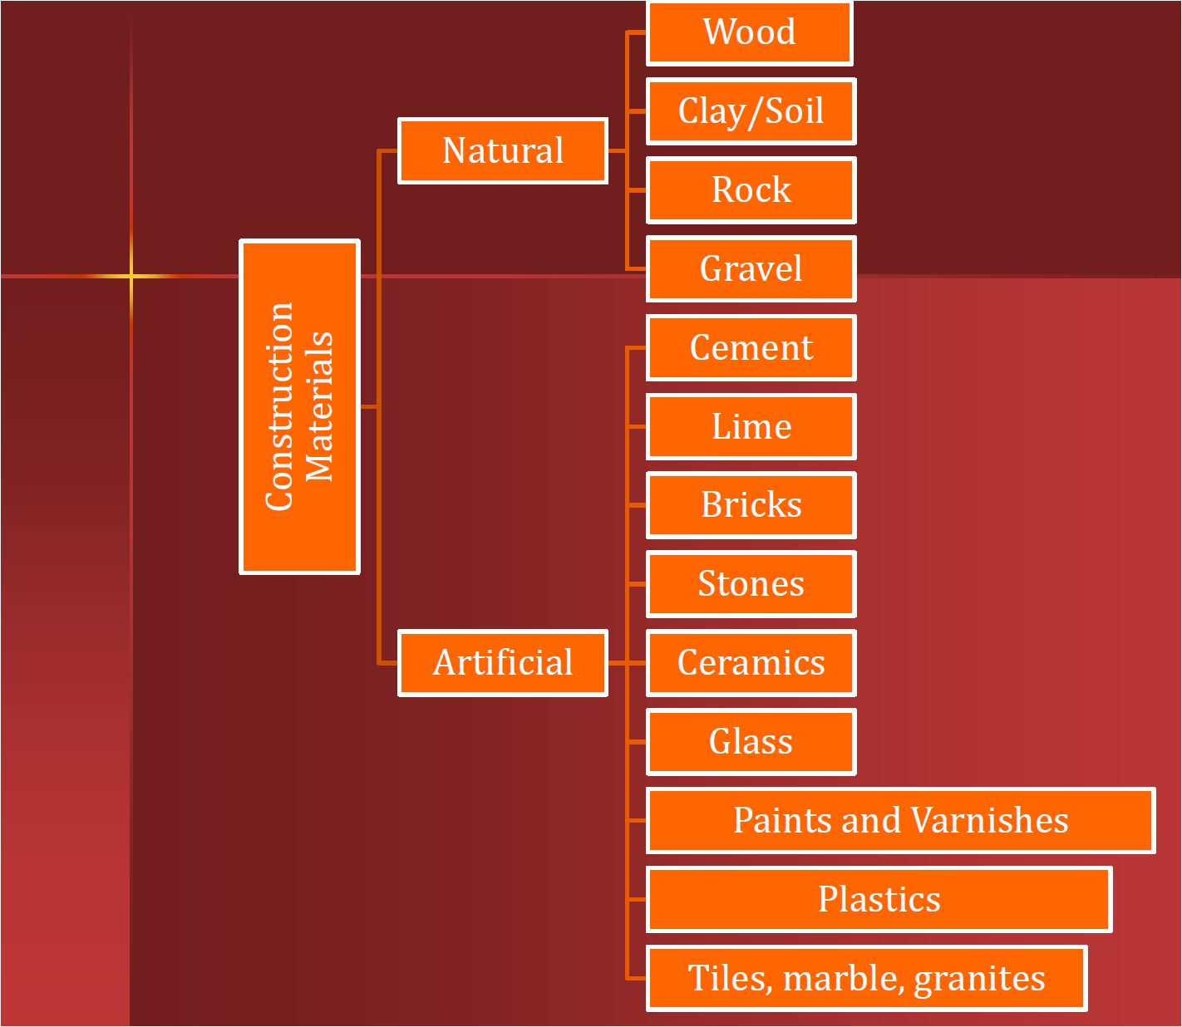

Slide 5
Physical Properties of Materials
Density is a measure of how compact or heavy it is, in a given volume. We measure density in mass per unit volume which is written using measures like grams per milliliter (g/mL), grams per cubic centimeter (g/cm^3), or kilograms per liter (kg/L).
Specific gravity is the ratio between the density of an object, and a reference substance. The specific gravity can tell us, based on its value, if the object will sink or float in our reference substance. Usually our reference substance is water which always has a density of 1 gram per milliliter or 1 gram per cubic centimeter.

Slide 6
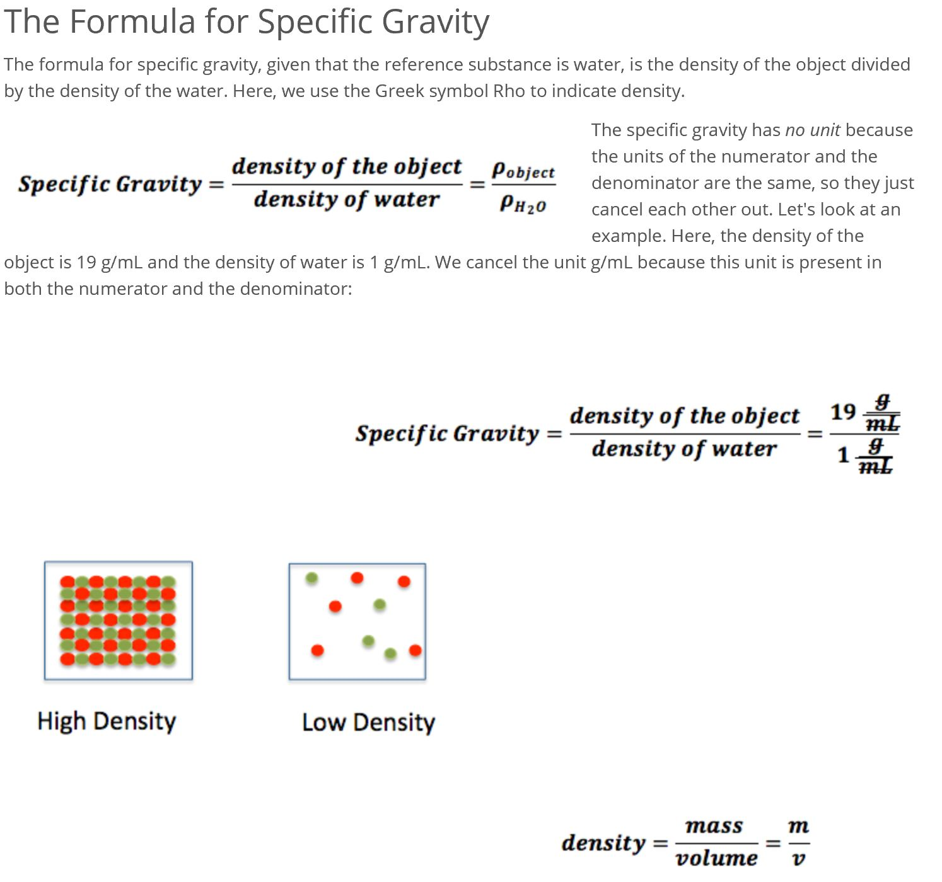

Slide 7
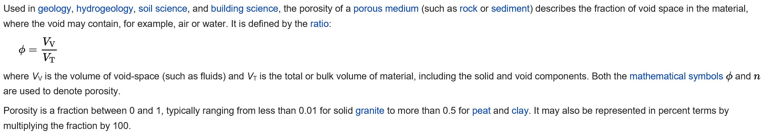
Porosity

Slide 8
Mechanical Properties of Materials
The mechanical behavior of materials is the response of the material to external loads. All materials deform in response to loads; however, the specific response of a material depends on:
its properties
the magnitude and type of load
the geometry of the element
The most common mechanical properties considered are strength, ductility, hardness, impact resistance, and fracture toughness.

Slide 9
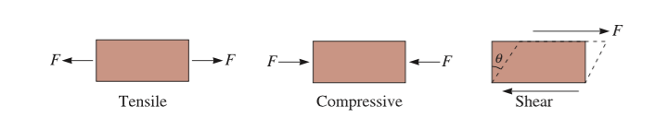
Stress, strain, & stress-strain relation.
All loading on materials can be considered as combinations of three basic types – tension, compression and shear.
There are different types of forces or “stresses” that are encountered in dealing with mechanical properties of materials. In general, we define stress as the force acting per unit area over which the force is applied.

Slide 10
Tensile and compressive stresses are normal stresses. A normal stress arises when the applied force acts perpendicular to the area of interest. Tension causes elongation in the direction of the applied force, whereas compression causes shortening. A shear stress arises when the applied force acts in a direction parallel to the area of interest.
stress=load/area and therefore its dimensions are [Force]/[Length]2. Typical units are N/mm2 (or MPa in the SI system)
Stress(σ)=P/A

Slide 11

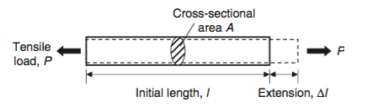
Moreover, dividing the deformation of the material caused by the applied load over the original length is defined as strain of the specimen (i.e., ε= change in length/original length).

Slide 12
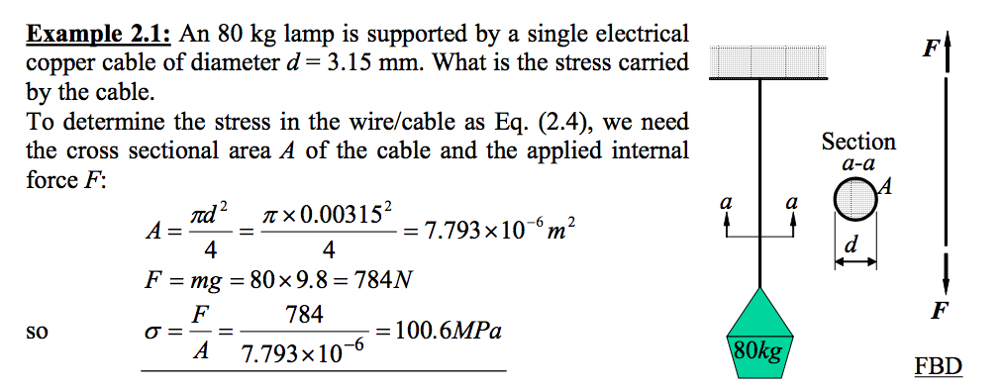

Slide 13
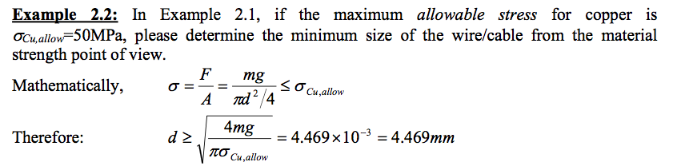
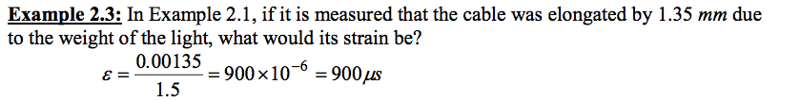

Slide 14
The material strength depends on its ability to sustain a load without undue deformation or failure. The property is inherent in the material itself and must be determined by experiment. One of the most important tests to perform in this regard is the tension or compression. To do so, a bunch of standard specimen is made. The test is performed in universal test machine. The following figure shows the specimen and test result of Stress-Strain Diagram.

Slide 15
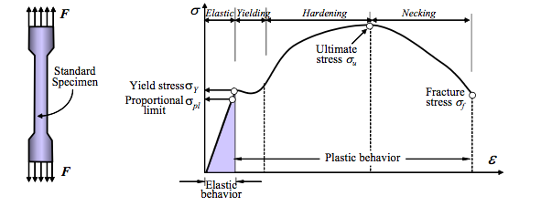
The Stress-Strain diagram consists of 4 stages during the whole process, elastic, yielding, hardening and necking stages respectively.
^{Hooke’s Law}
The stress-strain linear relationship was discovered by Robert Hook in 1676 and is known as Hooke's law. It is mathematically represented by Eq.
σ = Eε

Slide 16
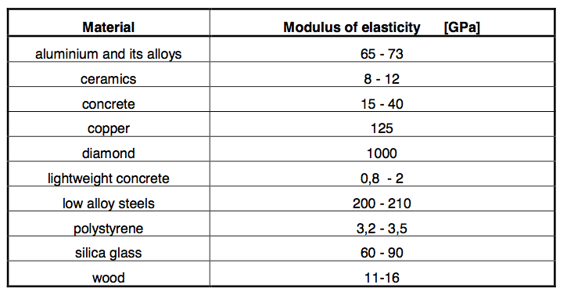
where E is terms as the Modulus of Elasticity or Young's Modulus with units of N/m2 or Pa. For most of engineering metal material, GPa is used, e.g. mild steel is about 200GPa~210GPa. The value of modulus of elasticity for some materials is shown in table below.

Slide 17
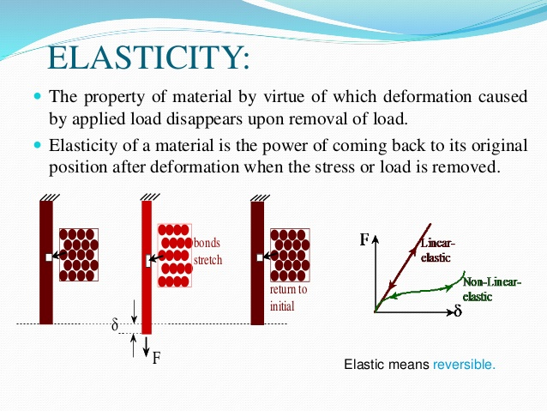

Slide 18
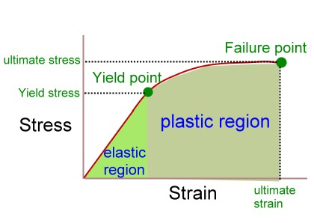
Plasticity is the ability of a material to deform permanently without breaking or rupturing. This property is the opposite of strength.

Slide 19
Brittleness is the opposite of the property of plasticity. A brittle metal is one that breaks or shatters before it deforms. White cast iron and glass are good examples of brittle material.
Ductility is the property that enables a material to stretch, bend, or twist without cracking or breaking. This property makes it possible for a material to be drawn out into a thin wire.

Slide 20
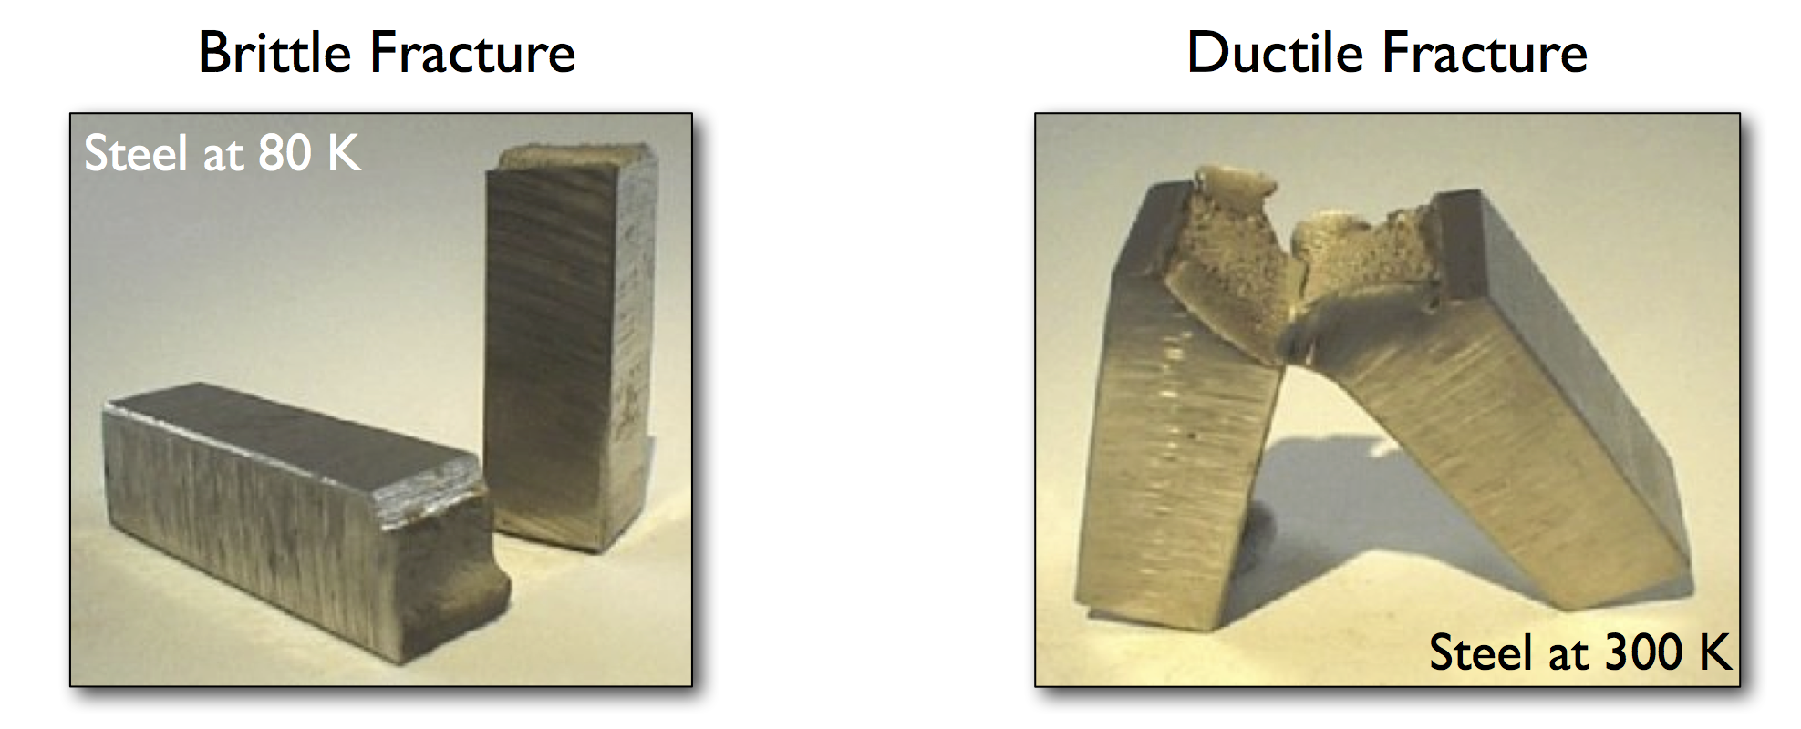

Slide 21
Difference Between Ductility and Brittleness
• Ductility is the ability of a material to withstand tensile force when it is applied upon it as it undergoes plastic deformation.
• Brittleness is the opposite of ductility as it refers to the ability of materials to break into pieces upon application of tensile force without any elongation or plastic deformation.
• Glasses and ceramics are considered brittle whereas gold and silver are ductile materials.
• Ductility allows wires to be drawn of materials.
• Increase in temperature increases ductility while addition of impurities decreases ductility.

Slide 22
Hardness
Hardness is usually defined as the resistance of a material to plastic penetration of its surface. Hardness is a mechanical property, which can be dramatically changed by processing and heat treatment. It can correlate with tensile strength, in the case of many metals, and can be an indicator of wear resistance and ductility.
Scratch tests are the simplest form of hardness tests. In this test, various materials are rated on their ability to scratch one another. Mohs hardness test is of this type. This test is used mainly in mineralogy.

Slide 23
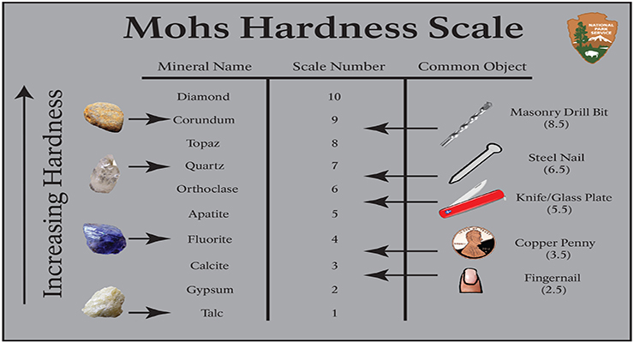

Slide 24
Toughness
Toughness is the property that enables a material to withstand shock and to be deformed without rupturing. Toughness may be considered as a combination of strength and plasticity.
When a material has a load applied to it, the load causes the material to deform. Elasticity is the ability of a material to return to its original shape after the load is removed. Theoretically, the elastic limit of a material is the limit to which a material can be loaded and still recover its original shape after the load is removed.

