Slide 1
Professional Practice Goals and Career Options Interior Design/ 4th Stage
Dr. Zaid Al Hamdany

Slide 2
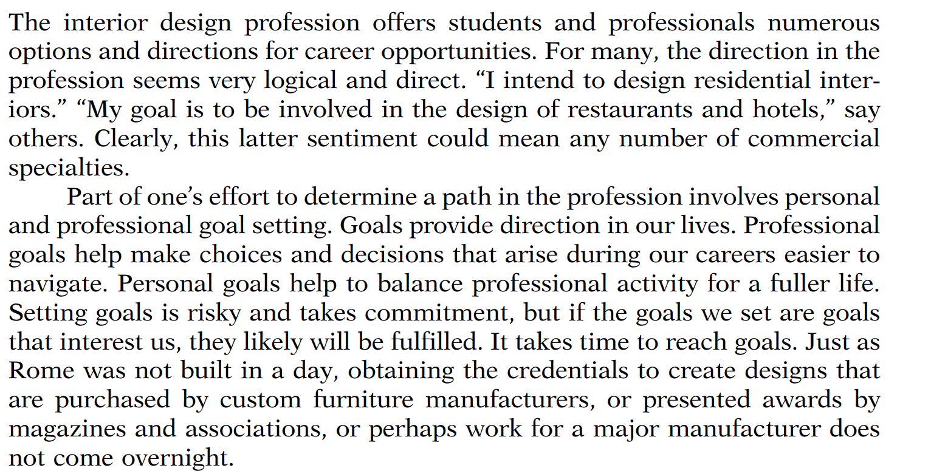

Slide 3
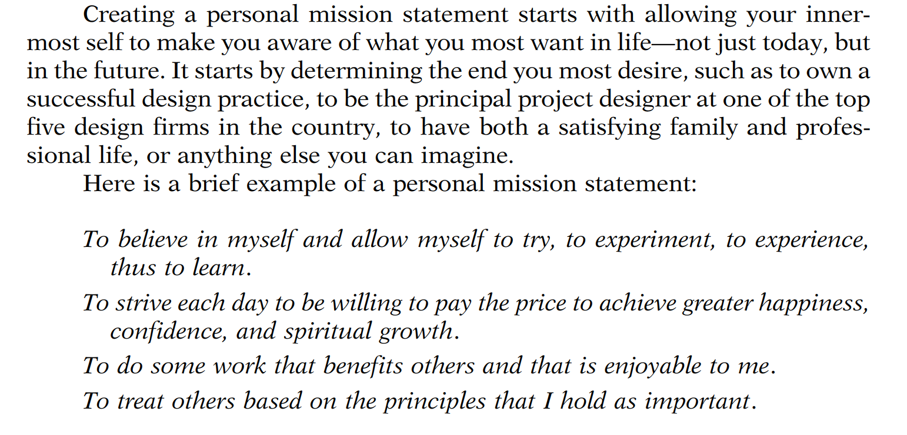
A PERSONAL MISSION STATEMENT

Slide 4
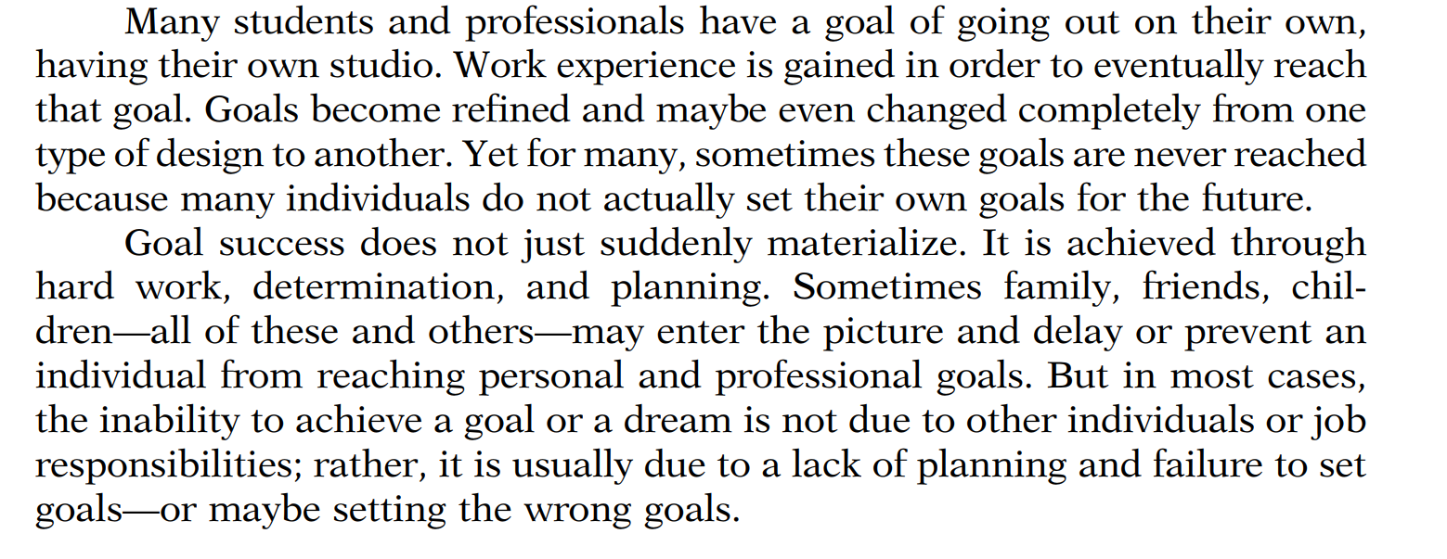
PERSONAL AND PROFESSIONAL GOALS

Slide 5
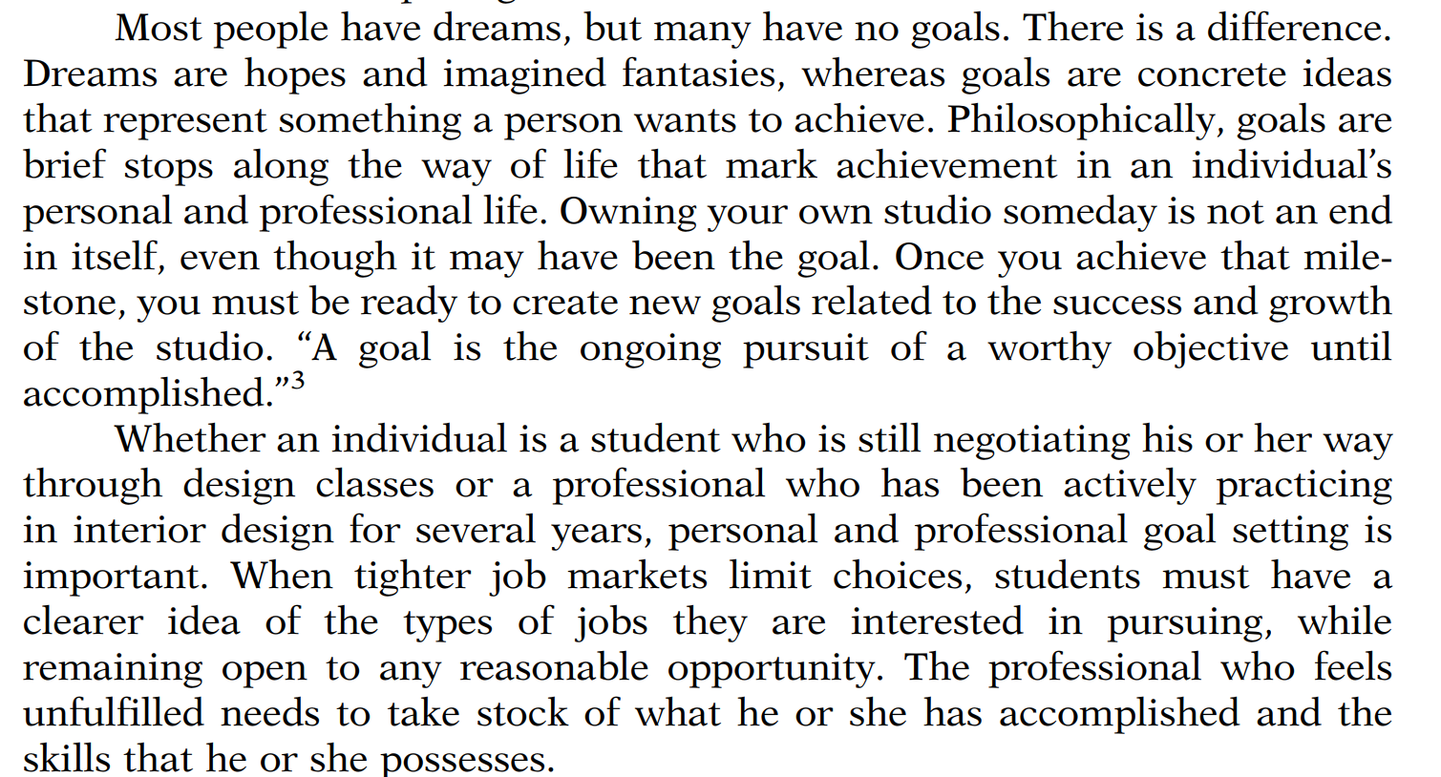
What Are Goals?

Slide 6
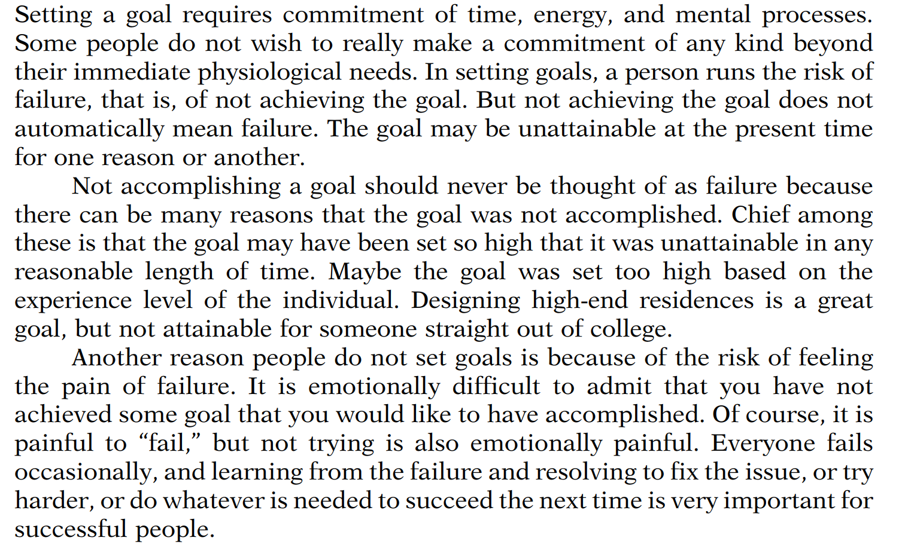
Risks in Goal Setting

Slide 7
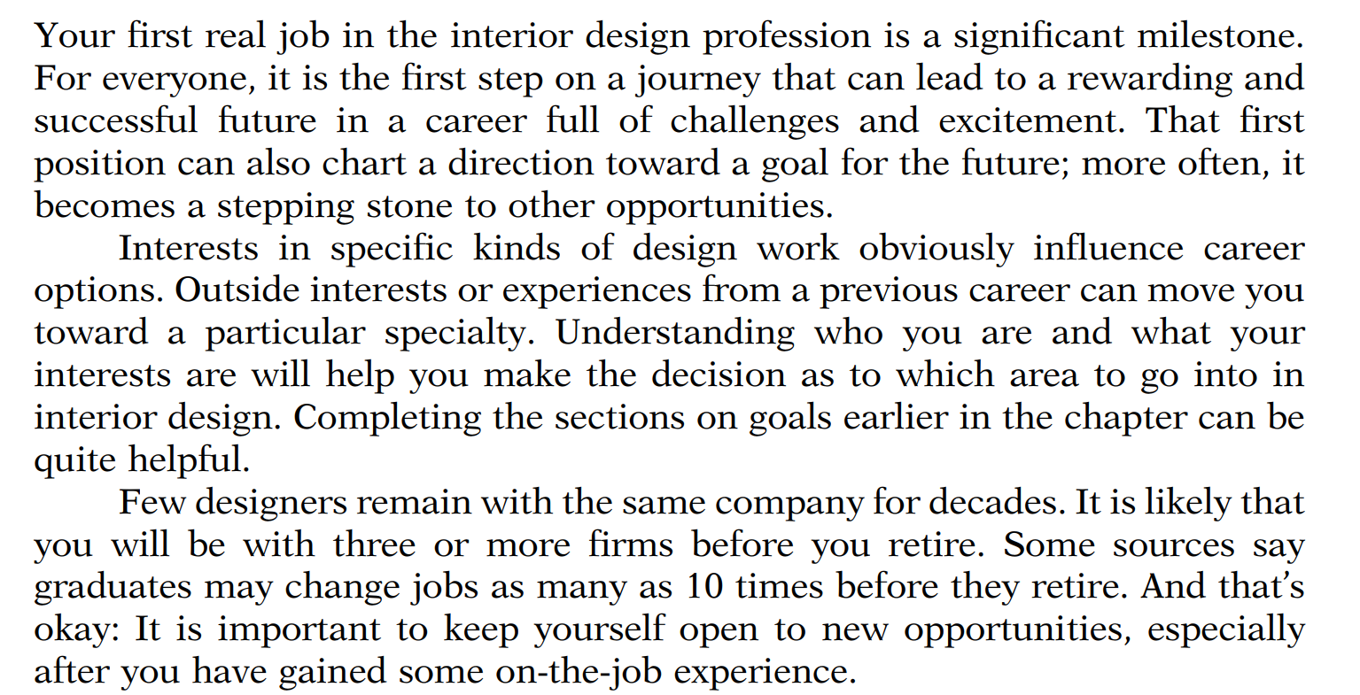
CAREER DECISIONS

Slide 8
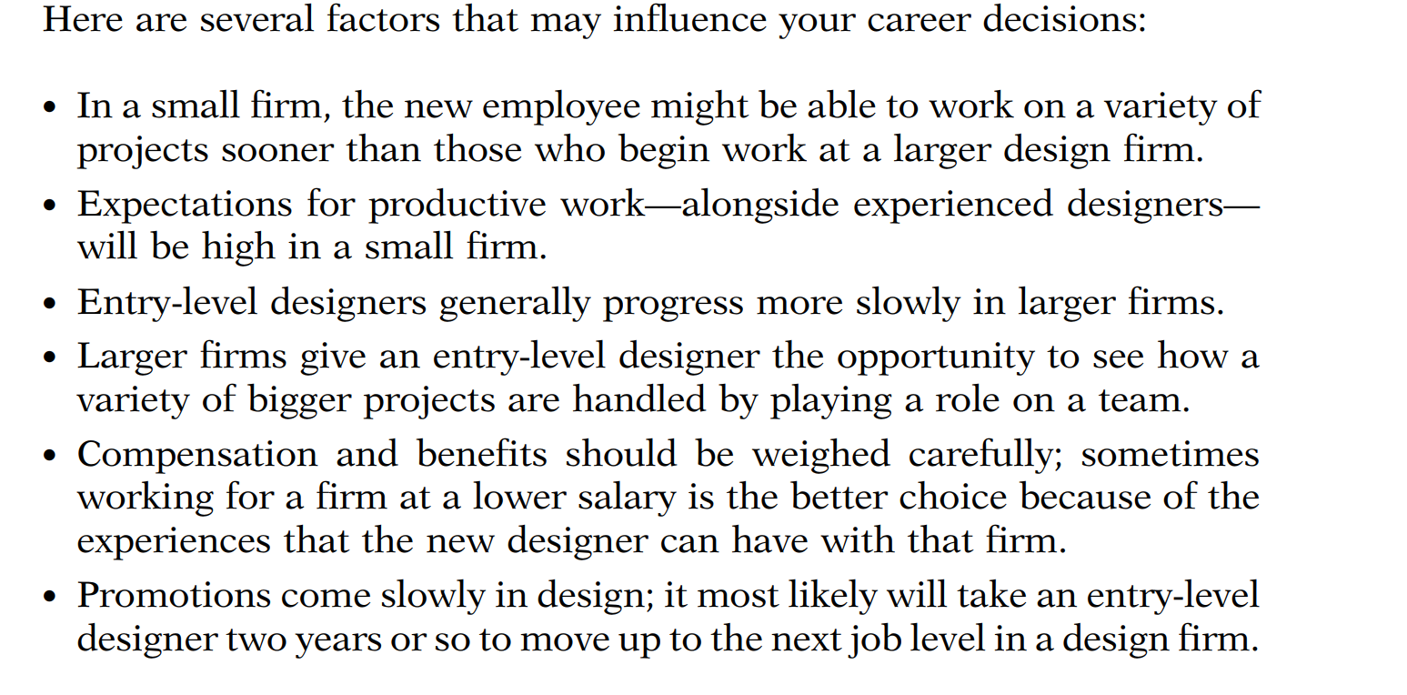

Slide 9
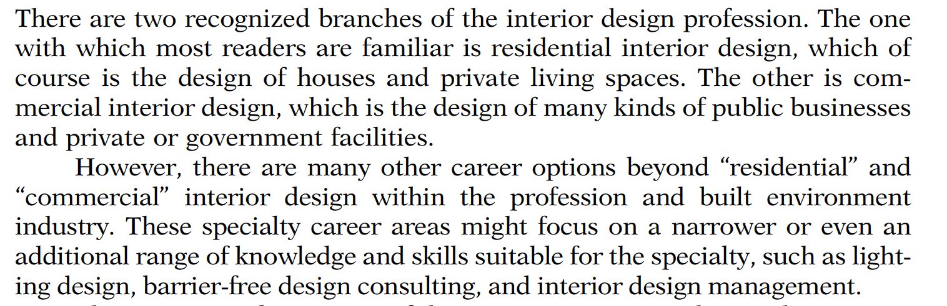
DESIGN CAREER SPECIALTIES

Slide 10
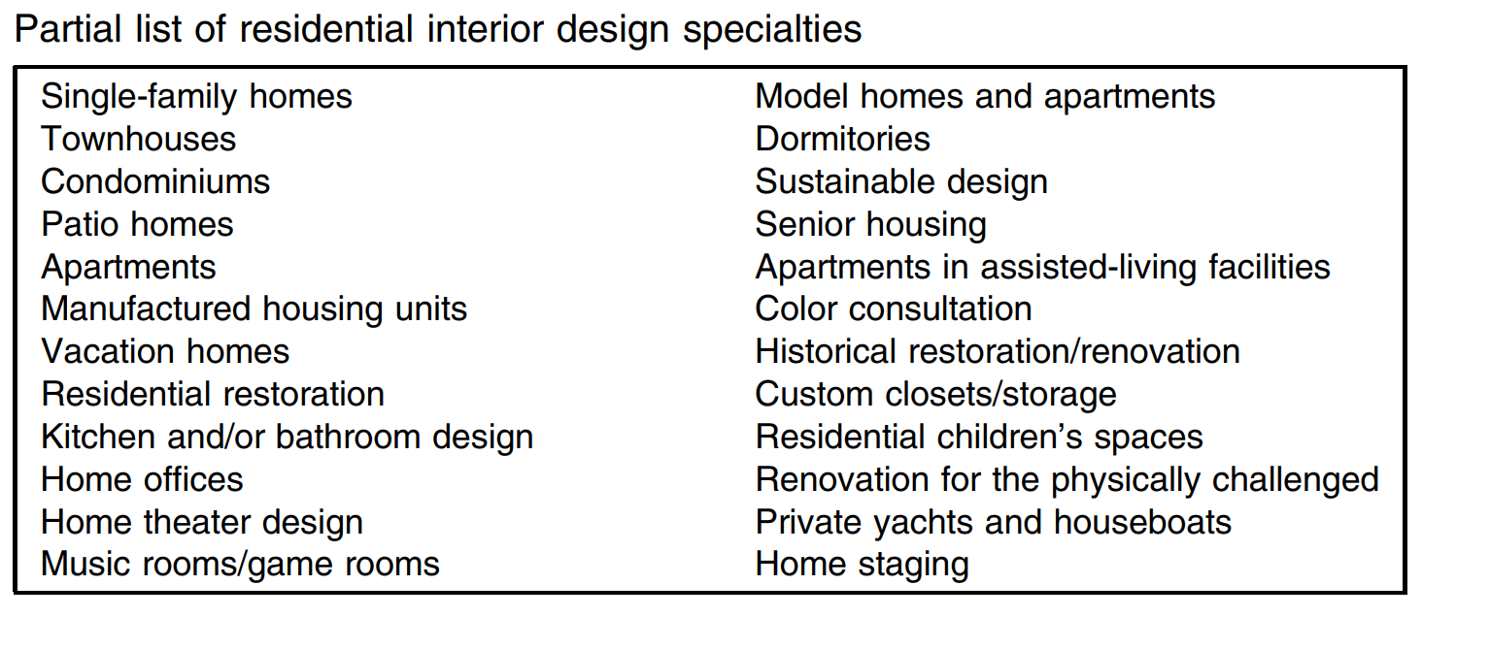

Slide 11
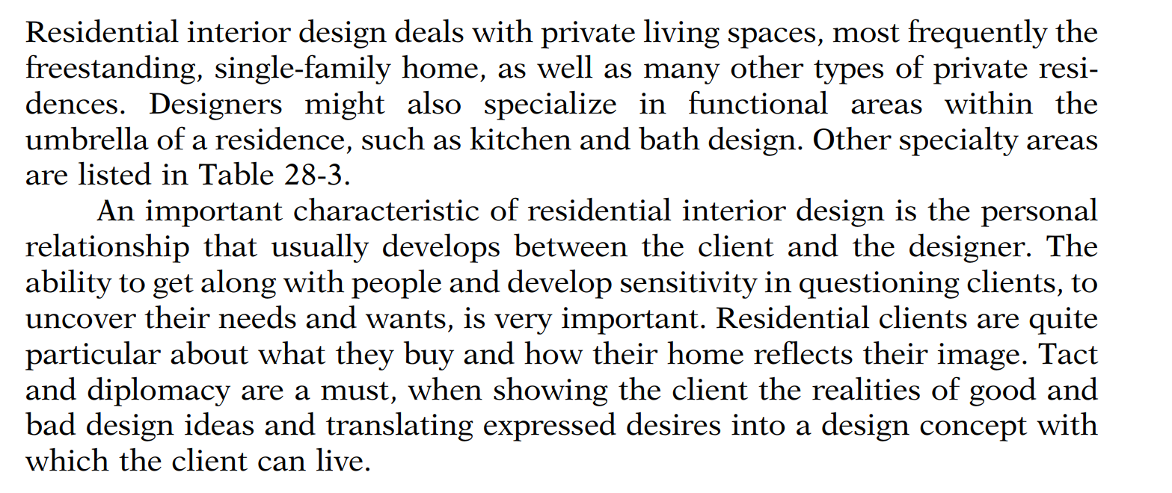
Residential Interior Design

Slide 12
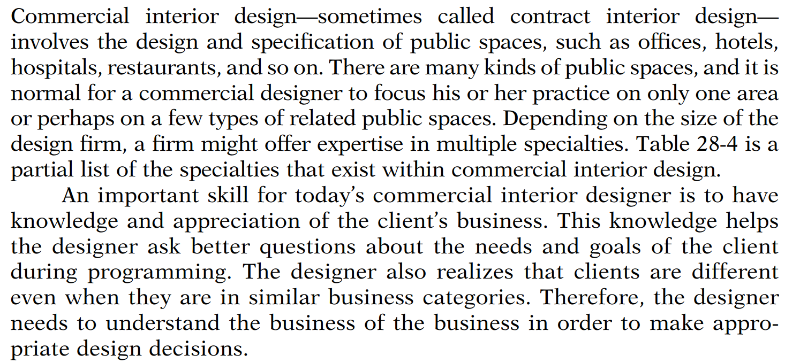
Commercial Interior Design

