Slide 1
Professional Practice
Preparing Design Contracts
Interior Design/ 4th Stage
Dr. Zaid Al Hamdany

Slide 2
designers. Sometimes they should have entered into a contract but did not. Too often, when this happens, a dispute occurs between the parties, as each claims he or she did not get what was agreed to verbally. Interior design contractual relationships should never be taken lightly. Serious consequences occur when promises made in a contract are not fulfilled.
It is imperative that designers take care in the preparation of their contracts. They must carefully compose and organize Designers enter into many contracts: with clients, with vendors, with craftspeople, and even with othere the various clauses to protect themselves and ensure that the work outlined can be accomplished. In addition, in a contract for design services, it is the interior designer’s responsibility to fulfill the contract.

Slide 3
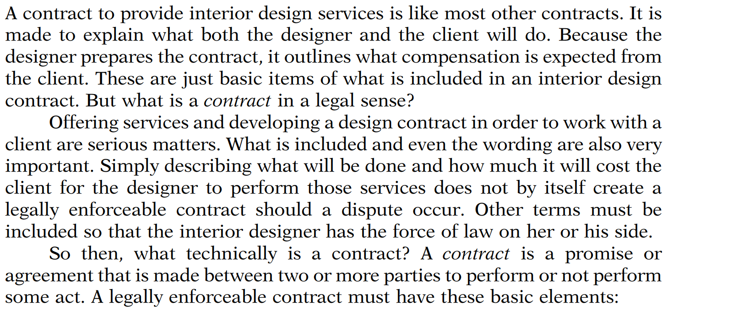
DEFINITION AND BASIC ELEMENTS OF A CONTRACT

Slide 4
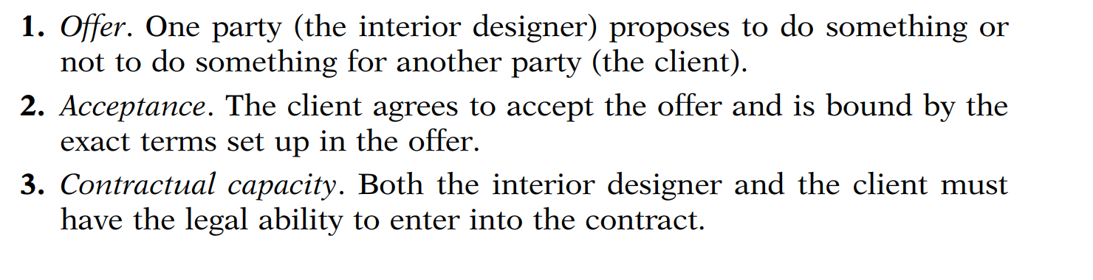
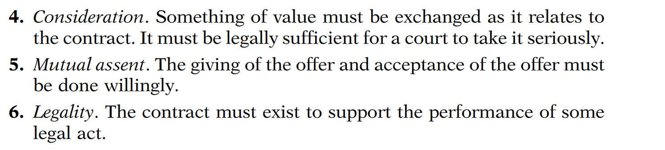

Slide 5
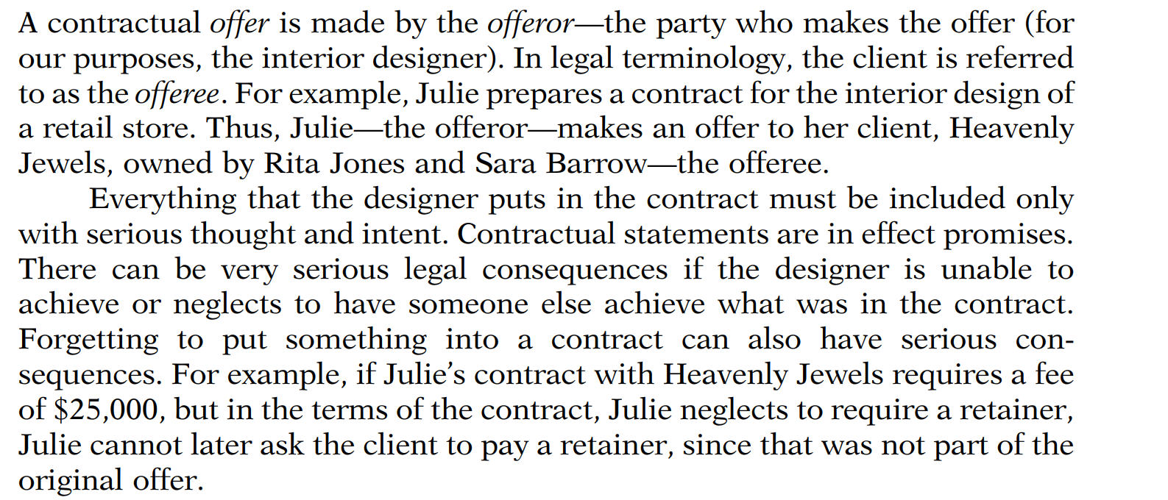
Offer

Slide 6
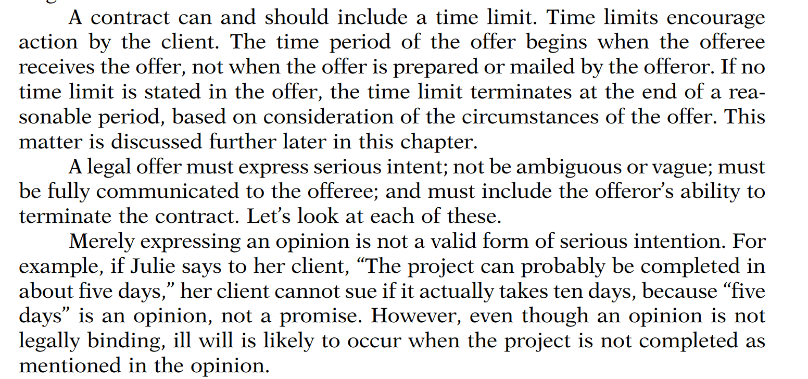

Slide 7

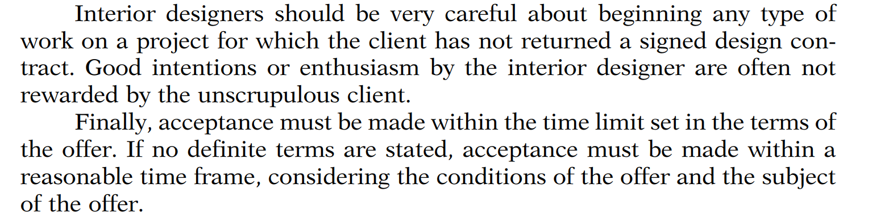
Acceptance

Slide 8
Contractual Capacity
Contractual capacity relates to the full legal competency and authority of the parties. Both parties in a contract must have the legal capacity or authority to enter into a contract. It is very important for the interior designer to be sure this is so. For example, Harold, the owner of HRH Interiors, obtains a signature on a contract from the office manager of a physician’s office. The doctor refuses to pay the first invoice for the design fee, because the office manager did not have the legal authority to sign the contract.

Slide 9
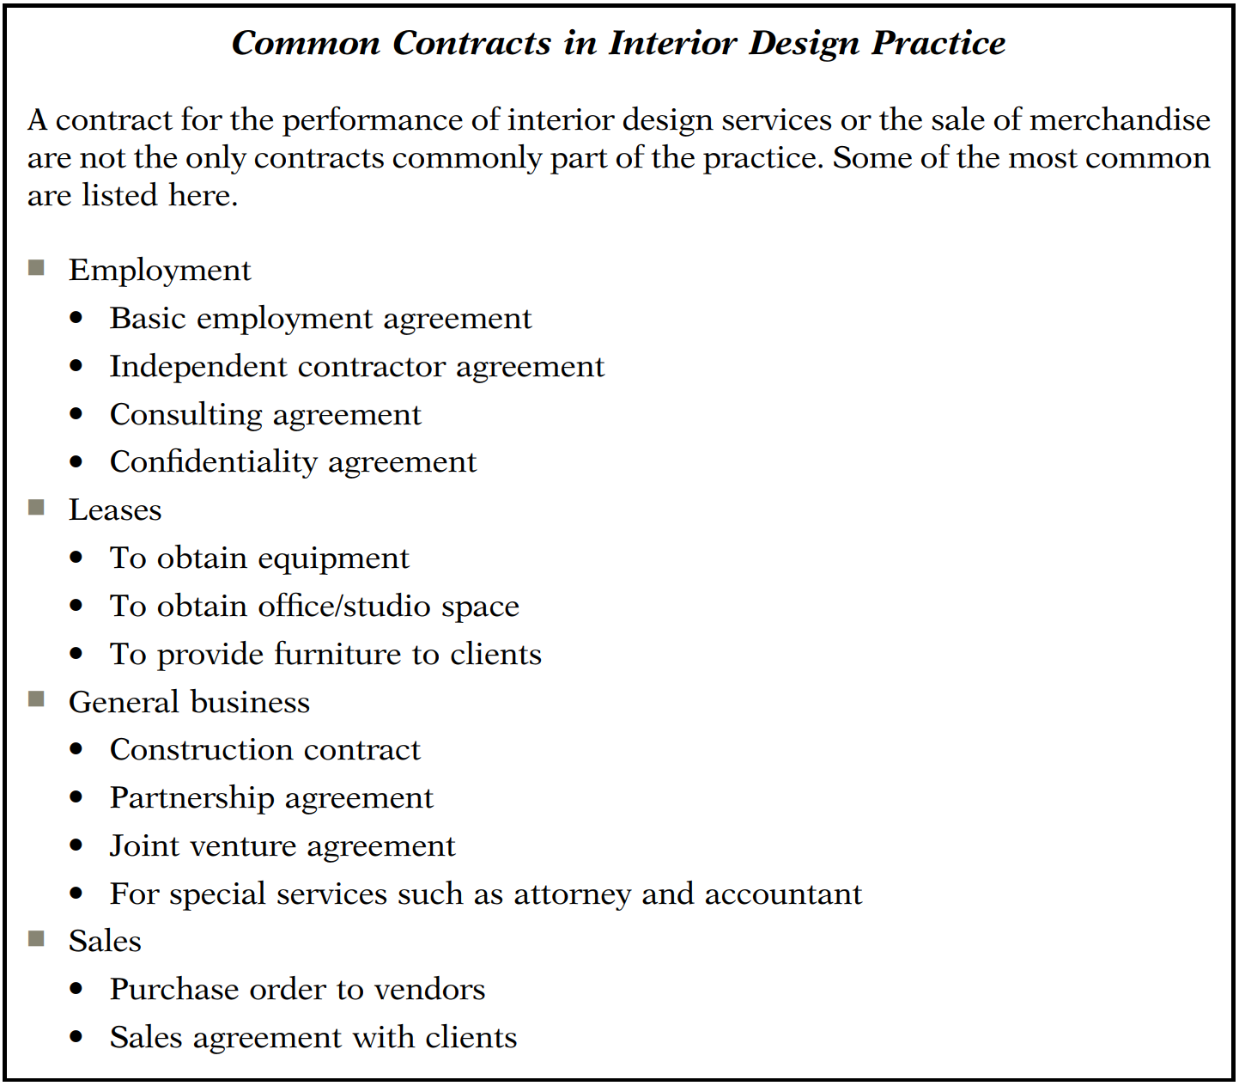

Slide 10
LETTER OF AGREEMENT OR CONTRACT?
For some clients, the idea of signing a “contract” produces fear. Interior designers for many years have used a different term for the agreement between interior designer and client for services: they call it a letter of agreement. A letter of agreement is a contract that is less formal in content and terminology and looks more like a letter. Nevertheless, if it meets the criteria discussed earlier, it is a contract and affords the designer the same legal consideration for enforcement as a contract.
It is really only a semantic difference as to what the agreement is called. Many residential interior designers prefer to use the terminology “letter of agreement,” whereas the term contract is more commonly used for commercial projects. Unfortunately, with the increasing litigation in the industry, letters of agreement are not very simple anymore. It is up to the designer to decide whether the term contract or letter of agreement is more appropriate to his or her interior design practice. Whatever terminology is used, it is critical to include clauses that protect the designer in case of a dispute.

Slide 11
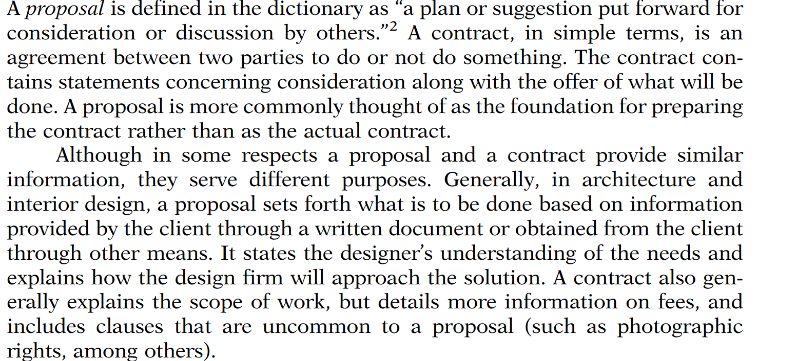
Proposal versus Contracts

Slide 12
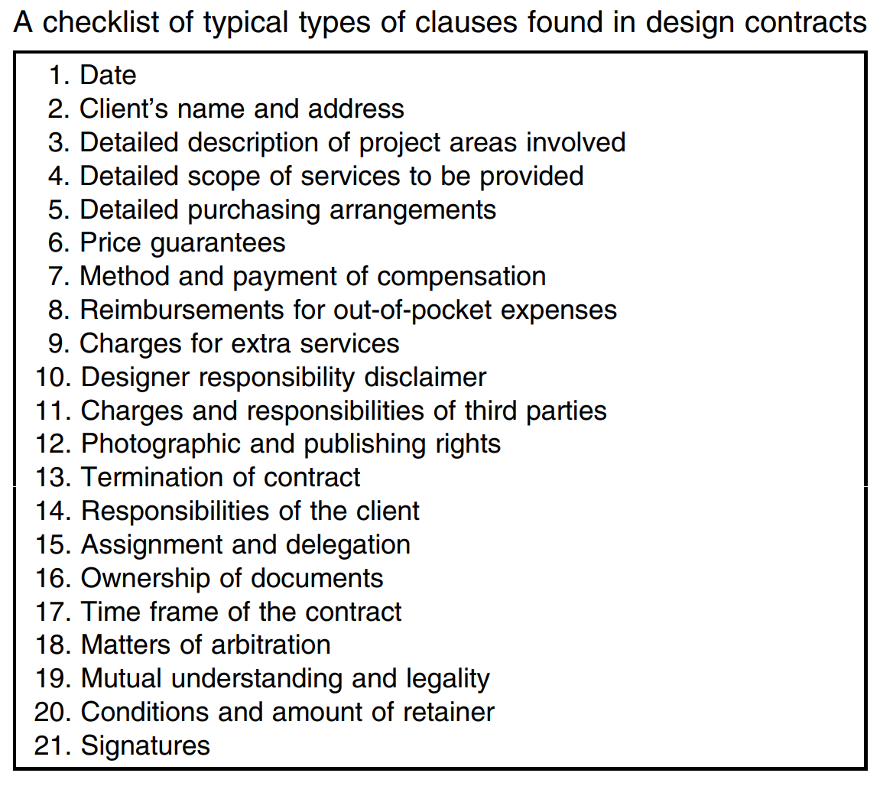
INTERIOR DESIGN CONTRACTS: CONTENT AND FORM
Clients have high expectations of interior designer performance regardless of the type or size of the project. A design contract for services serves as an effective promise of what the interior designer will do for the client. Carefully prepared contracts start with understanding the parts and pieces of what is commonly included.

Slide 13

Typical questions used as the basis of design contract preparation

Slide 14
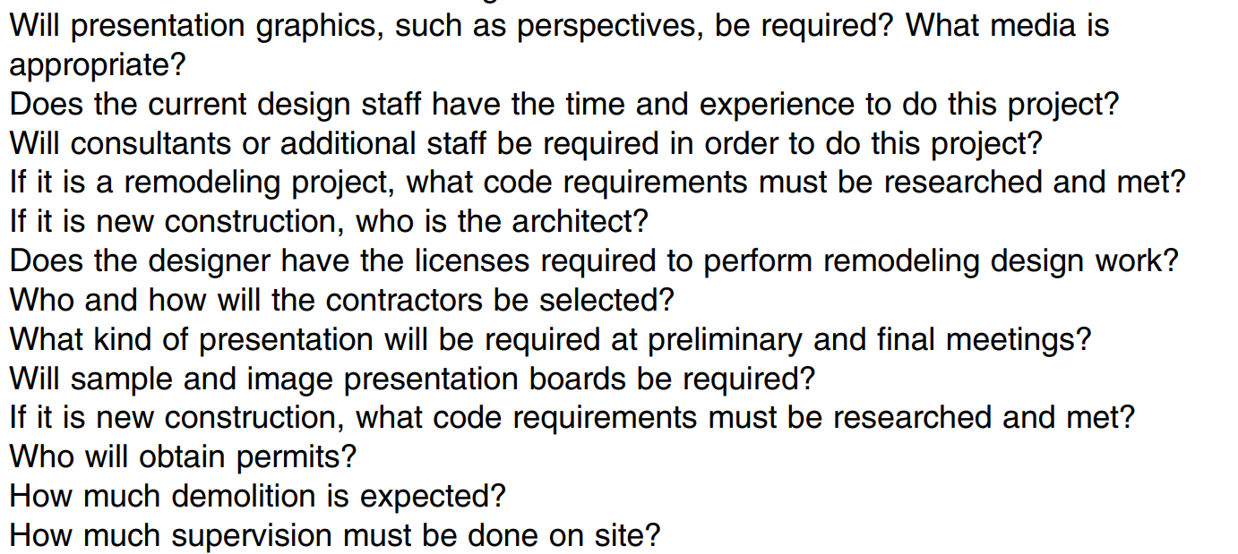

Slide 15
