Slide 1
Professional Practice Project Compensation and Design Fees Interior Design/ 4th Stage
Dr. Zaid Al Hamdany

Slide 2
Income for a design firm comes from the fees the designer charges for services. Some firms also sell merchandise, and income from merchandise sales also results in income for the firm. Design services fees when not combined with merchandise sales, must cover the cost of the designer’s time or salary expense and overhead expenses, such as electricity, cost of drafting paper, and telephone calls. Those fees must also provide a margin of profit.
It can be argued that charging a professional fee (rather than selling merchandise) is one additional factor in “professionalizing” the profession. Some might argue that it does not take an educated, certified, licensed individual to sell desks or sofas. The changing opportunities for clients to purchase goods from sources other than an interior designer have meant that the designer must be sure his or her time spent on design concepts is compensated.

Slide 3
There is no one way to charge for services that will satisfy all situations and all types of interior design practice. Each firm must decide which fee method is appropriate for its purposes. Many factors will affect this decision.
The variety of fee methods available allows the professional to choose a method with which he or she is comfortable and appropriate for the job. A professional can customize how he or she charges clients to suit the client’s needs and the specific project. However, the different fee methods can create confusion.
Inconsistency can be a problem if the designer is working with clients who talk to each other a lot, as is often the case in residential interior design practice.

Slide 4
CALCULATING THE BILLING RATE
The billing rate is a dollar amount charged for each design professional, staff member, or (in some cases) the type of service provided. Most typically, the billing rate is expressed as an hourly rate. Some situations might call for a day rate, in which case the billing rate is for a full day’s work rather than per hour. A billing rate is used to calculate fixed fees and in most other types of fee methods as well.
The billing rate begins with the salary rate of the employee. However, the salary rate alone does not cover all the overhead expenses and profit that must be considered in determining a billing rate. Thus, the billing rate is actually calculated based on the firm’s multiple (also called a multiplier).

Slide 5
A method commonly used in interior design and architectural offices is todetermine the multiple of direct personnel expense. The direct personnel expense (DPE) is a number that includes the employee’s salary and costs of employee benefits such as unemployment taxes, medical insurance, and paid holidays. Calculation of the DPE is the most accurate way to determine a firm’s multiple.
It is not simply a combination of the salary and benefits. The DPE, to be accurate, must include direct and overhead expenses as well as profit; otherwise, the fee multiple will not be adequate to result in profitability. Direct expenses, by the way, are those that are directly related to a specific project. Overhead expenses are those that relate to the general operations of the business.

Slide 6
Too often, the small firm owner or sole practitioner forgets that any benefits provided to employees—even themselves—add expenses that reduce profits. Many new owners of an interior design firm are very surprised to find that they made a net profit of only 2 to 4 percent—if they see any net profit at all—because they have not carefully considered their expenses of operating the firm when determining their compensation. Net profit rates of around 10 to 15 percent are more common, especially in firms that carefully control costs and accurately translate profit plans into billing rates.

Slide 7
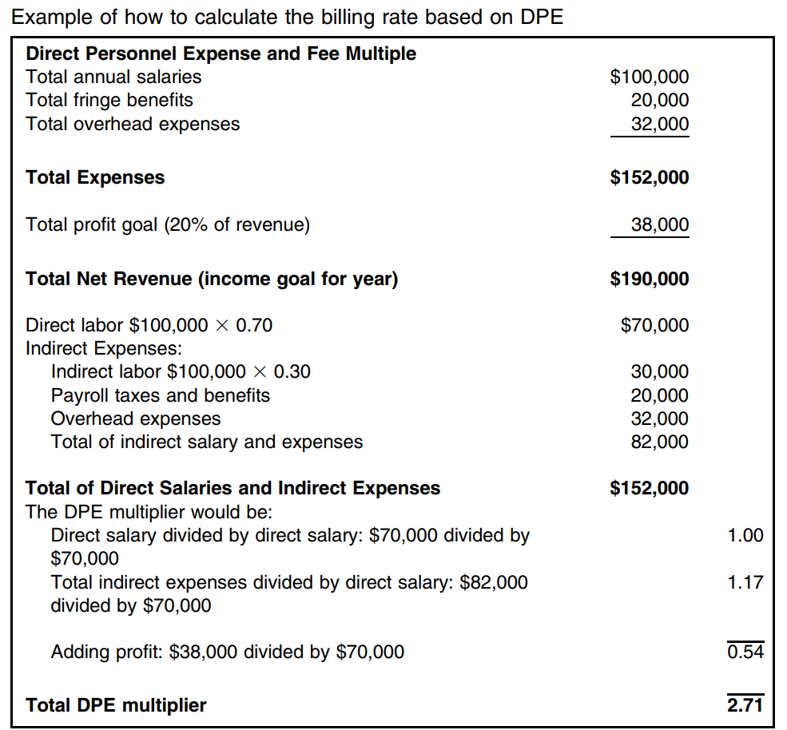

Slide 8
The total net revenue shown in the example is revenue that does not include any sale of furniture. It is solely related to the offering of design services. In this situation, the revenues are realized when designers work on design projects; thus, it is necessary to determine a factor for direct labor. Because it is very difficult for all professional staff to work at 100 percent billable time, and little of the support staff’s time is billable, it is necessary to create a multiplier based on DPE to be accurate.
Assuming that only 70 percent of possible work time is billable (referred to as a utilization rate), then $70,000 would be direct labor. A 70 percent utilization rate is reasonable if the designer also has non billable responsibilities such as marketing, administration, and employee supervision.

Slide 9
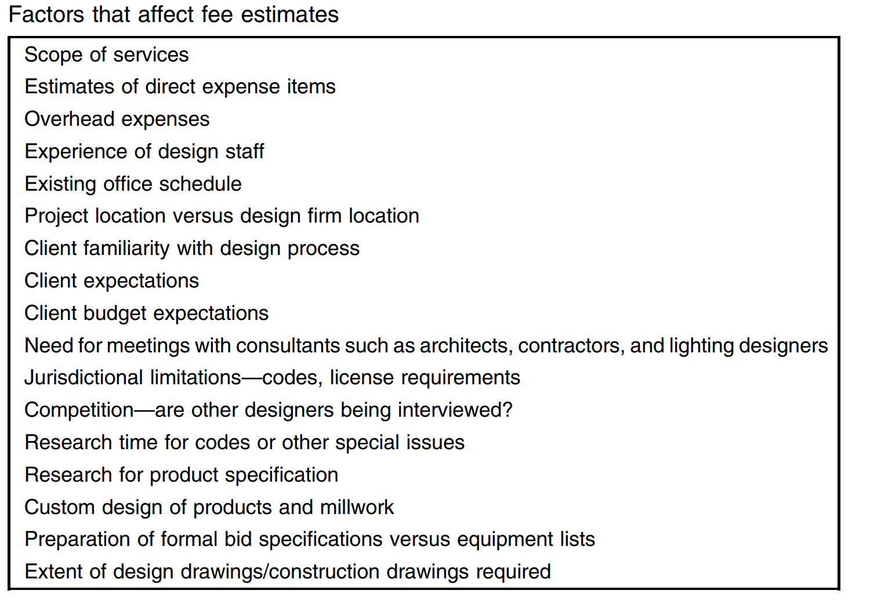
ESTIMATING DESIGN FEES Accurately and profitably estimating design fees for a project is never easy. Many factors can and do influence which fee method to use, the amount of time involved, and the resulting fee to charge the client that yields both revenue and profit.

Slide 10
INDIRECT JOB COSTS
It is not easy to estimate design fees that both cover expenses and return a profit. Several things can reduce profitability of a design project. Some of these indirect job costs—charges that add to project costs but are not associated with normal service expenses—can be mitigated through carefully drafted contract clauses and contingency allowances. Obviously, it is very important to control these indirect costs to maintain business profitability.
Following is a brief discussion of the most common and costly indirect job cost factors:

Slide 11
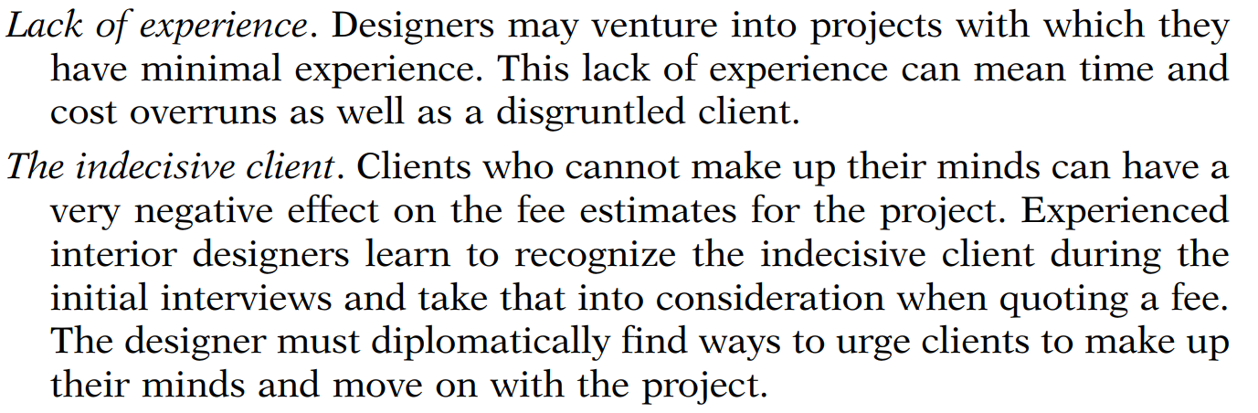
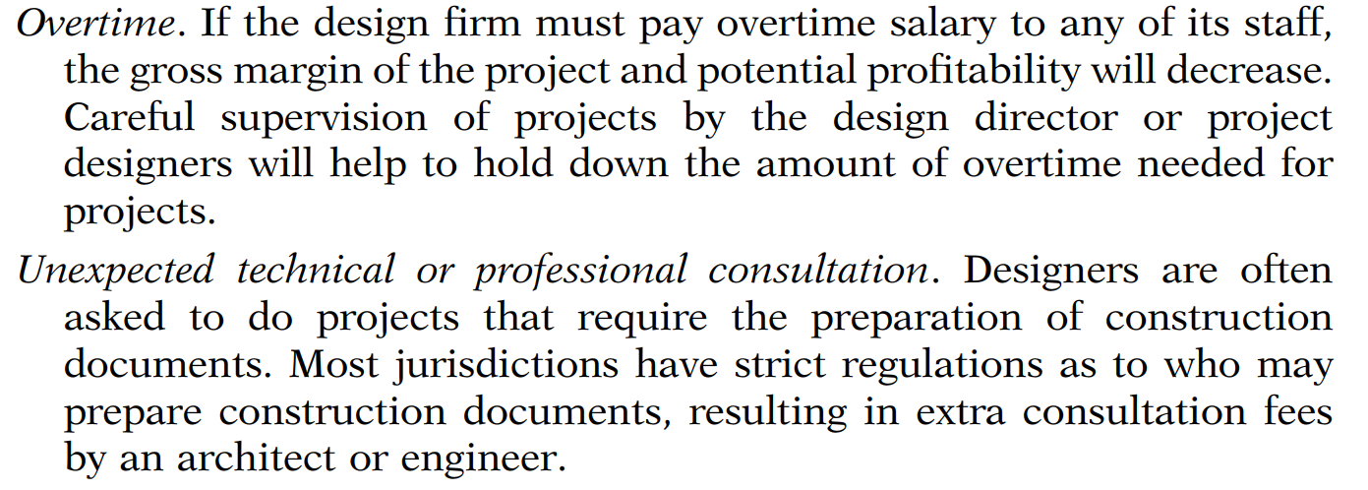

Slide 12
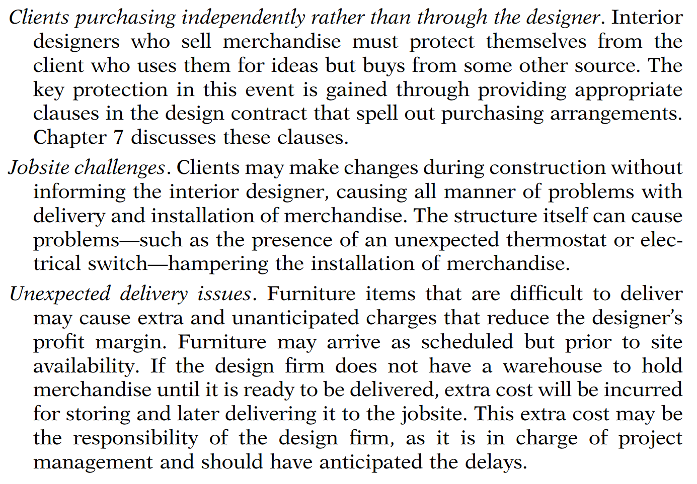

Slide 13
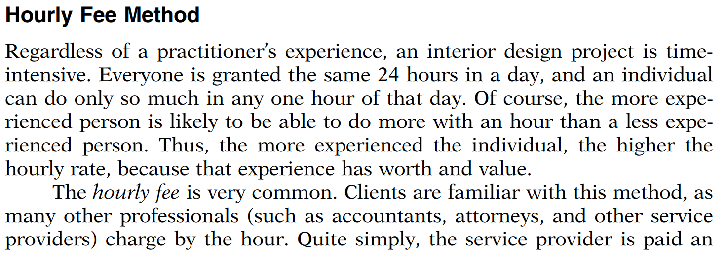
METHODS FOR SETTING DESIGN FEES

Slide 14
Fixed-Fee Method
Many designers and their clients have become increasingly satisfied with the fixed-fee method of compensation for interior design services. The fixed-fee method, also called the flat-fee, lump-sum, or stipulated-sum method, requires the interior designer to calculate a fee that will cover all the work and expenses required in the project scope of services, knowing that the fee cannot be increased beyond the fixed amount. It is common to add a reasonable additional amount to cover contingencies. The estimated fee is usually charged to the client whether the amount of time estimated is correct or not.
This fee method appeals to clients who are most concerned about the bottom line. Designers who wish to use this fee method should have a database of previous projects that will help them determine the approximate average times and expenses needed to execute various kinds of projects. This fee method is not recommended for the inexperienced designer, as she or he will not have a good idea or history as to how long it will take to complete projects.

Slide 15
Cost Plus Percentage Markup Method
A compensation method that many interior designers utilize when they also sell merchandise to the client is the cost plus percentage markup method. The client agrees to pay a specific markup on the actual cost of the merchandise and other items that the designer sells to the client. Increasingly, this method has been combined with the hourly method for design consultation. In this situation, the client obtains a better price on merchandise when he or she buys from the designer, because the designer passes on all the discounts that suppliers provide, arriving at a competitively low cost. Cost plus percentage markup is more commonly used in residential design, but can also be effective for commercial projects.

Slide 16
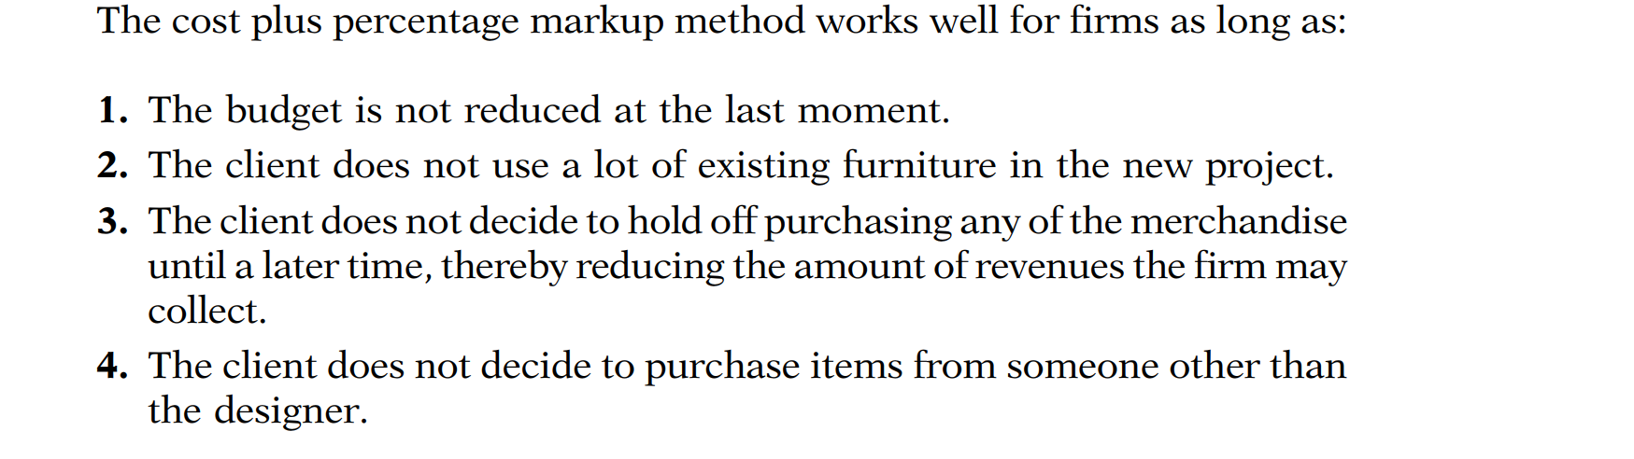

Slide 17
Square-Foot Method
Another method that requires a good history with projects is the square-foot method. The fee is determined by a rate per square foot times the amount of square footage of the project being designed. Commonly used in commercial design and by some designers in residential practice, the square-foot method can be a profitable way of determining the design fee. There are no industry standard square-foot fees, so the designer must have some experience with similar projects to establish an appropriate rate.

Slide 18
Retail Method
In the retail method, the design firm charges the client the retail price suggested by the manufacturer or supplier. If the manufacturer does not provide a suggested retail price, then the design firm marks up the merchandise from the net or cost price to achieve the retail price. Because both the suggested retail price and the markup percentage commonly used are 100 percent, the retail method provides a high gross profit margin for the firm. Although the most common markup is 100 percent, when selling to the consumer the markup can be higher.

