Slide 1
Electrical Lighting
Dr hassan hassoon ALDelfi

Slide 2
Emergency Lighting: It is defined as fixture works in case of emergency or when electric supply fails:
A- self charge
B – Central batteries plant: separate wiring is required, services to batteries should be considered.

Slide 3
Lightening Protection:
Maximum recorded is 2 Million Amp.
Average around 20000 Amp
Protection Point PP :
First 100 m62 we need 1 P.P
Then for every 300 m^2 we need 1 P.P
Conductor from P.P should be linked to ground and placed externally in a safe zone.

Slide 4
Uninterrupted Power Supply U P S
It is an emergency lighting.
Stand-By-Generators- consideration to zoning connection, fueling, maintenance and noise.
Critical Protection:
A-Metal wire
B-cartridge
Circuit Breaker
Special Conductors

Slide 6
I.S.O Symbols
Power Symbols:
Cooker control
Distribution Boards
Electric Meter.
Main Control
Power Point
Switch power point
Switch
2 way switch
Pull or pendant switch
Heating element
Boiler

Slide 7
Lighting Symbols
Discharge Lamp
Filament Lamp
Lightening Columns
Wall Light Bracket.
Height above F F L
Fan

Slide 8


Communication Symbols
Bell
Bell Push
Clock
Control Board
Fire Alarm
Telephone (internal)
Telephone ( external)
Aerial

Slide 9
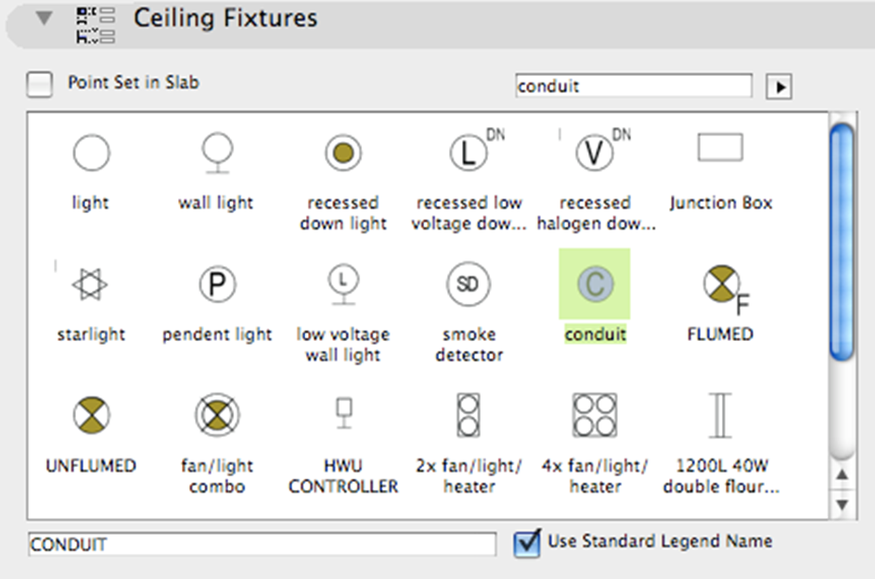

Slide 10
An electrical room is a room or space in a building ( or craft ) dedicated to electrical equipment. The size of the electrical room is usually proportional to the size of the building. Large buildings may have a main electrical room and subsidiary electrical rooms. Electrical equipment may be for power distribution equipment, or for communications equipment.^{[1]} Electrical rooms also included communication equipment and the like.
Electrical rooms typically house the following equipment:
Electric switchboards
Distribution boards
Circuit breakers and disconnects
Electricity meter
Transformers
Busbars
Backup batteries in a Battery room
Fire alarm control panels
Distribution frames

