Slide 1
Building Construction Technology I
(Masonry walls systems)
Department of Architectural Engineering/2nd stage
Dr. Zaid Al Hamdany

Slide 2

Masonry
 Masonry may be defined as the construction of building units bonded together with mortar.
 The building units may be stones, bricks, or precast concrete blocks.
 Depending upon the types of buildings units used, MASONRY can be classified into the following categories :
A. Stone masonry.
B. Brick MASONRY.
C. Composite MASONRY.
D. Cavity walls.
E. Lintel & Arches.

Slide 3
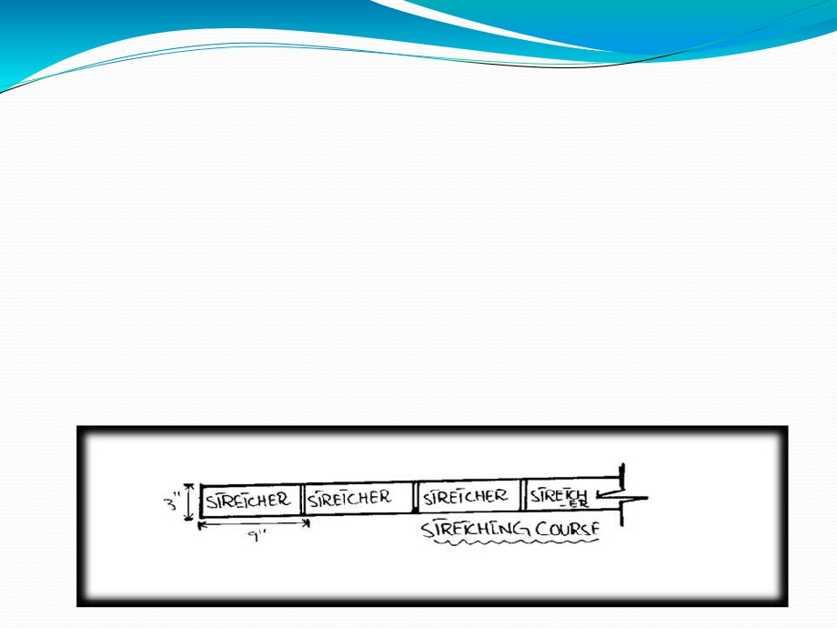
. Some Important Terms Used In
Masonry :
1. STRETCHER:
A brick, laid with its length horizontally and parallelly
with the face of the wall or other masonry member is called a "Stretcher" and a course, in which, all the bricks are laid as Stretchers is called a “Stretching course" or "Stretcher course".

Slide 4
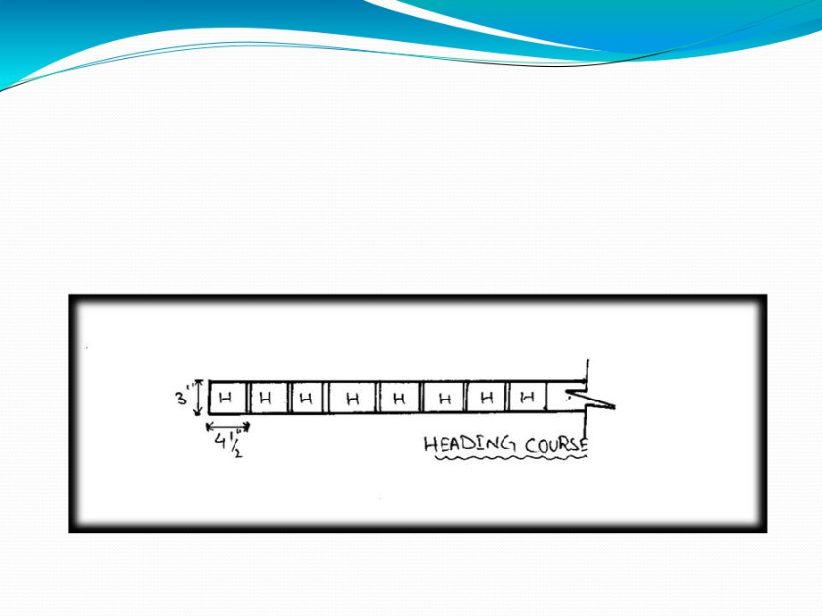
2. HEADER:
A brick laid, so that only its end shows on the face of a wall is called a "Header" and a course, in which all the bricks are laid as headers, is known as "Heading Course" or "Header course“.

Slide 5

3. BOND:
Bond is the arrangement of bricks or stones in each
course, so as to ensure the greatest possible interlocking
and to avoid the continuity of vertical joints in two successive courses, both on the face and in the body of a wall.
4. COURSE:
Each horizontal layer of bricks laid in mortar in a brick work is called a "course".
5. BRICK BATS :
The pieces of bricks, cut long their length and having width equivalent to that of a full or half brick are called "Brick bats“.

Slide 6
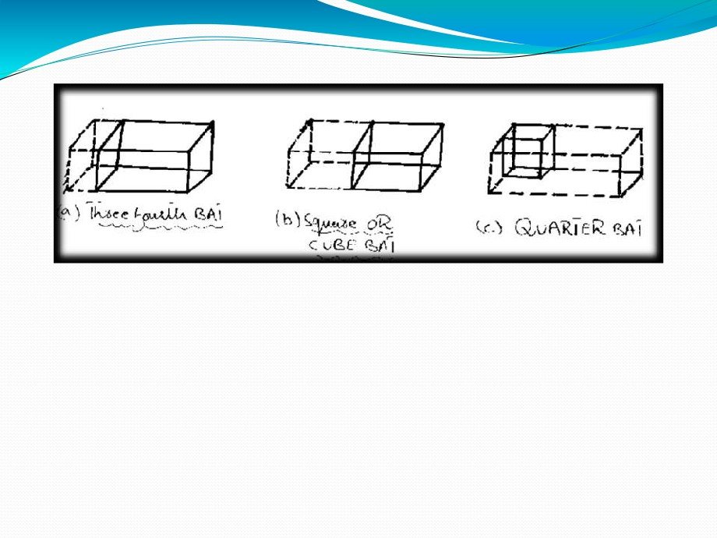
6. QUEEN CLOSER:
Queen closer is a brick, which is half as wide as full brick and is made by cutting a whole brick lengthwise into
two portions.
These are generally used next to the Quoin header for creating bonds in brickwork.

Slide 7
7. KING CLOSER:
A brick, whose one diagonal piece is cut off one corner
by a vertical plane passing through the center of one end to the center of one side.
8. BEVELED CLOSER:
A brick cut longitudinally along a vertical plane, starting at the middle of one end to the far corner.
One quarter of the brick is cut off in this way.
9. BULLNOSE :
A brick with rounded corners is called a “Bull Nose Brick”

Slide 8
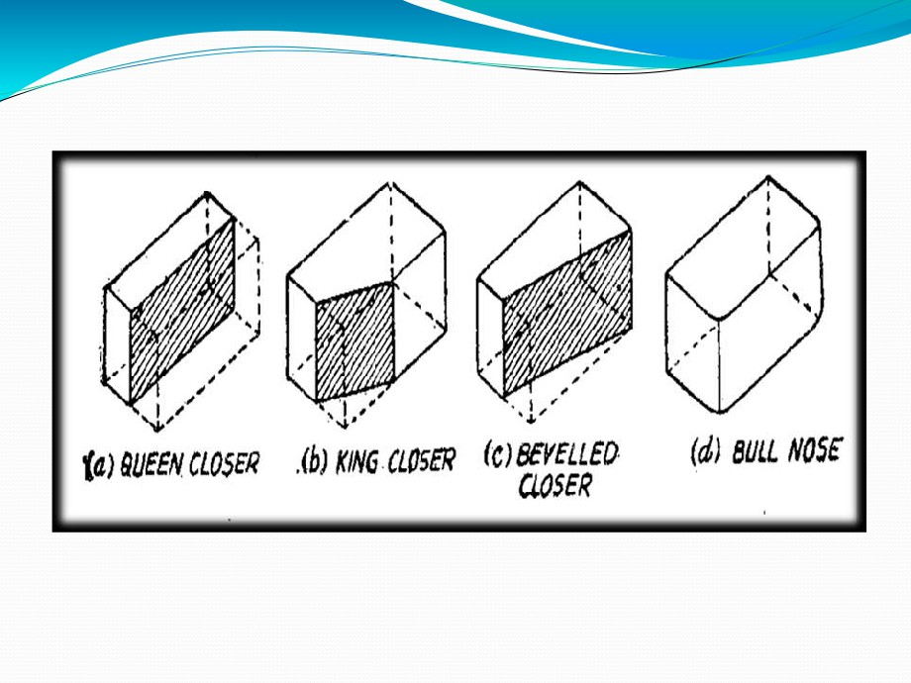

Slide 9
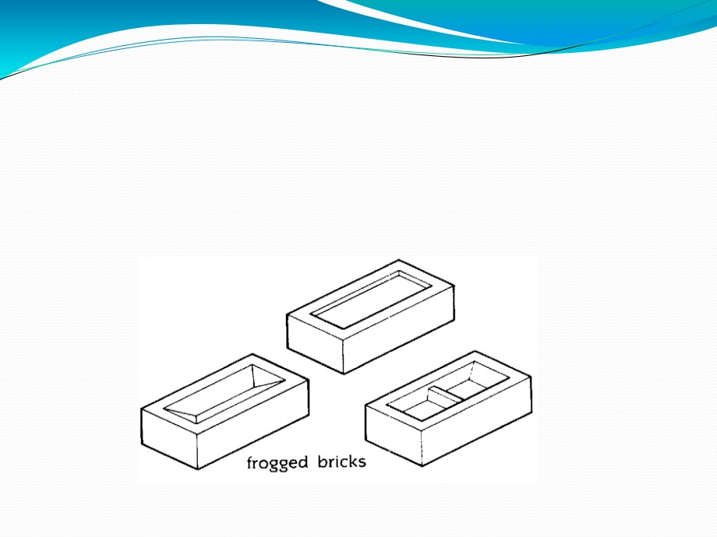
10. FROG
➢Froged bricks shall have depressions in one or more bed faces but their total volume shall not exceed 20% of gross volume of a brick.

Slide 10
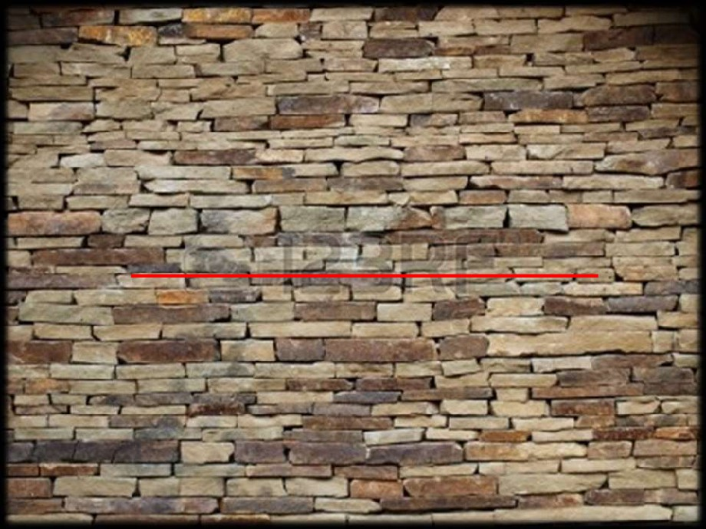
A.STONE MASONRY

Slide 11

STONE MASONRY
Rock, that is removed from its natural site and generally, cut or dressed and then finished for building purposes, is called "Stone" and the art of building the structure with stones as constructional units is called "Stone masonry".
❑ Main types of stone masonry:-
(1) Rubble masonry:-
(2) Ashlar masonry:-

Slide 12
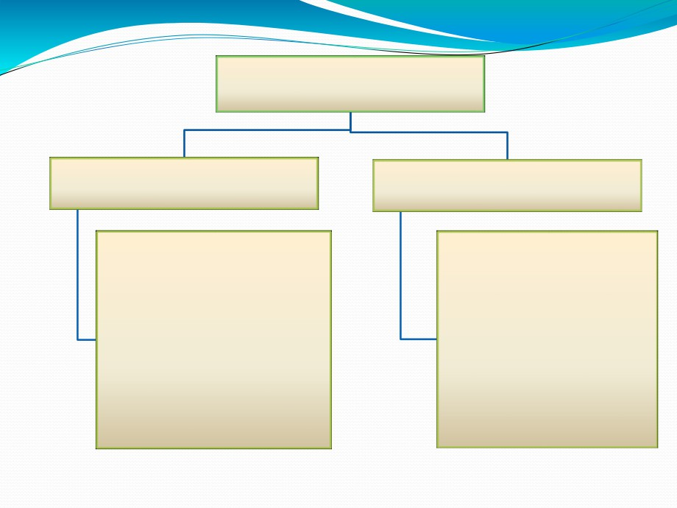
Stone masonry
Rubble masonry
Ashlar masonry
1. Coursed rubble masonry
1. Ashlar Fine masonry
2. Un-Coursed rubble masonry.
2. Ashlar Rough Tooled
3. Random rubble masonry
3. Rock (or) Quarry Faced
4. Polygonal rubble
4. Ashlar Chamfered
masonry
5. Ashlar Block in Course
5. Flint rubble masonry
6. Ashler Facing
6. Dry rubble masonry

Slide 13

RUBBLE MASONRY
The stone masonary in which either undressed or roughly dressedstones are laid is called "Rubble masonry".
In this masonary, the joints of mortar are not of uniform thickness.
The strength of rubble masonary depend on: ▪ The Quality of Mortar.
▪ The use of long through stones.
▪ The proper filling of mortar between the spaces of stones

Slide 14
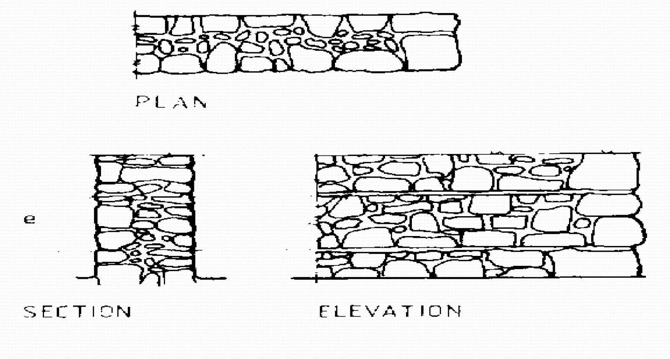
1.COURSED RUBBLE MASONRY.

Slide 15
➢In this type of masonry, the stones used are of widely different sizes. This is the roughest and cheapest form of stone masonry.
➢In coursed random rubble masonry, the masonry work is carried out in courses such that the stones in a
particular course are of equal height.

Slide 16
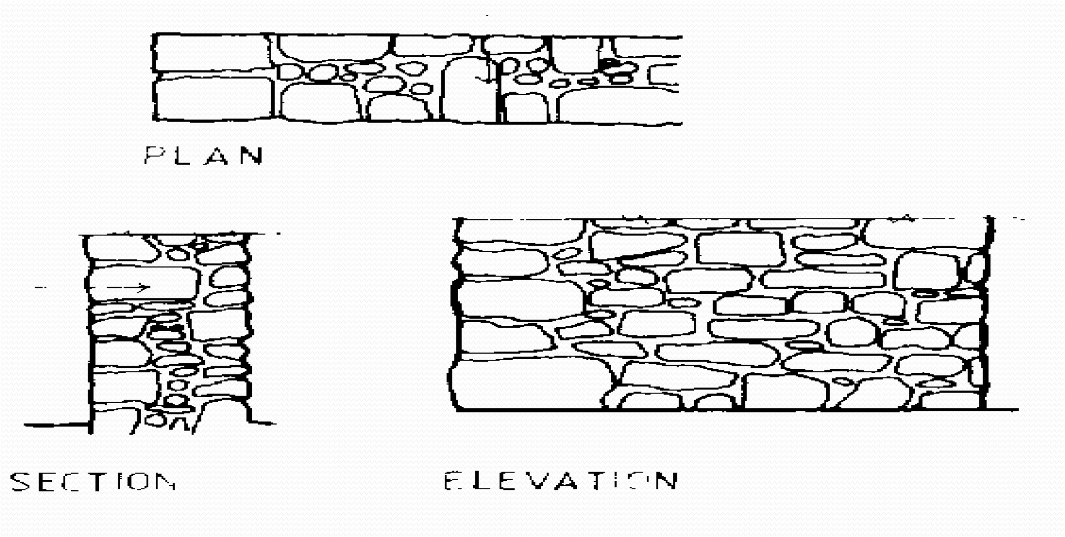
2.UN-COURSED RUBBLE MASONRY.

Slide 17
➢In this type of masonry, the stones used are of widely different sizes. This is the roughest and cheapest form of
stone masonry.
➢In un-coursed random rubble masonry, the courses are not maintained regularly. The larger stones are laid first and the spaces between them are then filled up by means of spalls or sneaks.

Slide 18
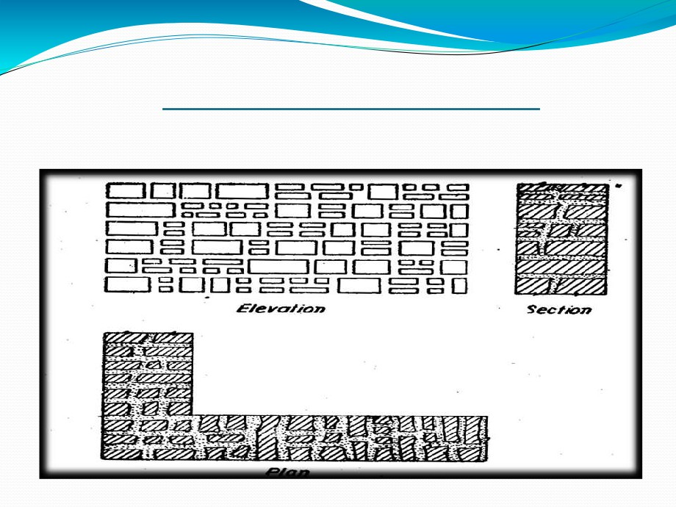
3.RANDOM RUBBLE MASONRY.

Slide 19
➢ In this type of masonry stones having straight bed and sides are used. The stones are usually squared and brought to hammer dressed or straight cut finish.
➢ In the coursed square rubble masonary, the work is carried out in courses of varying depth.

Slide 20
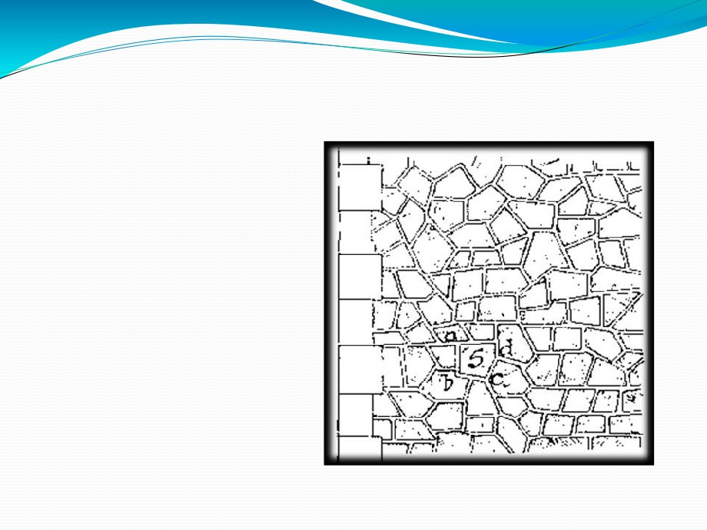
4.POLYGONAL RUBBLE MASONRY
➢ In this type of
rubble masonry, the
stones are
hammer
dressed. The stones
used for face work are dressed in an irregular polygonal shape. Thus
the face joints are seen
running in an irregular fashion in all directions.

Slide 21
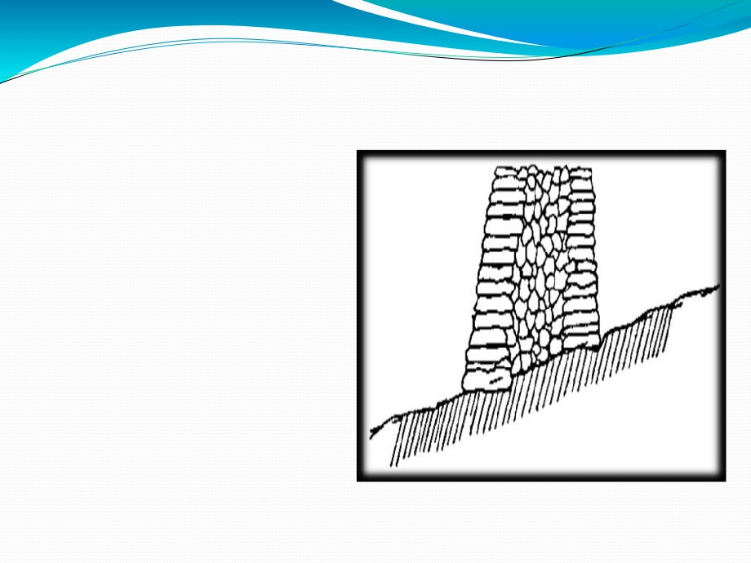
5.FLINT RUBBLE MASONRY
➢ In this type of
masonry stone used are
flints or cobbles. These
are irregularly shaped nodules of silica. The stones are extremely hard. But they are brittle and therefore they break easily.

Slide 22
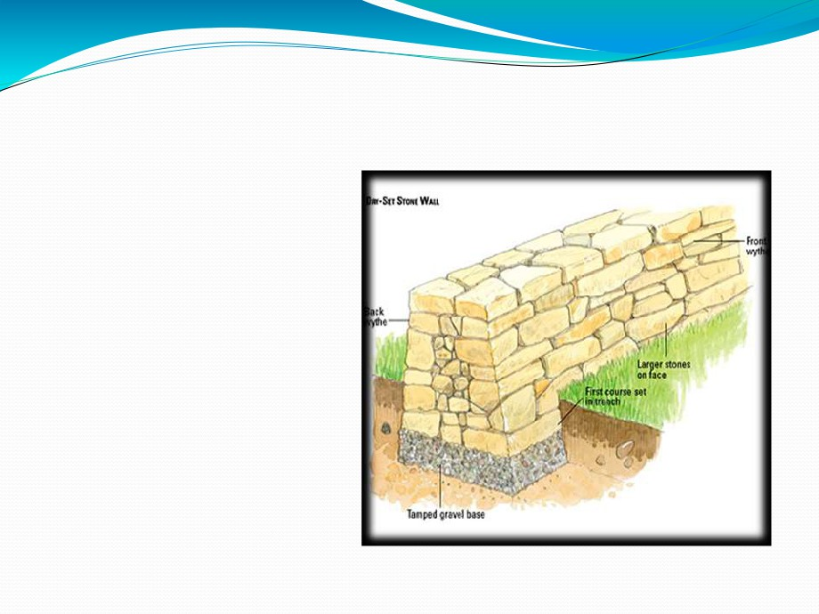
6.DRY RUBBLE MASONRY
➢ In this type of
masonry, mortar is not used in the joints.
This
type
of
construction is the cheapest and requires
more
skill
in
construction. This may
be used for non-load bearing walls such as compound walls, etc…

Slide 23

ASHLAR MASONRY
➢ The stone masonry in which finely dressed stones are laid in cement or lime mortar, is known as "Ashlar masonry".
➢ In this masonry all the joints are regular, thin, and of uniform thickness.
➢ This type of masonry is costly in construction as involves heavy cost of dressing of stones.
➢ This masonary is used for heavy structures, arches, architectural buildings, high piers, abutments of bridges, etc.

Slide 24
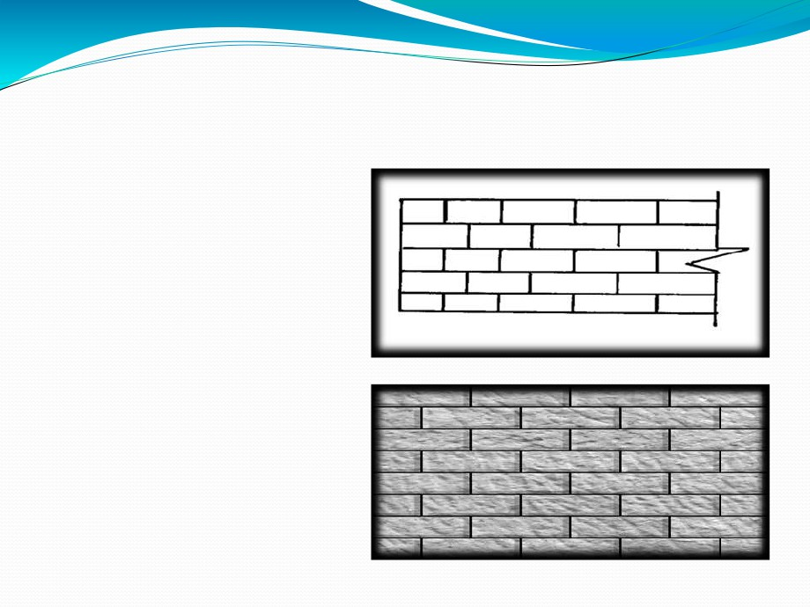
1. ASHLAR FINE MASONRY
➢ In this type ashlar masonry, each stone is cut to uniform size and shape
with all sides rectangular, so
that the stone gives perfectly horizontal and
vertical
joints
with
adjoining stone. This type
of ashlar masonry is very costly.

Slide 25
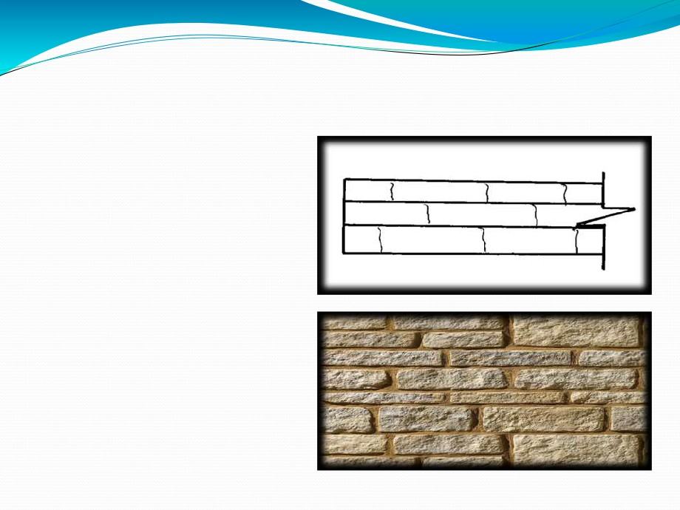
2. ASHLAR ROUGH MASONRY
➢ In this type of ashlar
masonry, the beds and sides are finely chisel-
dressed. But the face is
made rough by means of tools. A strip, about 25mm wide and made by means
of chisel is provided
around the perimeter of the rough dressed face of each stone.

Slide 26
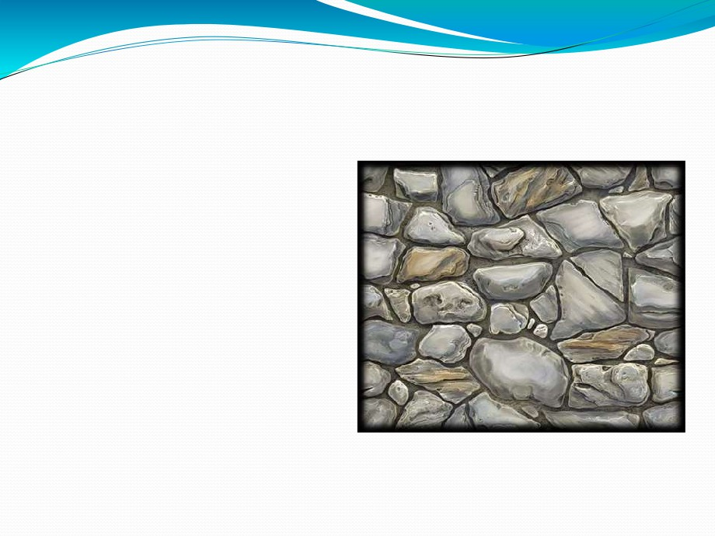
3. ROCK & QUARRY FACED
➢ In this type of ashlar masonry, a strip about 25mm wide and made by means of chisel is provided
around the perimeter of
every stone as in case of
rough-tooled
ashlor
masonry.
But
the
remaining portion of the
face is left in the same form as received from quarry.

Slide 27
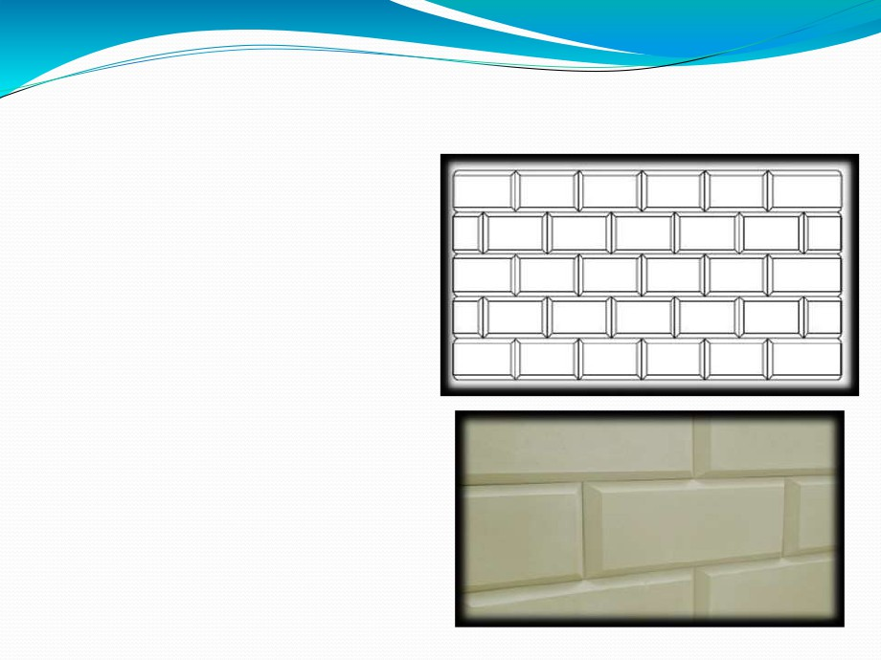
4. ASHLAR CHAMFERED MASONRY
➢ In this type of
ashlar masonry, the strip
is provided as below. But
it is chamfered or beveled at an angle of 45 degrees by means of chisel for a
depth of about 25mm.

Slide 28
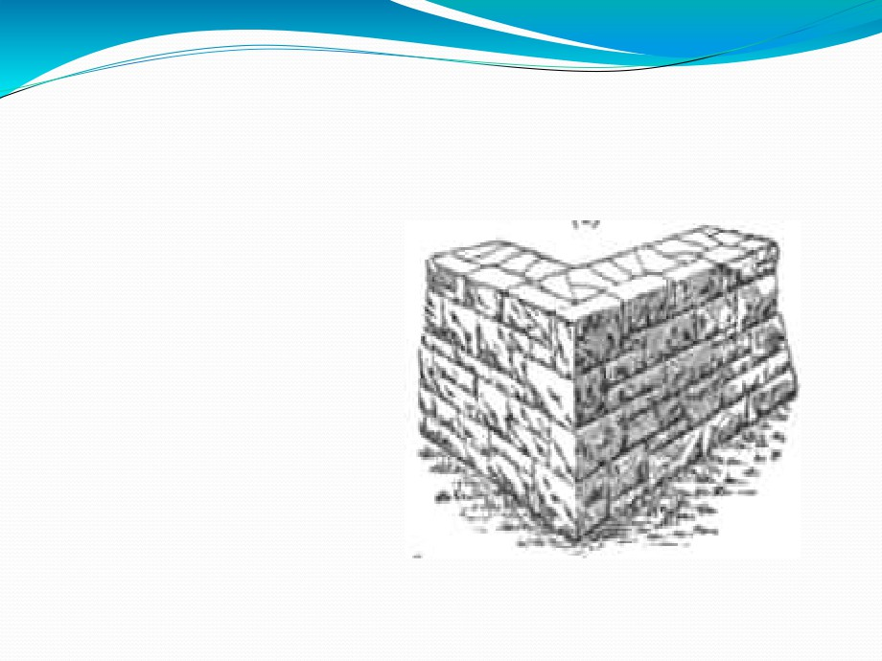
5. ASHLAR BLOCK IN COURSE MASONRY
➢ This is
combination of rubble masonry and ashlar
masonry. In this type of
masonary, the face work is provided with rough
tooled
or
hammer
dresses
stones
and
backing of the wall may be made in rubble masonary.

Slide 29
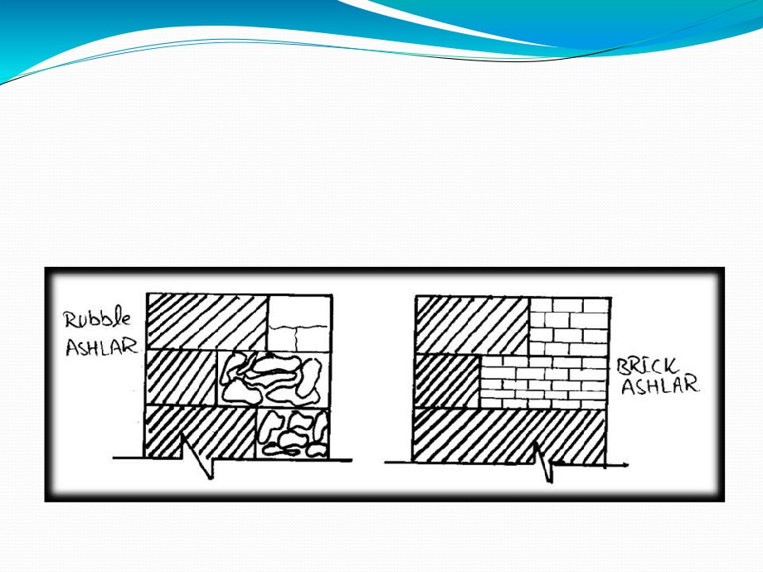
6. ASHLAR FACING MASONRY
➢ If the backing is of Rubble masonry, It is called “Rubble Ashlar" and if the backing is of brick work the masonry is termed as “Brick Ashlar”.

Slide 30
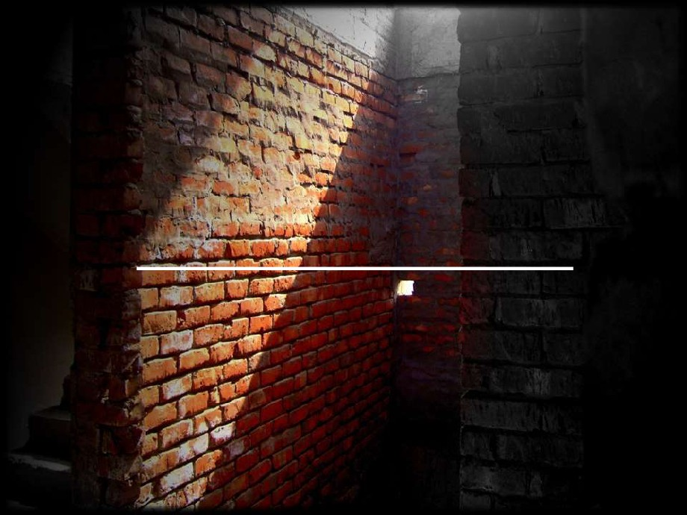
B.BRICK MASONRY

Slide 31
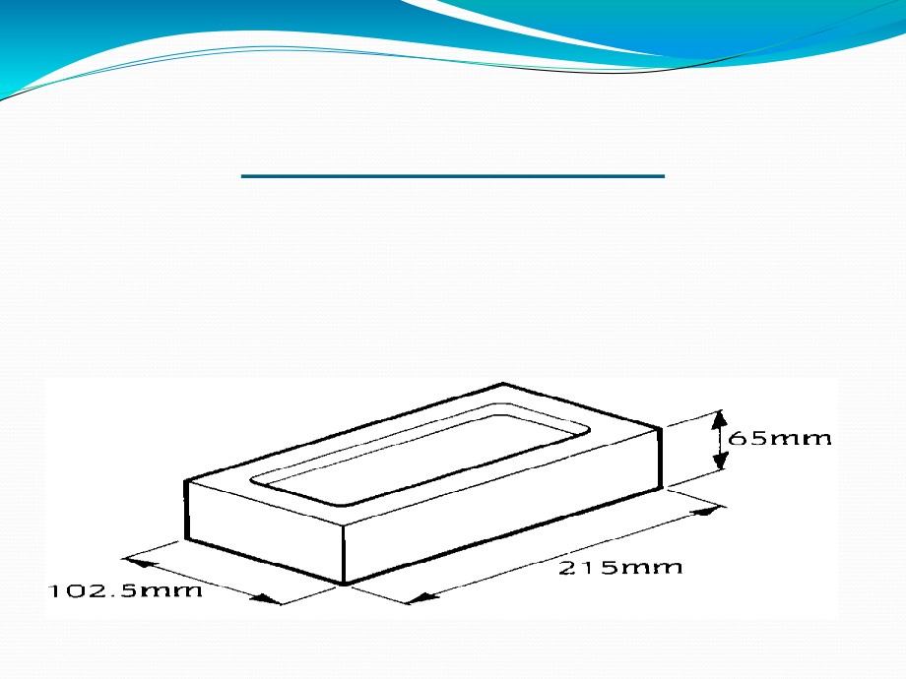
BRICK MASONRY
➢ Bond is the arrangement of bricks in each course, so as to ensure the greatest possible interlocking and to avoid the continuity of vertical joints in two successive courses, both on the face.

Slide 32
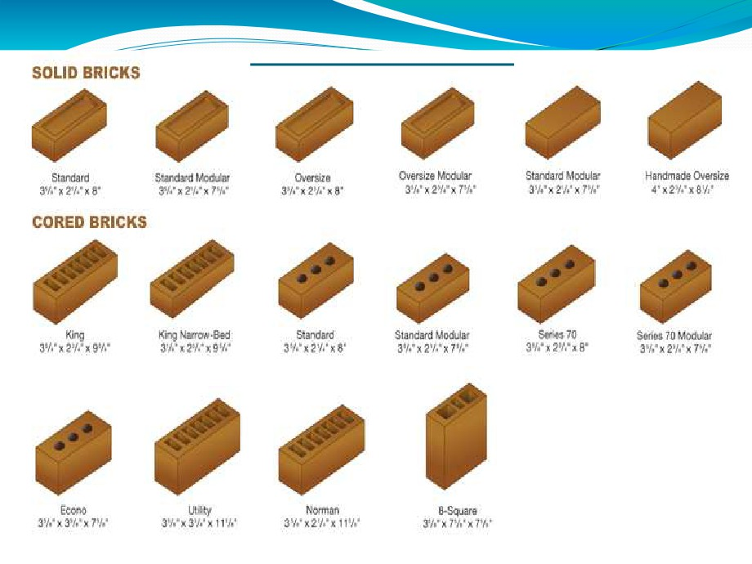
TYPES OF BRICKS
➢ Bricks used in masonary can be of two types:-
(1) Traditional bricks.
(2) Modular bricks.

Slide 33
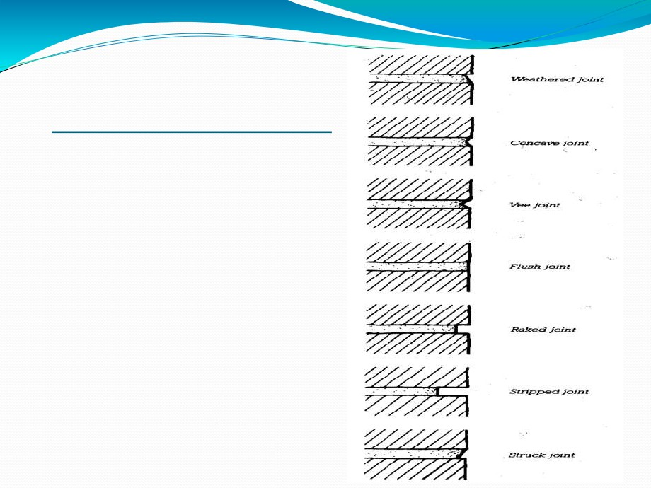
TYPES OF BRICK JOINTS
➢ WEATHERED
➢ CONCAVE ➢ VEE
➢ FLUSH ➢ RAKED ➢ STRIPPED ➢ STRUCK

Slide 34
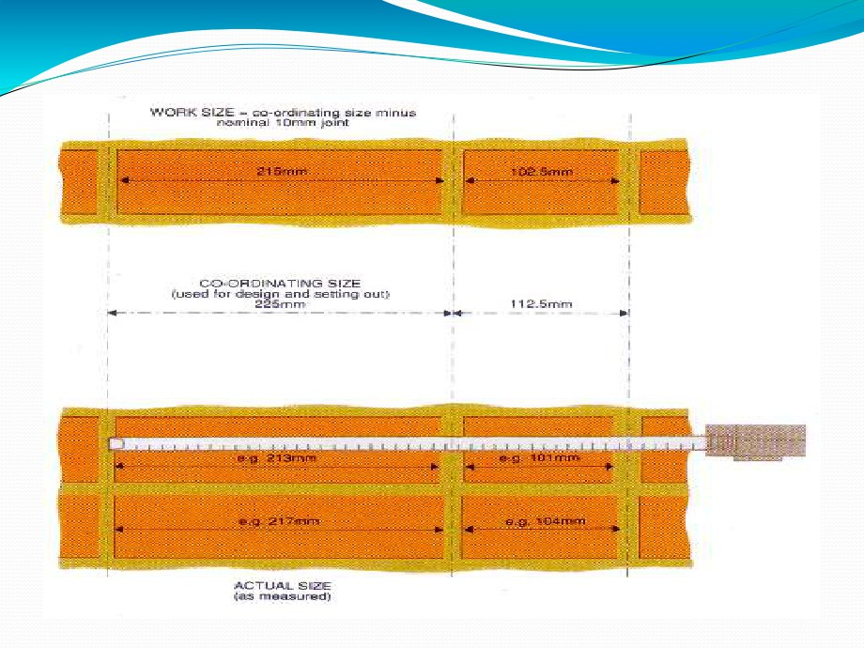

Slide 35

TYPES OF BONDS
1) Stretching Bond
2) Heading Bond
3) English Bond
4) Flemish Bond
(i) Double Flemish Bond
(ii) Single Flemish Bond
5) Garden Wall Bond
(i) English Garden Wall Bond
(ii) Flemish Garden Wall Bond
6) Raking Bond
(I) Herring Bone Bond
(Ii) Diagonal Bond
7)
Dutch Bond

Slide 36
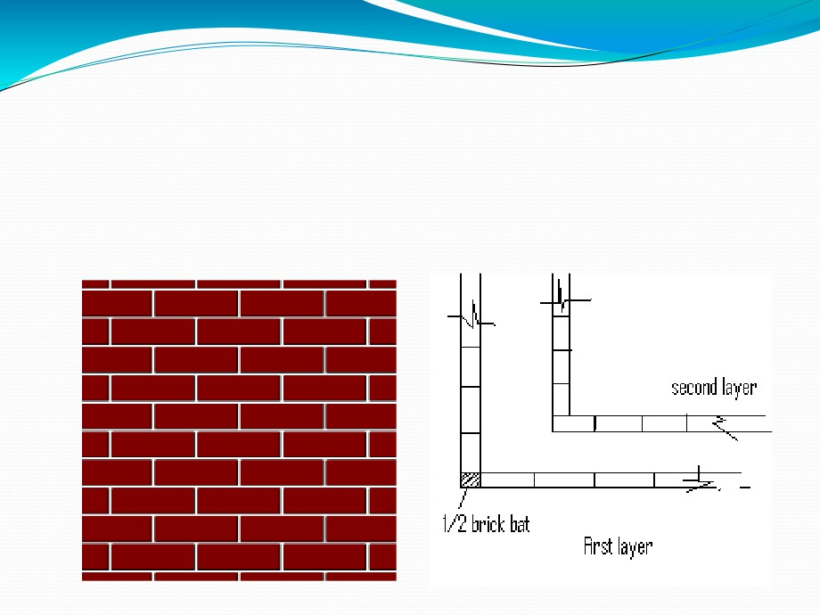
1.STRETCHING BOND
➢ The bond in which all the bricks are laid as stretchers in every course is called "Stretching bond”.

Slide 37
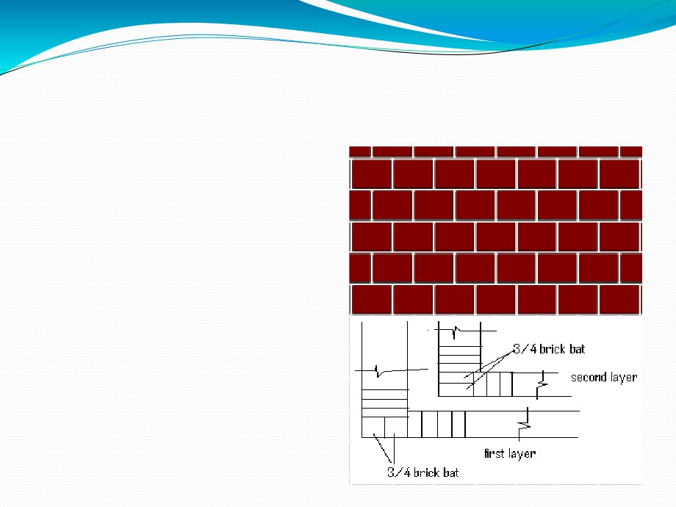
2.HEADING BOND
➢ The bond in which all the bricks are laid as headers
in every course of a wall is called "Heading bond".
➢ This bond is commonly used for constructing
staining of wells, footings of walls and columns, corbels, cornices, etc.

Slide 38
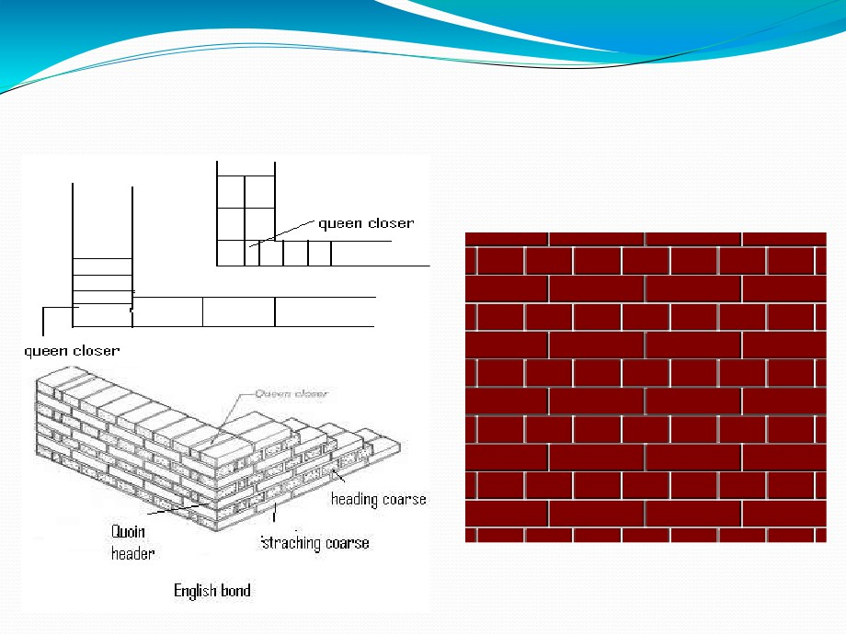
3.ENGLISH BOND

Slide 39
➢This bond consists of headers and stretchers laid in alternative courses.
➢It is strongest of all the bonds.
➢It provides rough appearance especially for one brick thick walls.
➢There are no noticeable continuous vertical joints in the structure built in this bond.
➢Much attention is not required in providing this bond. ➢Progress of work is more.
➢It is costly because the use of brick bats is not allowed.

Slide 40
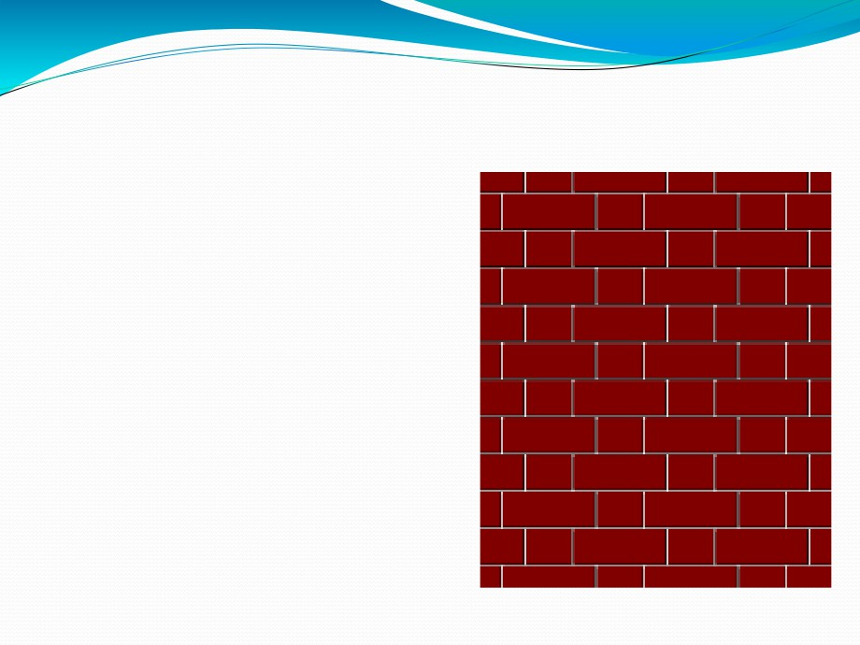
4.FLEMISH BOND
➢ The bond, in which headers and stretchers are laid alternately in
the same course, is called "Flemish bond".
➢ Two types Flemish bond:-
(i) Double Flemish Bond:-
(ii) Single Flemish Bond:-

Slide 41
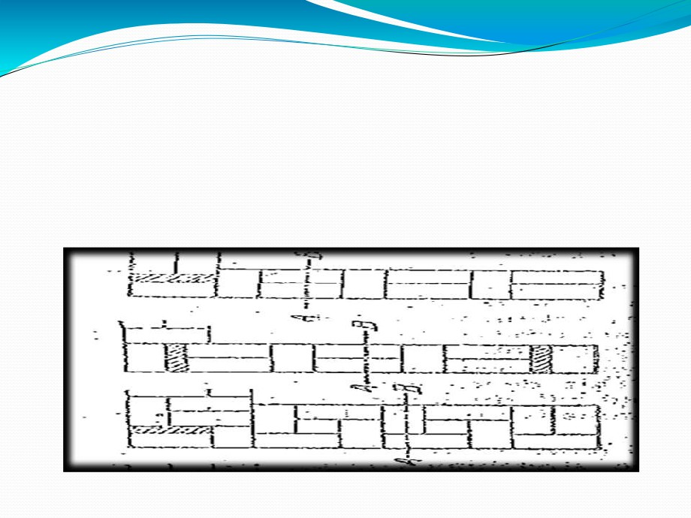
(i) Double Flemish Bond:-
➢ The bond in which headers and stretchers are laid alternately in each course, both in the face and back of the wall, is called Double Flemish Bond.

Slide 42
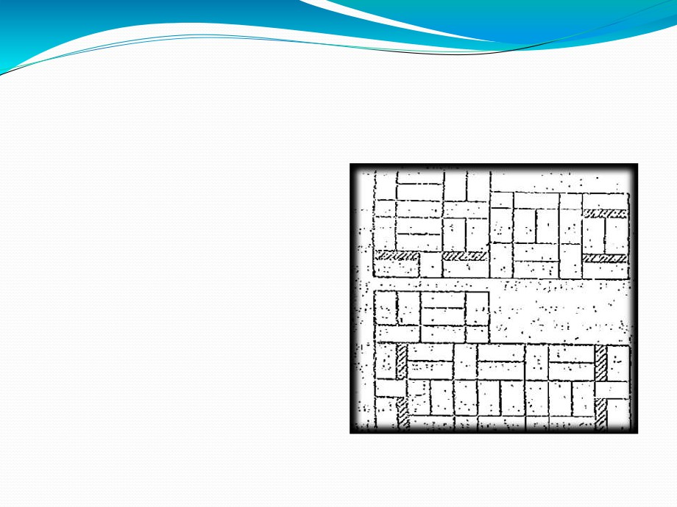
(ii) Single Flemish Bond:-
➢ The bond provided in a wall with Flemish bond in facing and English bond in backing is called "Single Flemish bond" or "Cross bond".
➢ This bond combines the advantages of both English
and Flemish bonds and
simultaneously
eliminates
their disadvantages.

Slide 43
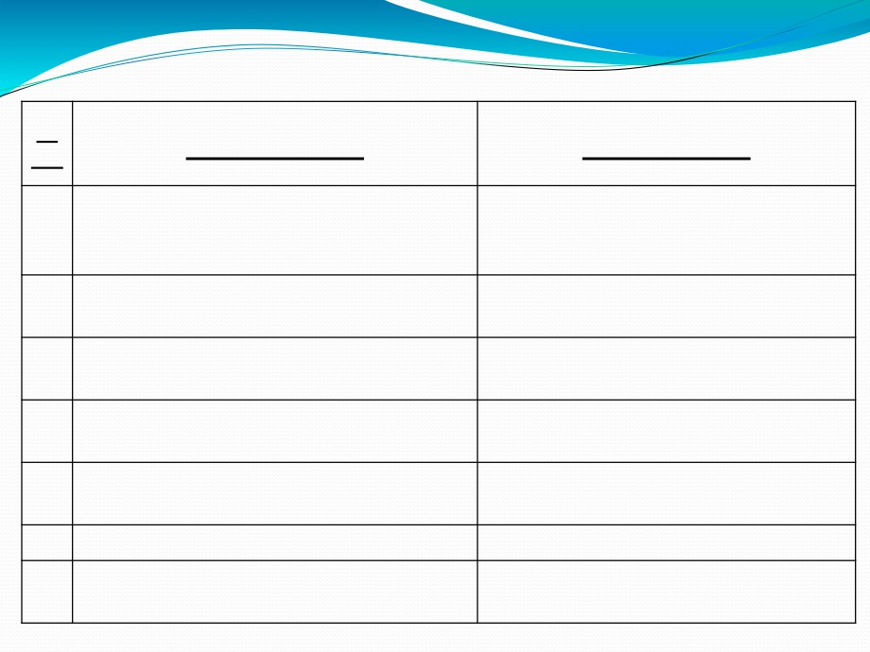
Sr
English Bonds
Flemish bond
No.
1
This bond consists of headers and stretchers
This bond consists of headers and
laid in alternative courses.
stretchers laid alternatively in each
course.
2
It is strongest of all the bonds.
It is less strong for walls having
thickness more than 13 ½ inches.
3
It provides rough appearance especially for
It provides good appearance for all
one brick thick walls.
thickness of walls.
4
There are no noticeable continuous vertical
There are partly continuous vertical
joints in the structure built in this bond.
joints in the structure built in this bond.
5
Much attention is not required in providing
Special attention is required in providing
this bond.
this bond.
6
Progress of work is more.
Progress of work is less.
7
It is costly because the use of brick bats is
It is economical because brick bats are
not allowed.
allowed for forming this bind.

Slide 44
5.GARDEN WALL BOND
➢ This bond is used for constructing one brick thick garden walls, boundary walls, and other walls such as outer leaves of cavity walls to provide good appearance.
➢ Two types Flemish bond:-
(i) English garden wall bond
(ii) Flemish garden wall bond

Slide 45
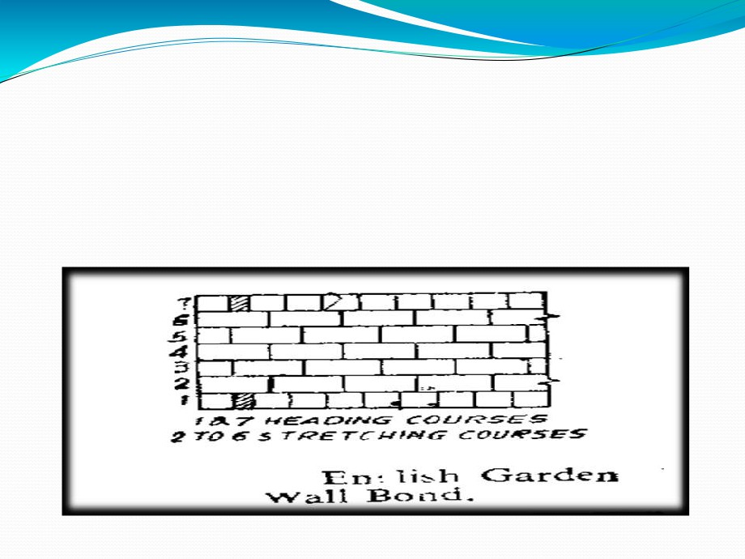
(i) English garden wall bond:-
➢ The garden wall bond in which a heading course is provided after 3 or 5 stretching courses is called "English Garden Wall Bond“.

Slide 46
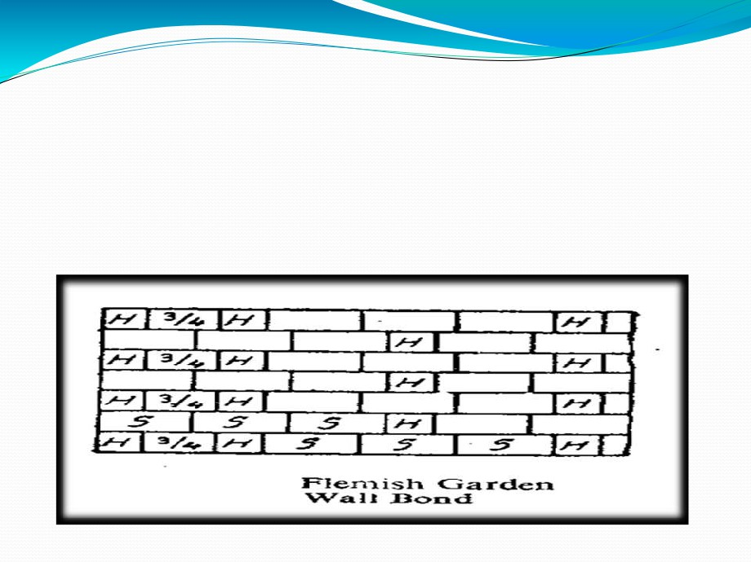
(ii) Flemish garden wall bond:-
➢ In this bond a header is provided after 3 or 5 stretches in each course.
➢ This bond is also known as “Sussex or Scotch Bond".

Slide 47
6.RAKING BOND
➢It this type of bond alternate course are placed in different directions to get maximum strength in the wall.
➢ Two types Flemish bond:-
(i) Herring wall bond
(ii) Diagonal wall bond

Slide 48
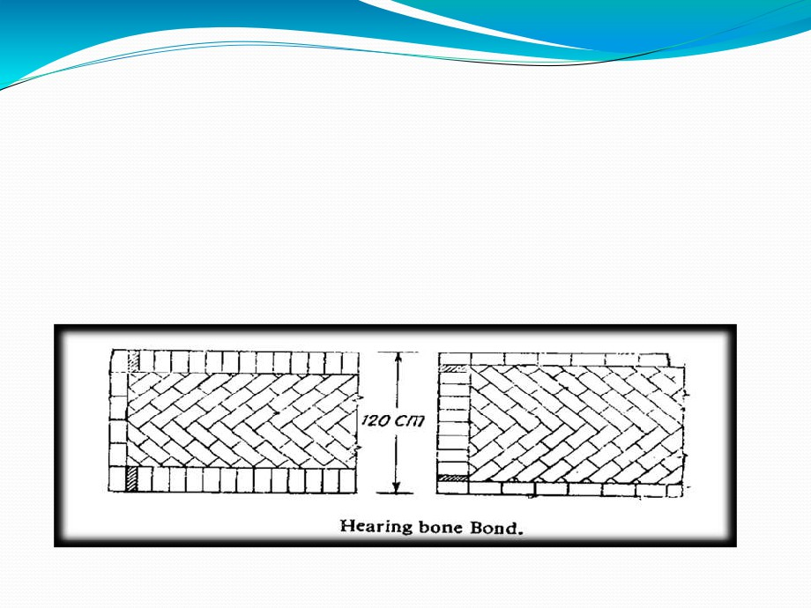
(i) Herring Bone Bond:-
➢ The raking bond in which bricks are laid at an angle of 45 degree , starting at the central line and proceeding towards the facing and backing of the wall, is called "Herring Bone Bond“.

Slide 49
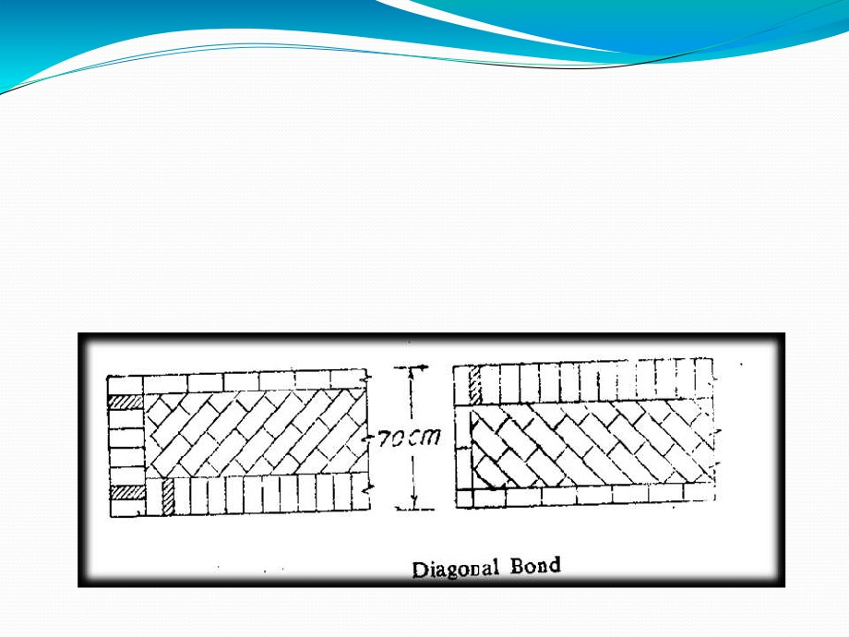
(ii) Diagonal Bond:-
➢ The raking bond in which bricks are laid starting from the corner in parallel rows inclined to the facing and backing of the wall is known as "Diagonal bond".

Slide 50
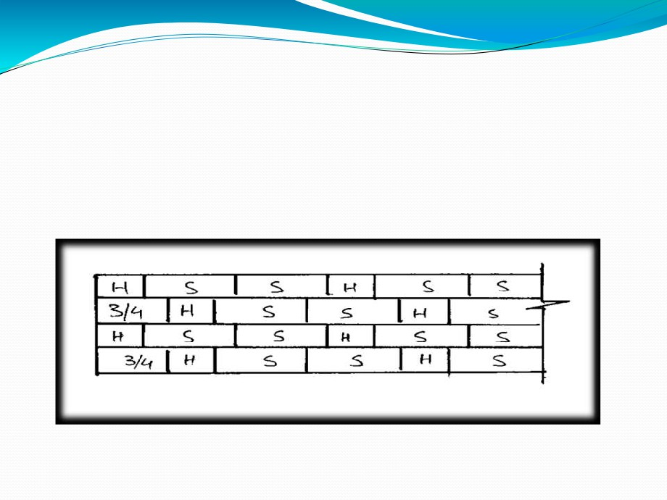
7.DUTCH BOND
➢ This bond in which two stretchers and one header are laid alternately in each course is called " Dutch Bond".
➢ This bond is used in the construction of boundary walls.

Slide 51
COMPARISON BETWEEN BRICK MASONRY AND STONE
MASONRY
(1) Stone is stronger and more durable than brick and for public buildings; it is decidedly more suitable than brick. It reflects strength in every inch of it. It is in tune with nature. Its color improves and looks more serene with age.
On the other hand, brick is an artificial product made as a copy of stone. It is flimsy material and plastering is only a camouflage for its defects.

Slide 52
(2) Stone is water proof. On the other hand, Brick absorbs moisture and with dampness certain salts rise in the walls from the ground and cause disintegration of bricks.
Especially brick should not be allowed to come in contact
with urine or sewage and in such places it must always be
covered with cement plaster or any other protective coat.
(3) Brick offers greater facility for ornamental work in plaster as a rough shape can first be given to it by means of any tool. This is not so in case of stones.
(4) Plaster does not stick so well to stones as it does to brick.

Slide 53
(5) On account of the regular shape and uniform size of brick, a proper bond can be obtained with comparative ease.
(6) Due to the handy size of brick, brick masonry can be more rapidly constructed than stone masonry.
(7) Brick wall requires a fixed quantity of mortar and even with careless masons, the regular shape of the brick
considerably reduces the possibility of hollows being left in the body of the wall. This is not so with some stone walls.

Slide 54

C.COMPOSITE WALL

Slide 55

COMPOSITE WALL
➢When walls are constructed with two or more types building materials, it is termed as composite masonry.
The composite masonry is adopted due to following reasons:-
1. It reduces overall cost of construction.
2.It improves the appearance of the structure by
concealing the inferior work.
3.It makes the use of locally available materials, to
obtain optimum economy.

Slide 56
➢ The usual combinations adopted to obtain composite masonary can be listed as below:-
1.Stone Facing with brick backing.
2 Stone slab Facing with brick baking.
3.Brick Facing with concrete baking.
4.Ashler facing with brick backing.
5.Ashler facing with rubble backing.

Slide 57
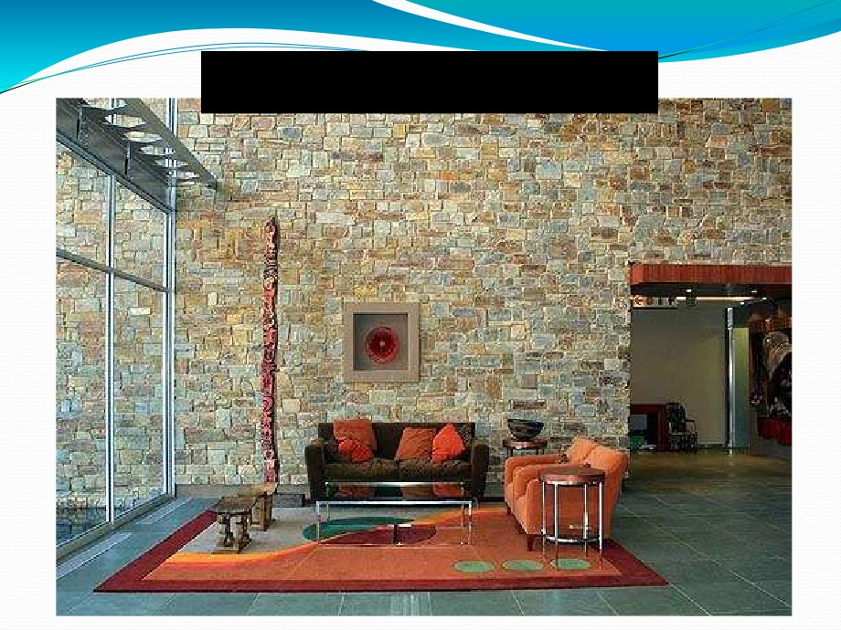
Stone Facing with brick backing

Slide 58
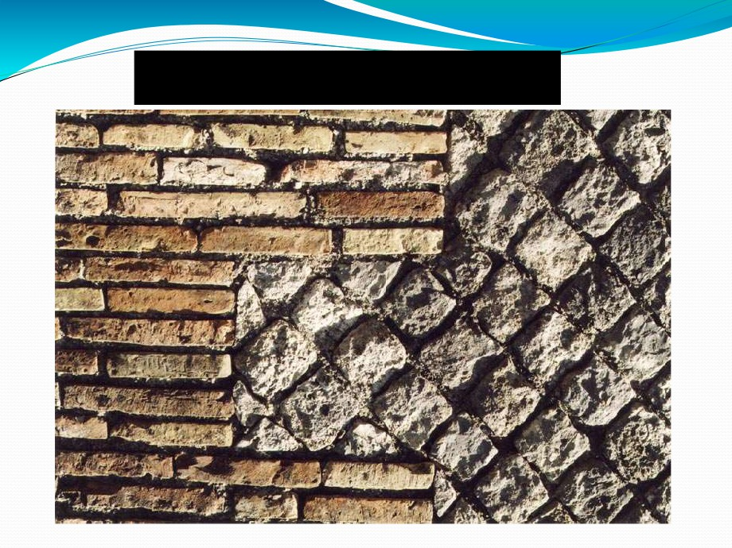
Brick Facing with concrete baking.

Slide 59
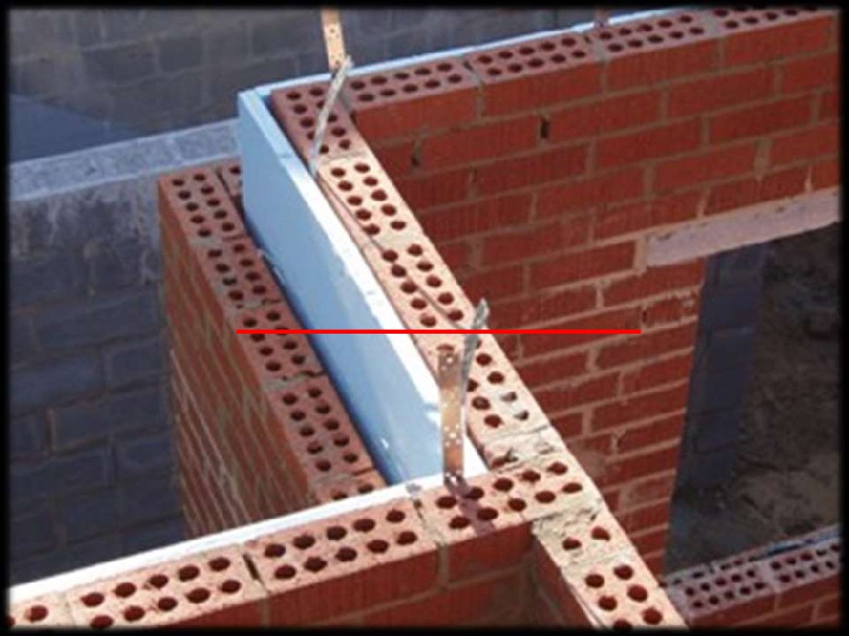
D.CAVITY WALL

Slide 60
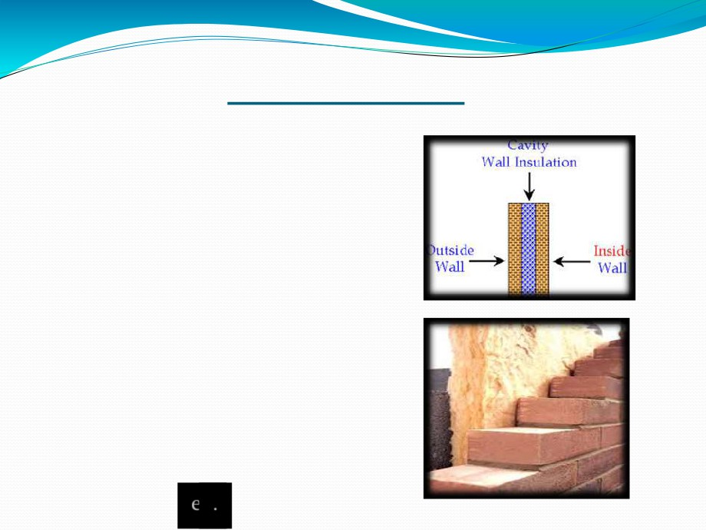
CAVITY WALL
➢ Cavity walls consist of two 'skins' separated by a hollow space.
➢ The skins are commonly masonary such as brick or concrete block.
➢ masonry is an absorbent material, and therefore will slowly draw rainwater or even humidity into the wall.
➢ The cavity serves as a way to drain this water back out through weep holes at the base of the wall system or above windows.

Slide 61
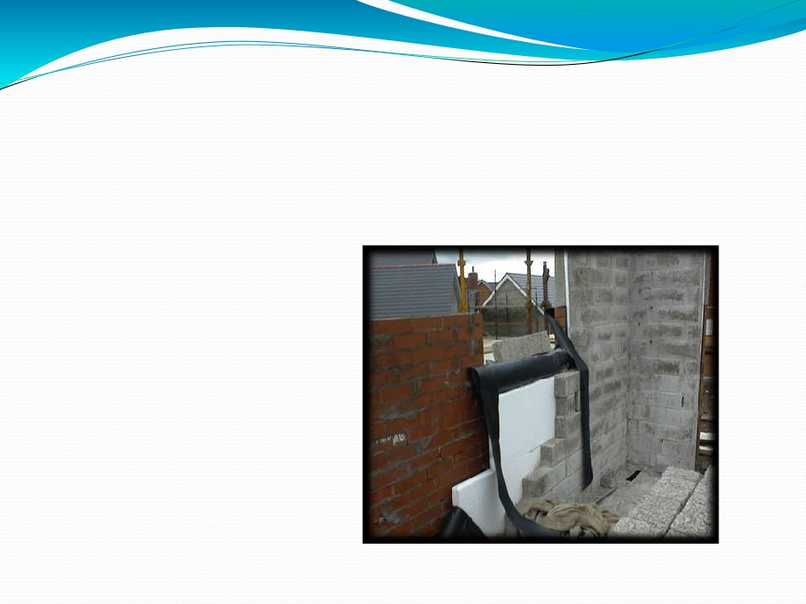
MAIN FUNCTIONS OF WALLS
Part of a cavity wall with the
1. Strength
internal skin removed to expose the Insulation.
2.Stability
3. Weather exclusion
4.Thermal Insulation
5.Sound Insulation
6.Durability
7.Fire resistance
8.Appearance

Slide 62
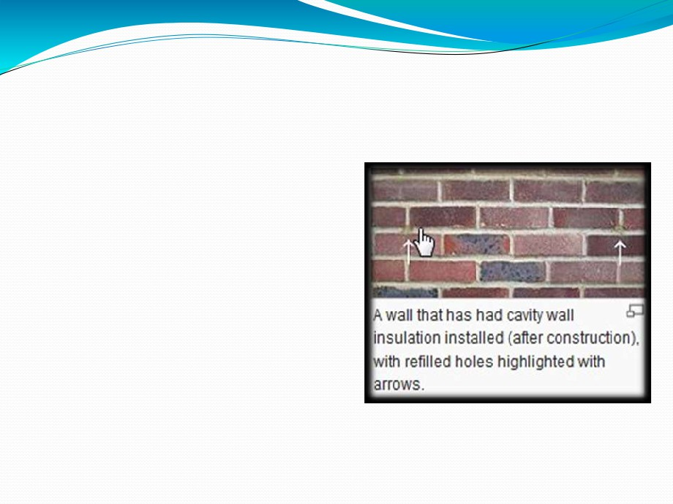
CAVITY WALL INSULATORS :
➢ Cavity wall insulation is
used to reduce heat loss through a cavity wall by
filling the air space with
material that inhibits heat transfer.
➢ This is because up to 35% of the heat loss from your property is through the walls.

Slide 63
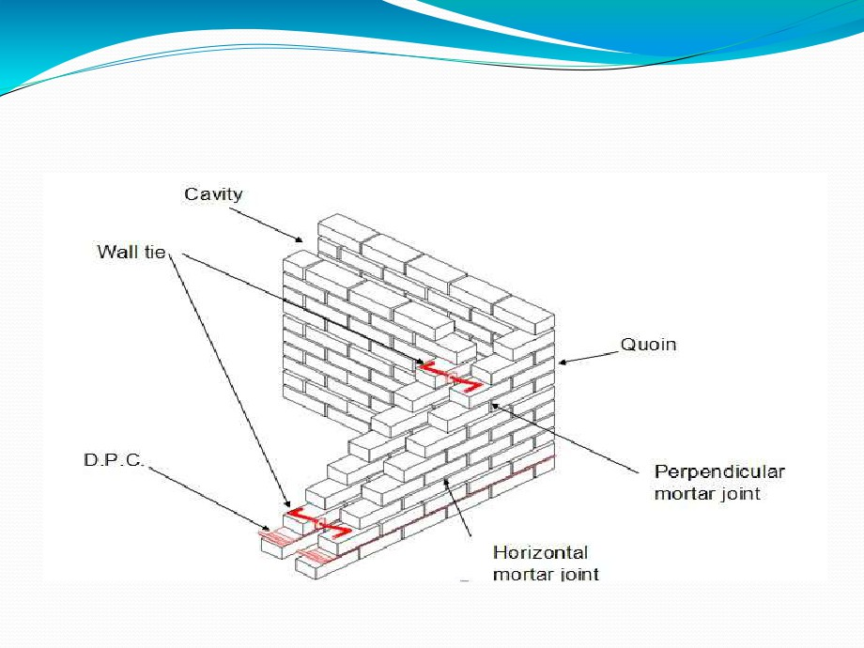
turn corner of a cavity wall in stretcher bond including wall ties and DPC

Slide 64
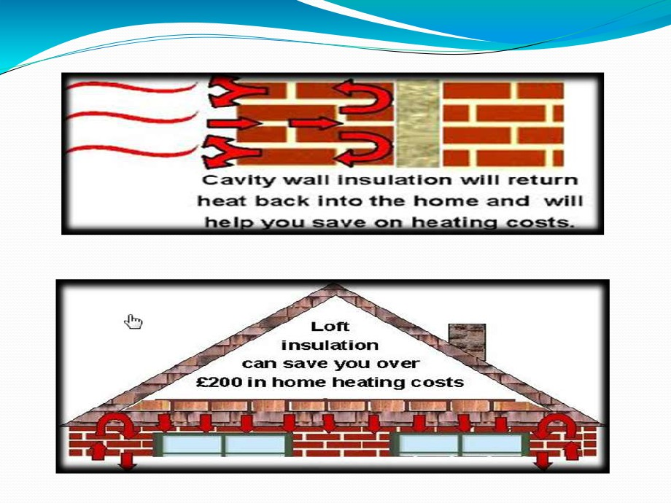

Slide 65
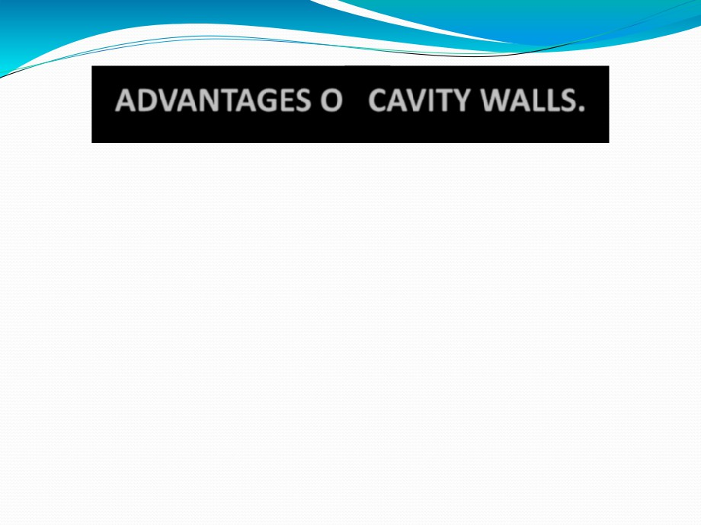
.
➢The moisture cannot enter from outer wall to inner wall , since there is no direct contact.
➢Provide good insulation against sound. ➢Protection against efflorescence. ➢Proves economical during construction. ➢Load on the foundation is reduced.
➢Reduction of heat transfer ,since air layer between leaves acts as non-conductor of heat.

Slide 66
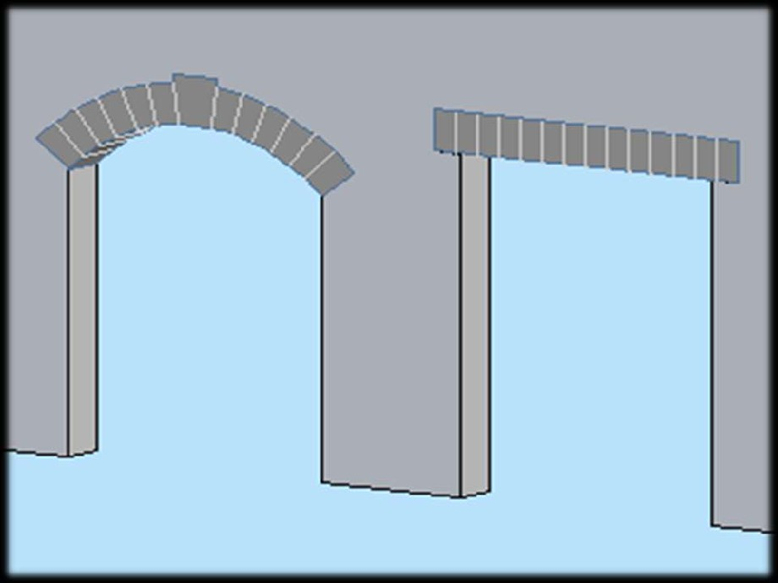
D. LINTEL & ARCHES

Slide 67
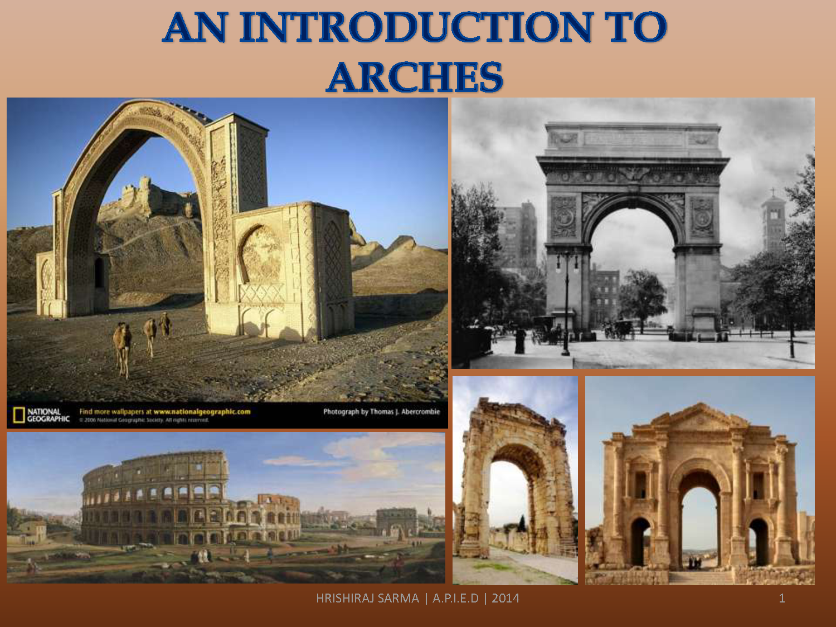

Slide 68
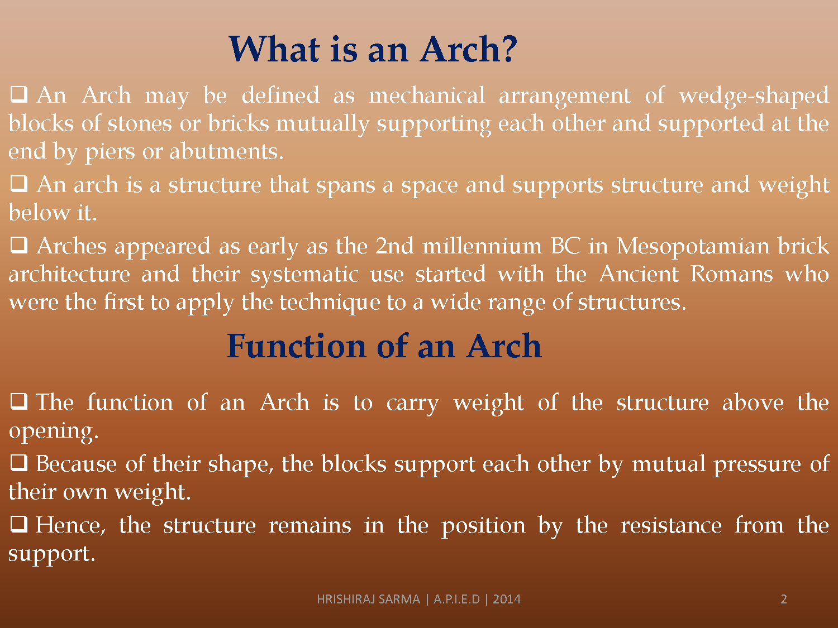

Slide 69
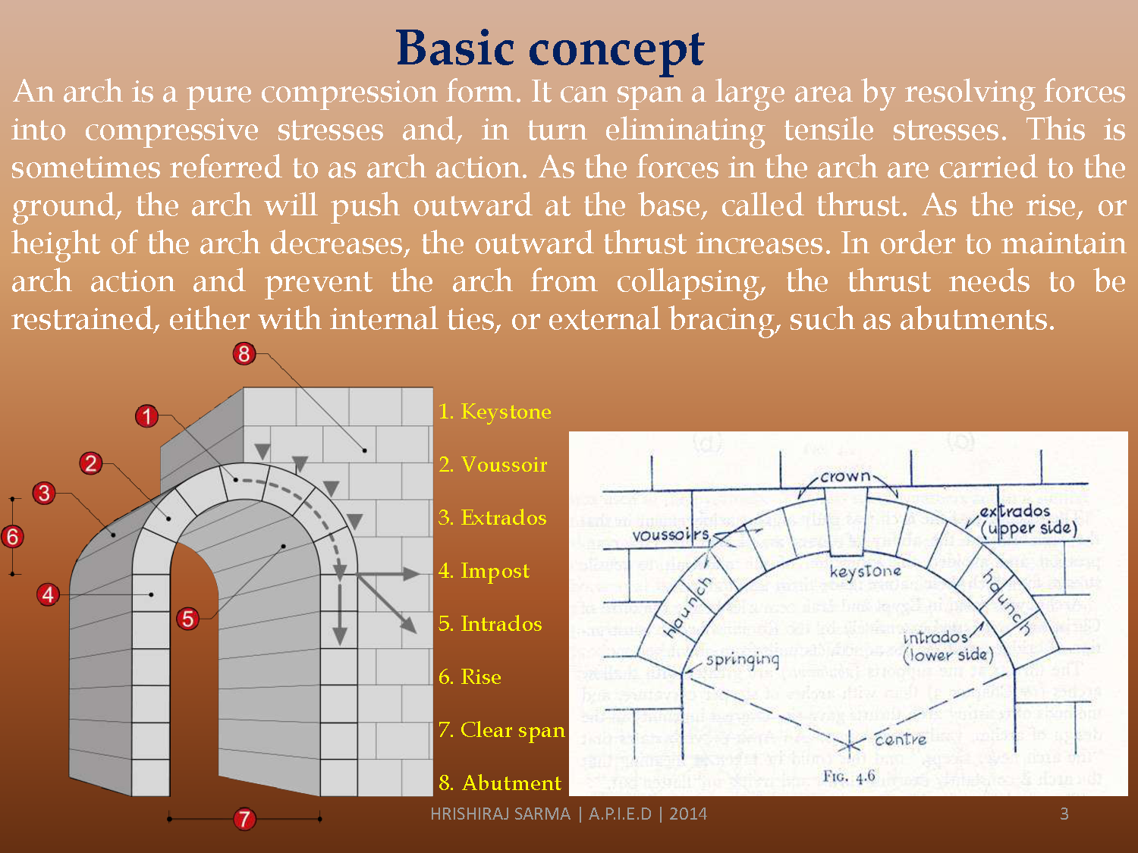

Slide 70
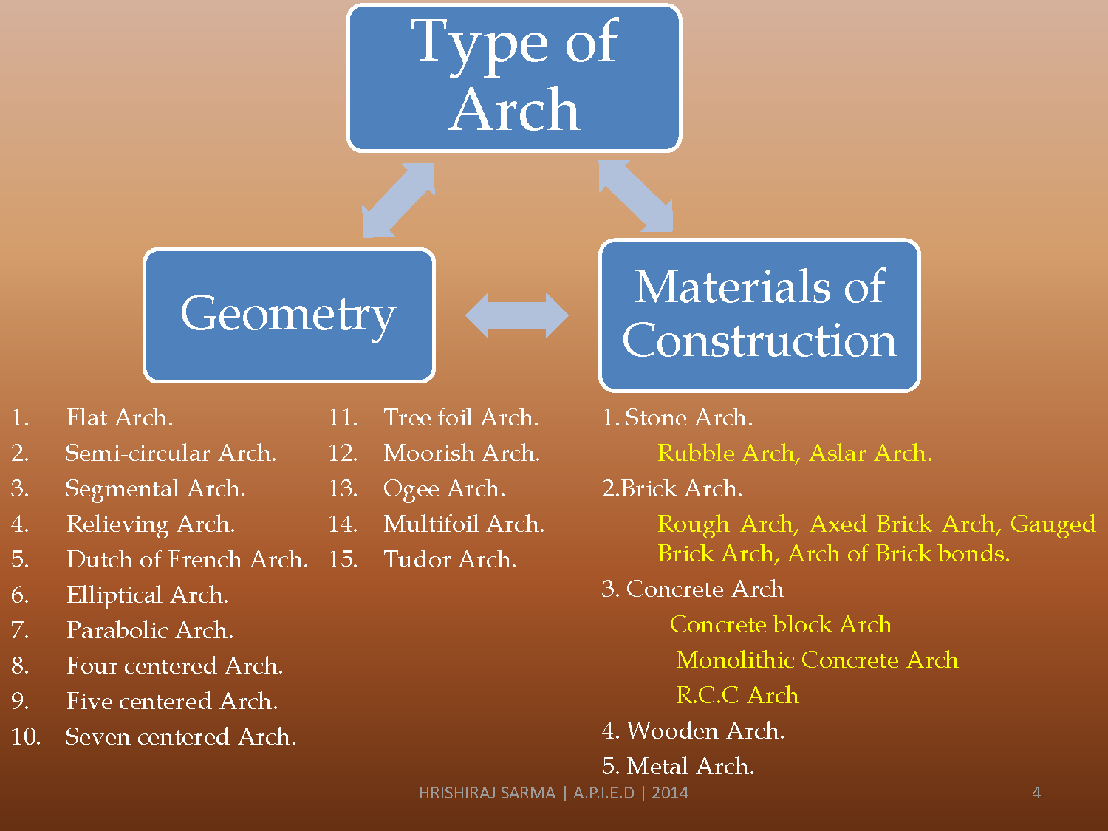

Slide 71


Slide 72


Slide 73


Slide 74


Slide 75


Slide 76


Slide 77


Slide 78


Slide 79


Slide 80


Slide 81


Slide 82


Slide 83


Slide 84


Slide 85


Slide 86


Slide 87


Slide 88


Slide 89
Lintels
Introduction
Openings are invariably left in the wall for the provision of doors, windows, cupboards, wardrobes, etc. And these openings are bridged by the provision of a lintel.
A LINTEL is a sort of beam which is equal to the width of the wall , and the ends of which are built into the wall.

Slide 90
VARIOUS TYPES OF LINTELS
1) TIMBER LINTELS
2) STONE LINTELS
3) BRICK LINTELS
4) STEEL LINTELS
5) REINFORCED CONCRETE LINTELS

Slide 91

TIMBER LINTELS
Timber lintels are the oldest types of lintels, though they are not commonly used now a days because they are relatively costlier, structurally weak and vulnerable to fire.

Slide 92

A TIMBER LINTEL

Slide 93


Slide 94
STONE LINTELS
A stone lintel consists of a simple stone slab of greater thickness. These are used where stones are abundantly available . They can also provided over openings in brick walls.

Slide 95

STONE LINTELS

Slide 96

Brick lintels are not structurally strong, and they are used where opening is less (less than 1 meter ) and loads are light.

Slide 97

STEEL LINTELS
Steel lintels are provided where the opening is large and where the super-imposed loads are also heavy. It consists of rolled steel joists or channel sections either used singly or in combination of two or three units.

Slide 98

STEEL LINTELS

Slide 99


Slide 100


Slide 101

REINFORCED CONCRETE LINTELS Reinforced cement concrete lintels have replaced practically all other types of lintels because of their strength, rigidity, fire resistance, economy and ease in construction. They can be used on any span.

Slide 102

REINFORCED CONCRETE LINTELS

Slide 103


Slide 104
CONCLUSION
Thus a lintel is a sort of beam, the width of which is equal to the width of the wall, and the ends of which are built into the wall.

