Slide 1
Building Construction Technology I
(Floor slabs)
Department of Architectural Engineering/2nd stage
Dr. Zaid Al Hamdany

Slide 2
Introduction
Floors are the horizontal elements which divide the building into different levels for the purpose of creating more accommodation within a restricted space one above the other and provide support for the occupants, furniture and equipment of a building.
The floor of a building immediately above the ground is known as ground floor. All other floors which are above the ground floor are known as the upper floors. The floors of the first story is known as the first floor and that of the second story is known as the second floor etc, etc. In case, part of the building is constructed below the ground level, or the building has the basement, the floor is known as basement floor.
Every floor has a structural component: (i) the sub-floor, which is a structural component to impart strength and stability to support the super-imposed loads and (ii) floor covering or flooring consisting of suitable floor finish.

Slide 3
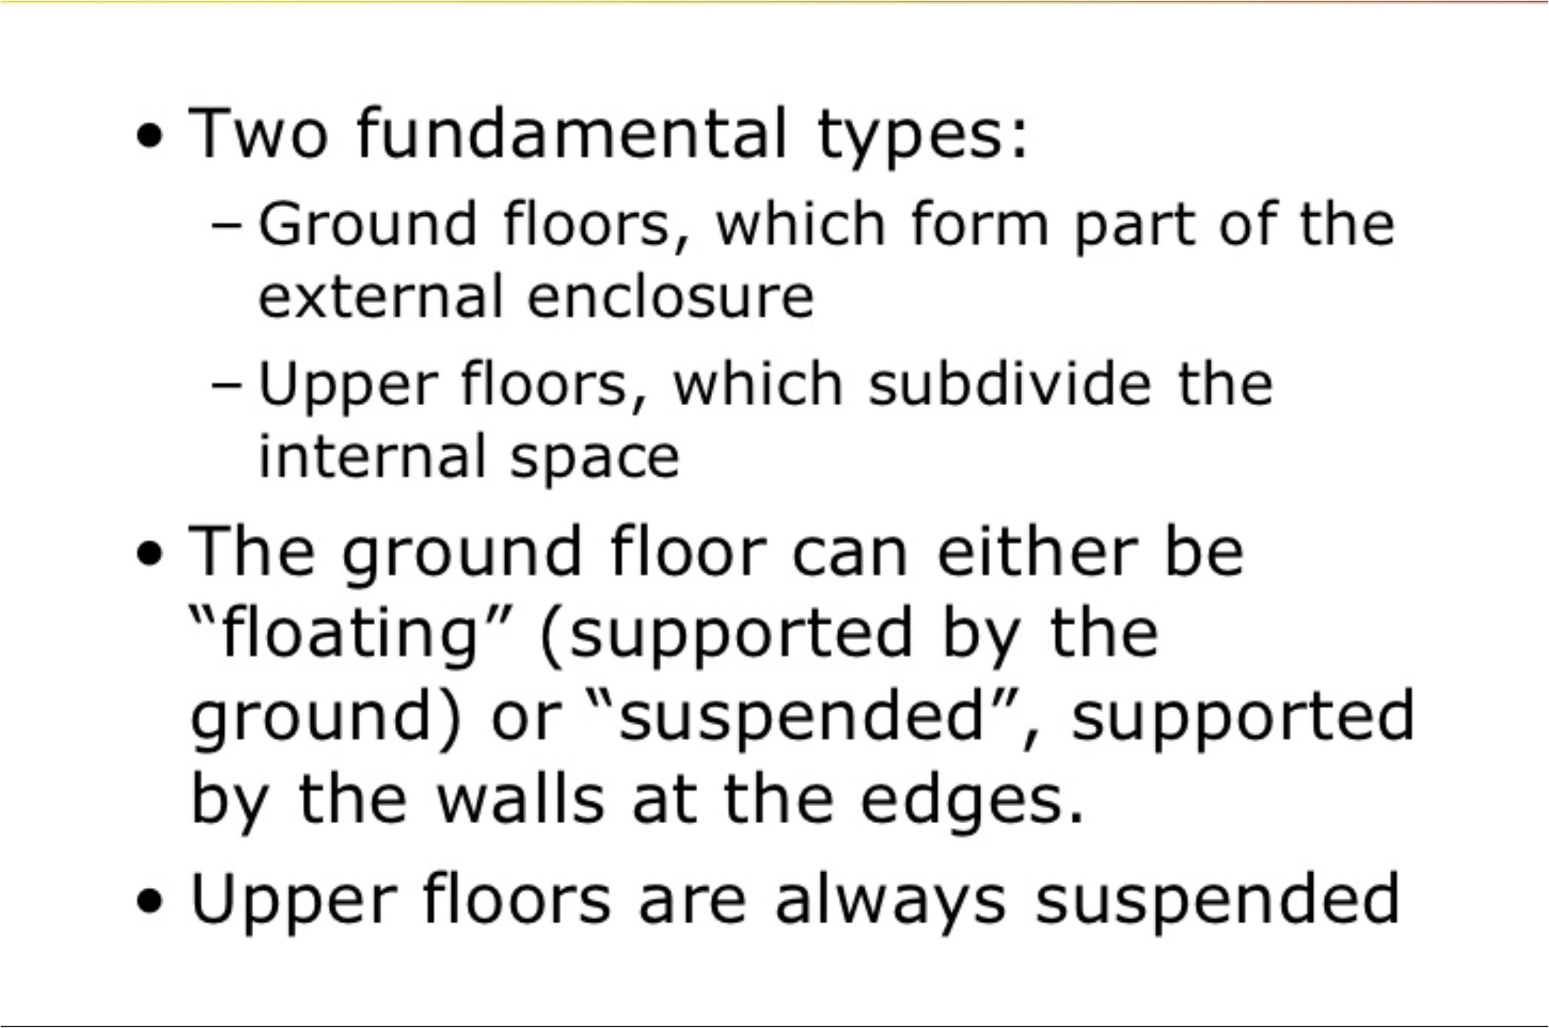
Types of floors.

Slide 4
Ground floors
Characteristics
Simple design
Load will be supported by the ground
Less problem related to distance of span
Choice to construct solid floor or suspended ground floor will depends on nature of the building and site condition
Design considerations
Among the design function that need to be taken in consideration for construction of ground floor slab is:
The provision of a uniform, level surface
Sufficient strength and stability
Exclusion of dampness from inside of building
Thermal insulation
Resistance to fire

Slide 5
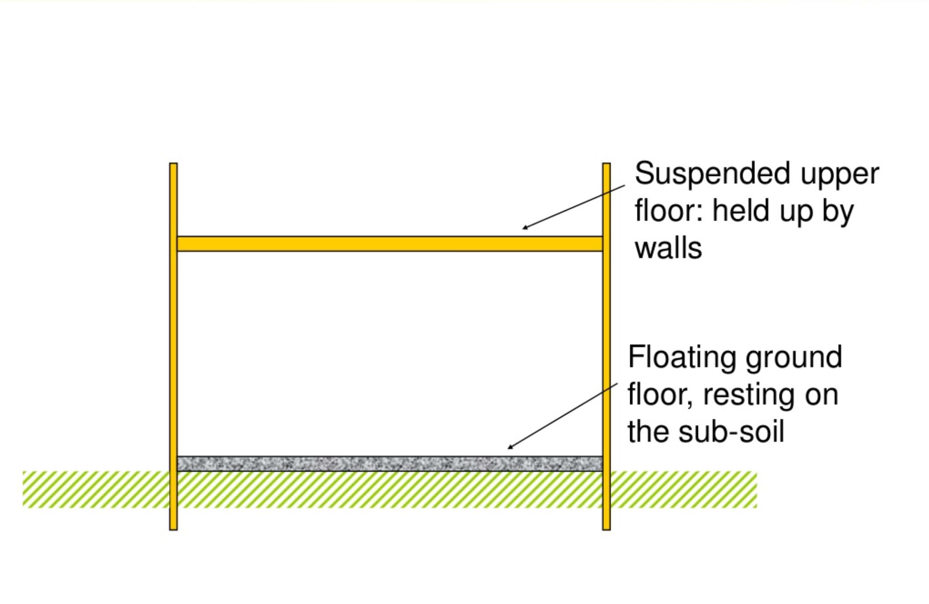

Slide 6
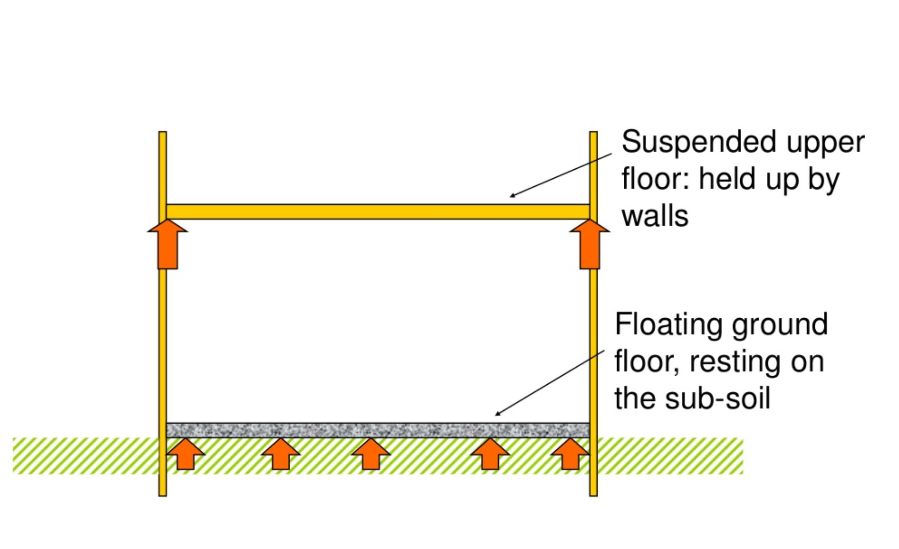

Slide 7
Floating ground floor.
Characteristics:
Constructed using concrete
Doesn’t use timber so there will be no decay
Solid floor need other finishing
Construction Of floating floor:
1) Clear the construction area
2) Remove topsoil / unsuitable material (225 mm)
3) Compact and level the soil

Slide 8
4) Place hardcore and compact it.
Hardcore plays the role to fill in any small pockets that have formed during over site excavation in order to provide a firm base for placing concrete bed and to help spread any point loads over a greater area.
5) Place Damp Proof Membrane
6) Prepare formwork
7) Prepare lean concrete (50 – 75mm) in order to ensure the reinforcement didn’t touch the ground.
8) Place Reinforcement Bar to increase strength
9) Pour concrete (1:2:4) with thickness of (150mm) and level it.
10)Place concrete of (25-50mm ) thickness (rendering process).

Slide 9
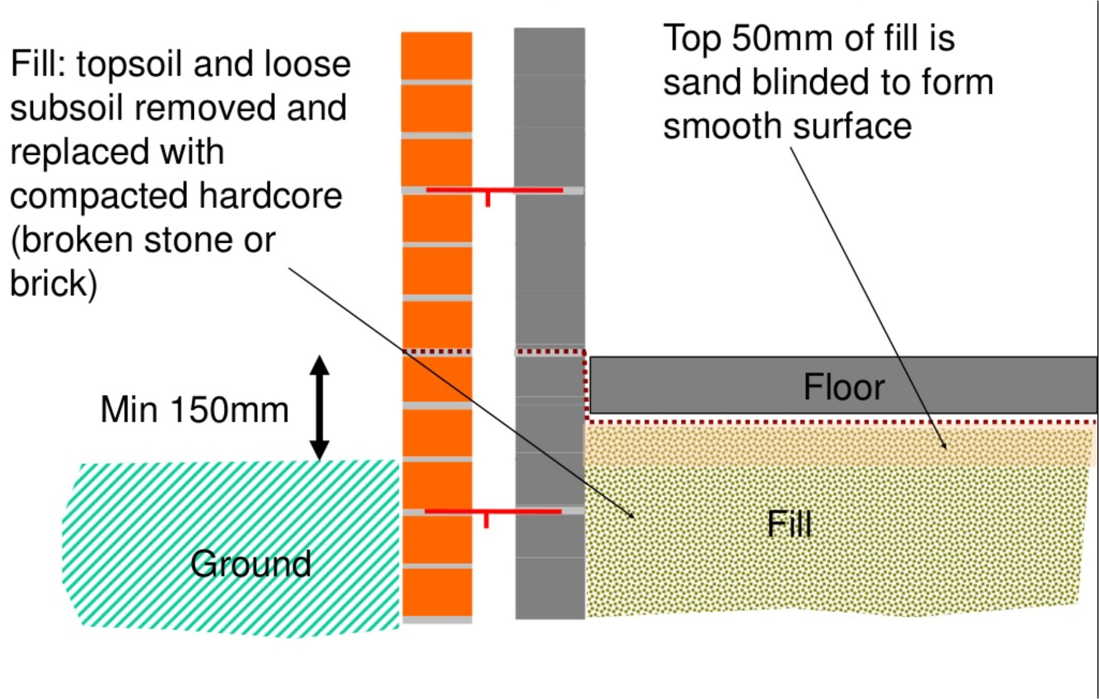
Floating ground floor details

Slide 10
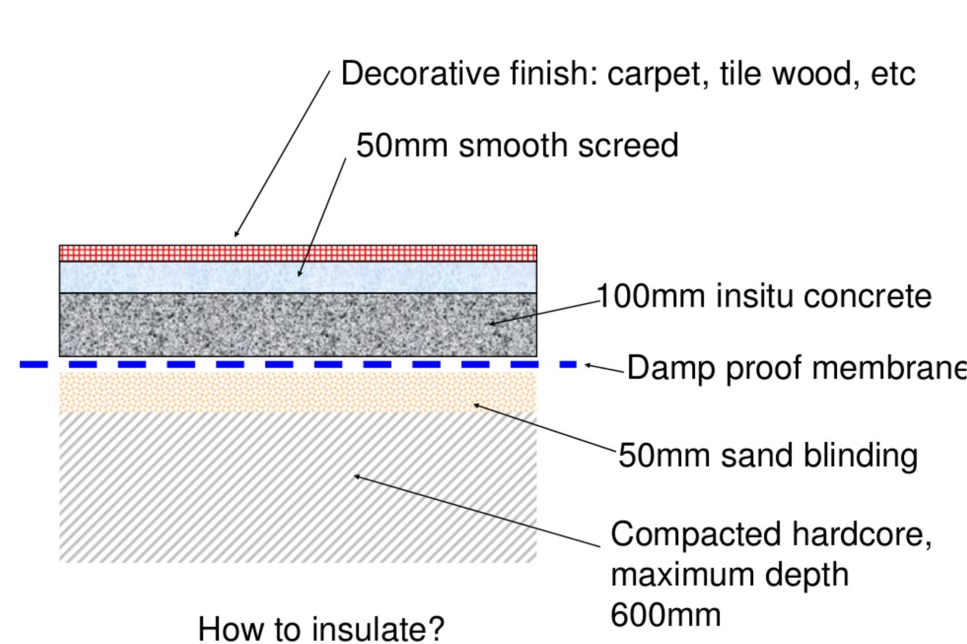
Floating gorund floor finish

Slide 11
SUSPENDED GROUND FLOOR
A ground floor need to be suspended under the following conditions:
a) domestic buildings on sloping sites where more than 600mm depth of infill would be required
b) where the bearing capacity and nature of the ground different from one part to another
c) where the ground is shrinkable clay, expansive material or unstable soil type.
Suspended floors / slab is fixed some distance above the ground. There are 2 types of suspended ground floor such as:
a) Suspended timber ground floors
b) Suspended precast concrete floors

Slide 12
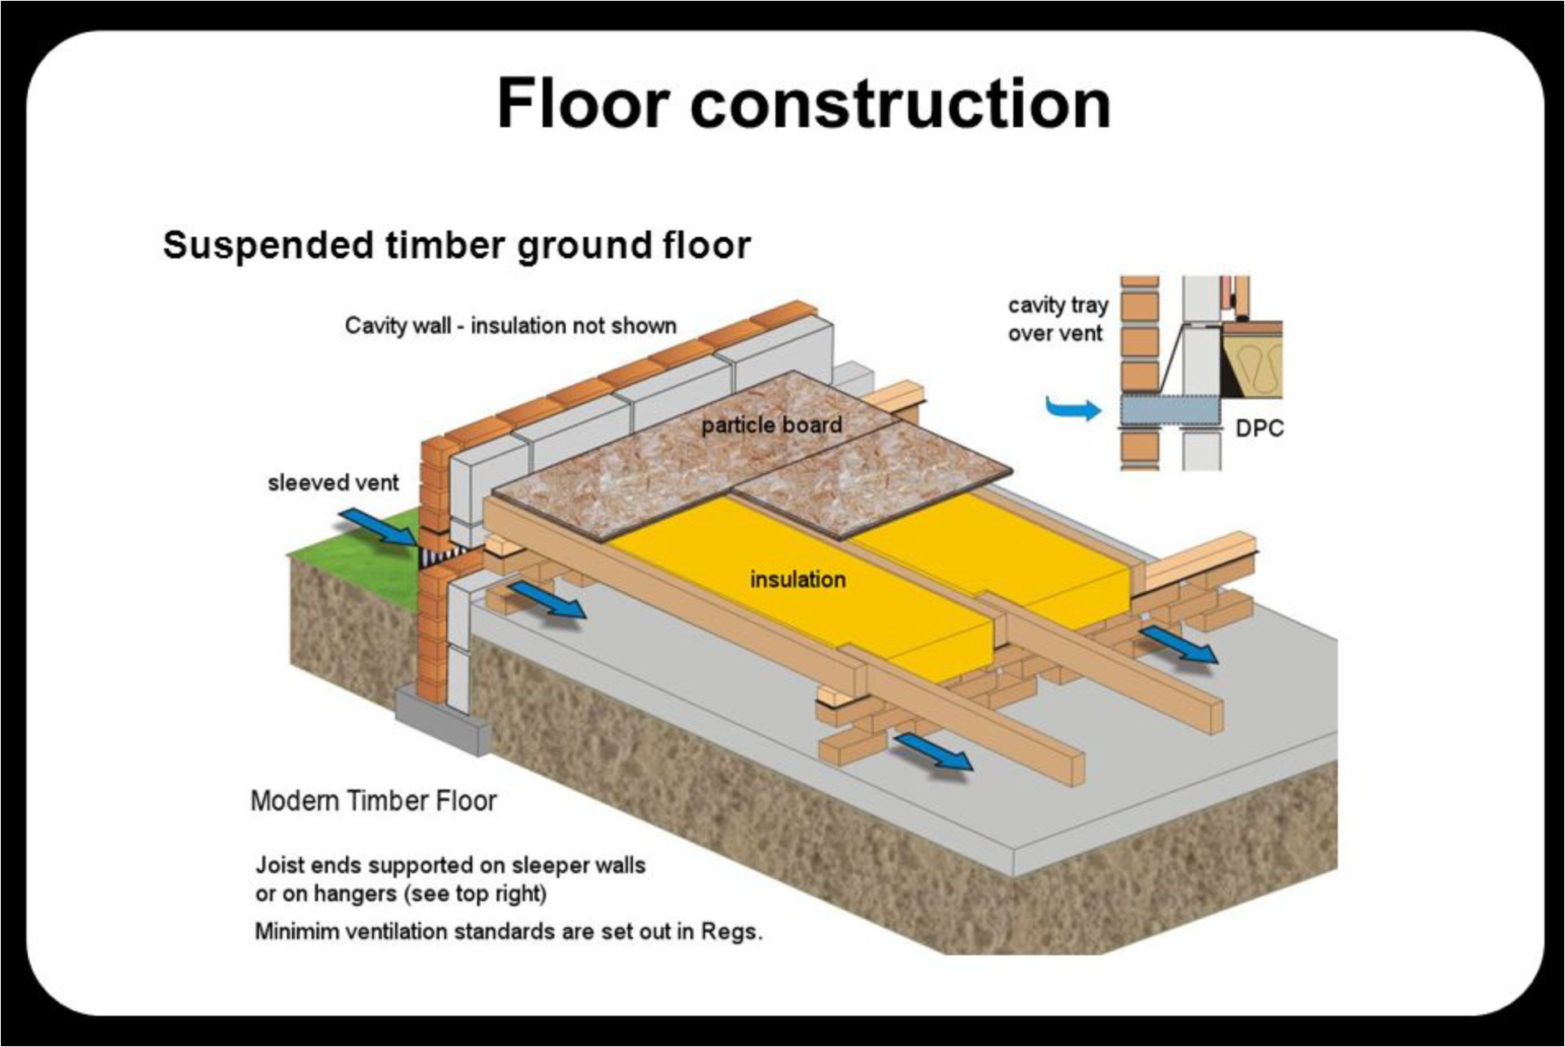

Slide 13
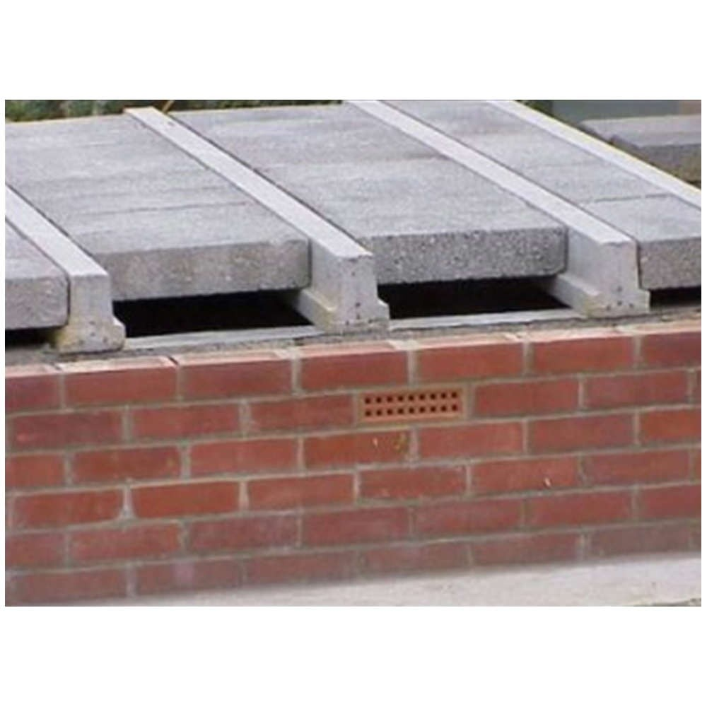
Suspended precast concrete floor

Slide 14
Suspended upper floor
A suspended floor is a floor slab where its perimeter is, or at least two of its opposite edges are, supported on walls, beams or columns that carry its self weight and imposed loading.
Types of upper floors:
1. Reinforced Concrete floors
Flat Slab
Waffle Slab
Beam Floor Slab

Slide 15
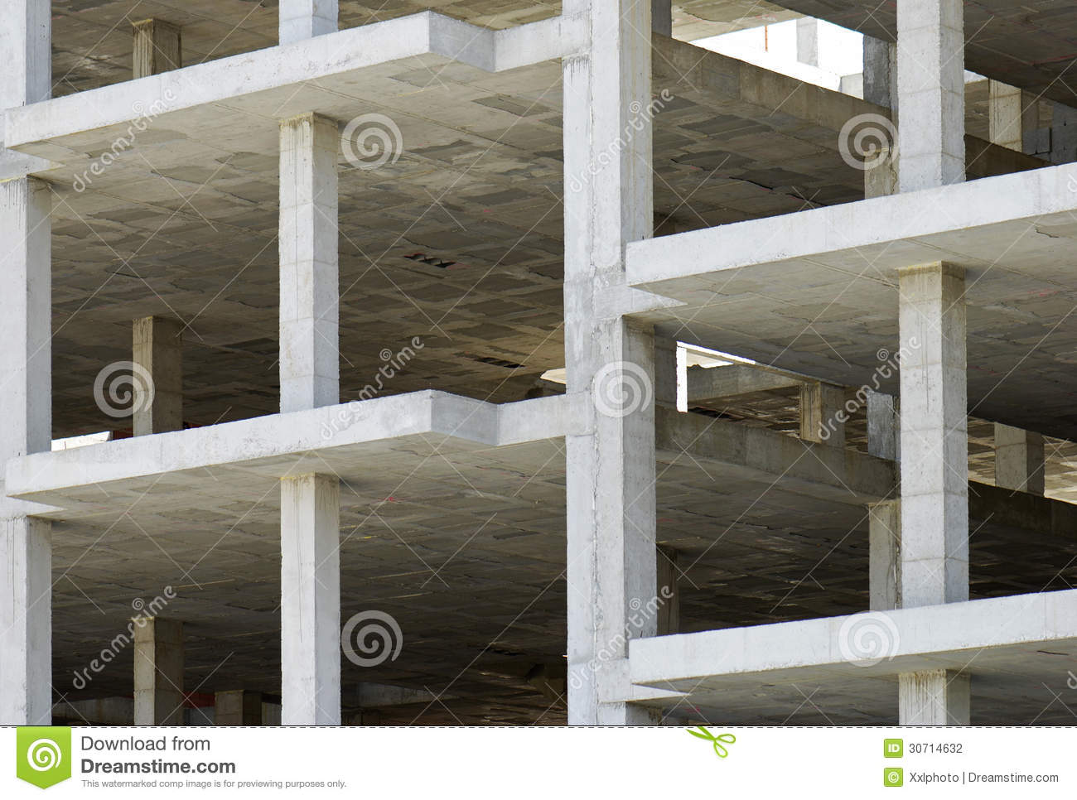
Flat slab: A flat slab is a two-way reinforced concrete slab that usually does not have beams and girders, and the loads are transferred directly to the supporting concrete columns.

Slide 16
Advantages and Disadvantages of Flat Slabs
Advantages:
Require simple formworks
No beams—simplifying under-floor services outside the drops
Have a minimum structural depth
Usually do not require shear reinforcement at the columns.
Disadvantages:
Cover Medium spans
Generally not suitable for supporting brittle (masonry) partitions
Drop panels may interfere with larger mechanical ducting
Vertical penetrations need to be avoided at the area around the columns
For reinforced flat slabs, deflection at the middle strip may be critical.

Slide 17
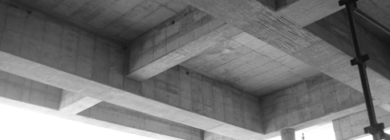
Beam floor slab: This system consists of beams framing into columns and supporting slabs spanning between the beams. It is a very traditional system. The relatively deep beams provide a stiff floor capable of long spans, and able to resist lateral loads. However, the complications of beam formwork, co-ordination of services, and overall depth of floor have led to a decrease in the popularity of this type of floor.

Slide 18
Waffle slab
Used as alternative to an in-site flat slab or a beam and slab suspended floor this is because it requires less concrete
less reinforcement and can be used to reduce the number of beams and columns required with the resultant savings on foundations.
Molds are very strong, lightweight & capable of supporting all the normal loads encountered in building works.
Spans >10 m
Use prefabricated standard forms
special molds are placed at certain distance
skilled workers are needed & need less steel

Slide 19
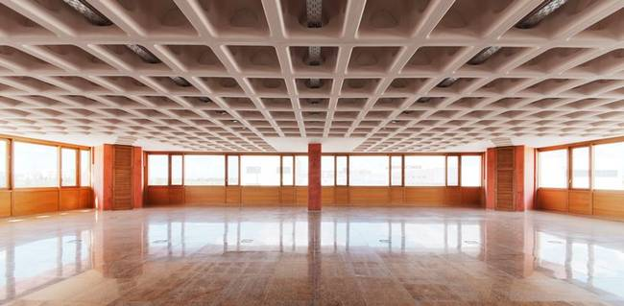

Slide 20
2. Precast concrete floors
Precast concrete is a construction product produced by casting concrete in a reusable mold or "form" which is then cured in a controlled environment, transported to the construction site and lifted into place ("tilt up"). In contrast, standard concrete is poured into site-specific forms and cured on site.
Advantages of Precast Concrete floor is:
a) Doesn’t need formwork
b) Time taken for concrete to cure in the formwork can be eliminated
c) Better quality control
d) Doesn’t need many workers as in in-situ concrete construction
e) fast completion of construction project

Slide 21
long spans available with precast concrete flooring systems reduce the number of secondary beam required and maximize the column free space.
Fire resistance ratings normally between 1 & 2 hours.
Among the things that need to be considered before considering any system of precast concrete flooring are:
a) maximum span f) Sound insulation
b) nature of support g) Thermal insulation
properties
c) weight of units h) Fire resistance of units
d) thickness of units i) Speed of construction
e) Amount of temporary support required

Slide 22
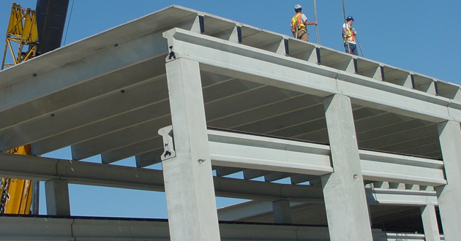
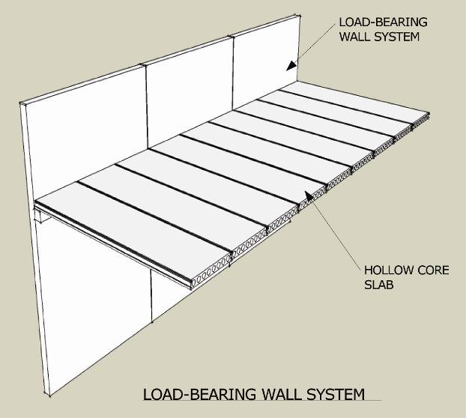

Slide 23
3. Timber floors
A floor above ground level that is made from timber joists spanning between walls or beams.
The usual type of timber floor consists of a single system of joists to which the floor boarding and other coverings are secured together with the ceiling material secured to the underside. This type of floor is suitable for domestic property and small commercial premises.
However, where the span of the joists exceeds about 5 m or the load to be placed on the floors is heavy, the size of joists required would involve an uneconomical use of timber. In such cases the surveyor will no doubt find that the difficulty has been overcome by installing a double floor, that is, dividing the length of the room into bays by means of timber beams or rolled steel joists.

Slide 24
Timber upper floors are supported in the following ways:
Joists bear directly on the wall.
Joists rest on a timber wall plate built into the wall.
Joists supported on a mild steel (MS) or wrought iron (WI) bearing bar built into the wall.
Joists may rest on a wall plate supported on WI or MS corbels built into the wall and are usually spaced at about 700 mm center to center.
In more modern properties the joists are supported on galvanized steel hangers. This method is useful where the joists derive their support from a party wall.

Slide 25
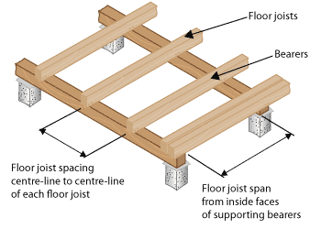

Slide 26
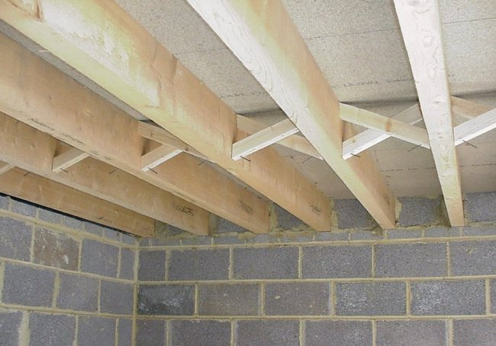

Slide 27
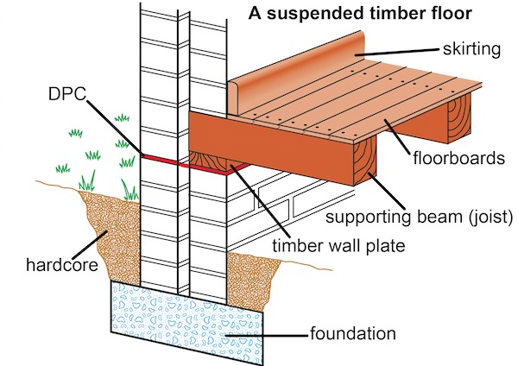

Slide 28
